Slide 2
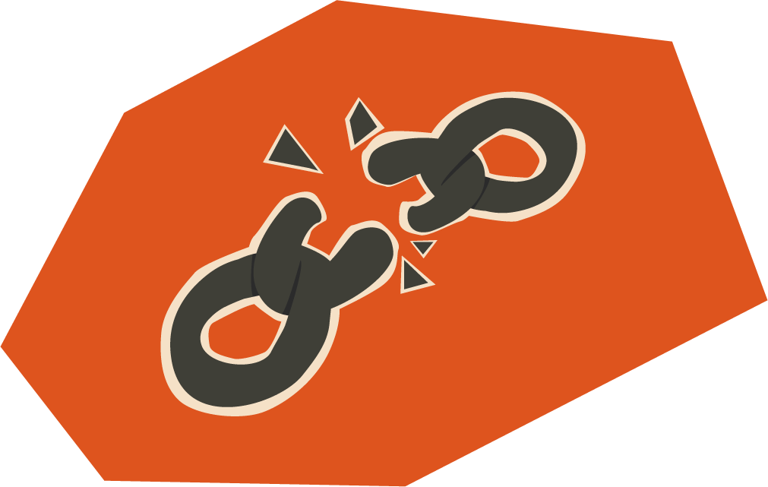
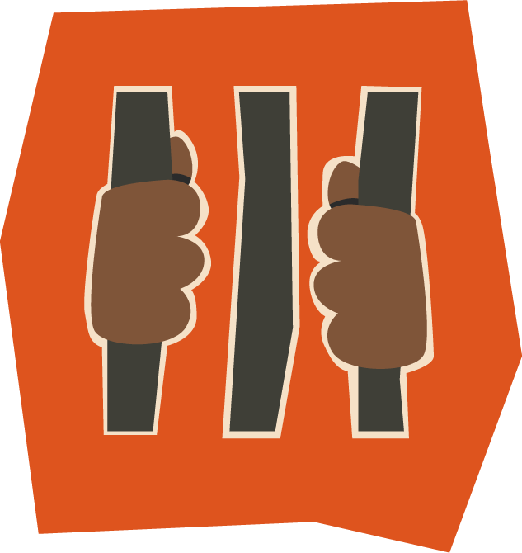
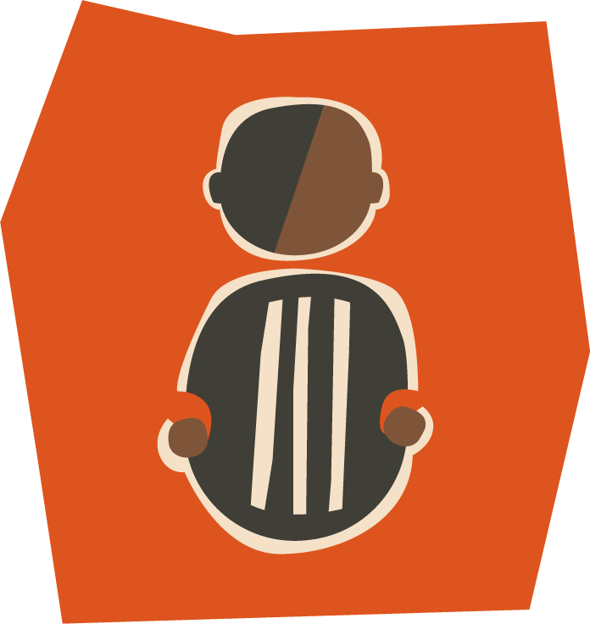
Imagine if a well in the middle of the desert was the only safe place for your fellowship to meet and worship.
Across North Africa, Christians risk their lives to follow Jesus and share him with their neighbours.
Believers sometimes even have to bury their Bibles to hide them from people who persecute them.

Slide 3
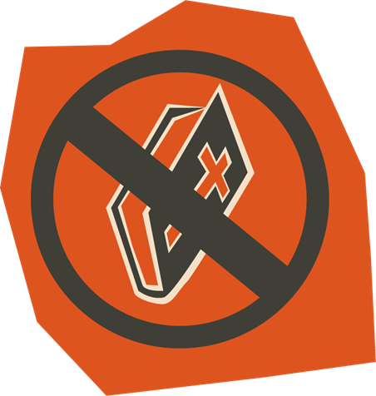
BMS World Mission partner worker Abraham* recently received a phone call from an unknown number.
It was a Christian he supports in a Muslim country, who told him that 11 Christian leaders had been arrested and put in prison.
The last few leaders were fleeing, fearing for their lives.
*Name changed for security reasons.

Slide 4
We know that you deeply care for your brothers and sisters in North Africa. They long to tell people about Jesus, despite the huge challenges they are facing.
Will you give today so that Abraham and his team can share the gospel and make disciples? Your gift will transform lives as people find abundant life in Jesus Christ.

Slide 6
Our partners lead disciple making training sessions across the Middle East and North Africa.
Pray that they will inspire people to reach their own people for Jesus Christ and train others for effective evangelism throughout all Arabic-speaking countries.

Slide 7
45 church leaders in a North African country have been arrested, and others are in hiding.
Pray that those in prison will be released and for the church to remain faithful.
Praise God that 32 people have been baptised in the past year, despite the persecution.

Slide 8
Christians in North Africa are having a conference in the next month to worship together.
Pray they will find a safe place to hold the conference with privacy for singing. Pray the property owner will look favourably on Christians attending.
Pray that people will be seriously in going deeper in their relationship with God.

Slide 9
