Slide 1
Photo: Chad

Slide 2
Notes:
Use this Heart for the Gospel logo or delete as needed.

Slide 3
Please pray for three villages in Cambodia: Tropeangrun, Vehpous and Sveysaw. In these villages an evangelism programme has started. In two villages, Sveysaw and Vehpous, churches have been established with a membership of 20 and 50 people respectively.
Photo: India
Notes:
Use this slide to showcase beautiful Heart for the Gospel images. Remember to check sensitivities of images as you do so.

Slide 4
Praise God for those who are responding to be trained as disciple makers. Pray that we would be able to train 5,000 disciple makers spread across BMS World Mission partners.
Photo: Uganda
Notes:
Do you want words over a large image? Use this gradient slide and replace the background image.

Slide 5
Notes:
Use this slide to promote Hope for the World work.

Slide 6
Pray for Israel and the Occupied Palestinian Territories. Pray for the Church and the ongoing conflict causing a high number of casualties and fatalities every day. Pray for peace in every part of the country and for the growth and progress of spiritual service.
Photo: Palestine
Notes:
Use this slide to showcase beautiful Hope for the World images. Remember to check sensitivities of images as you do so.

Slide 7
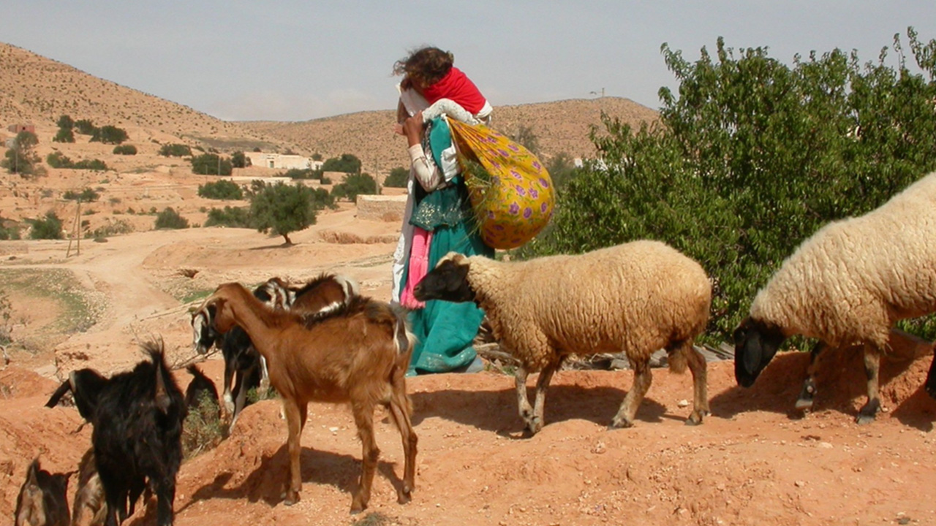
Pray for the village of Amdir, in Mauritania, which has been suffering from a water shortage due to their well collapsing. Pray that a new well can be built and that the inhabitants of the village will gain access to a source of water.
Photo: Tunisia
Notes:
Do you want words over a large image? Use this gradient slide and replace the background image.

Slide 8
Notes:
Use this Help for Journey logo or delete as needed.

Slide 9
Credit: © Chris Hoskins for BMS World Mission
Pray for forcibly displaced people who get stuck in refugee camps and similar settings, sometimes for years or decades. Lift up those in your life – including yourself if appropriate – who feel stuck in their journey of faith.
Photo: Poland
Notes:
Use this slide to showcase beautiful Help for the Journey images. Remember to check sensitivities of images as you do so.

Slide 10
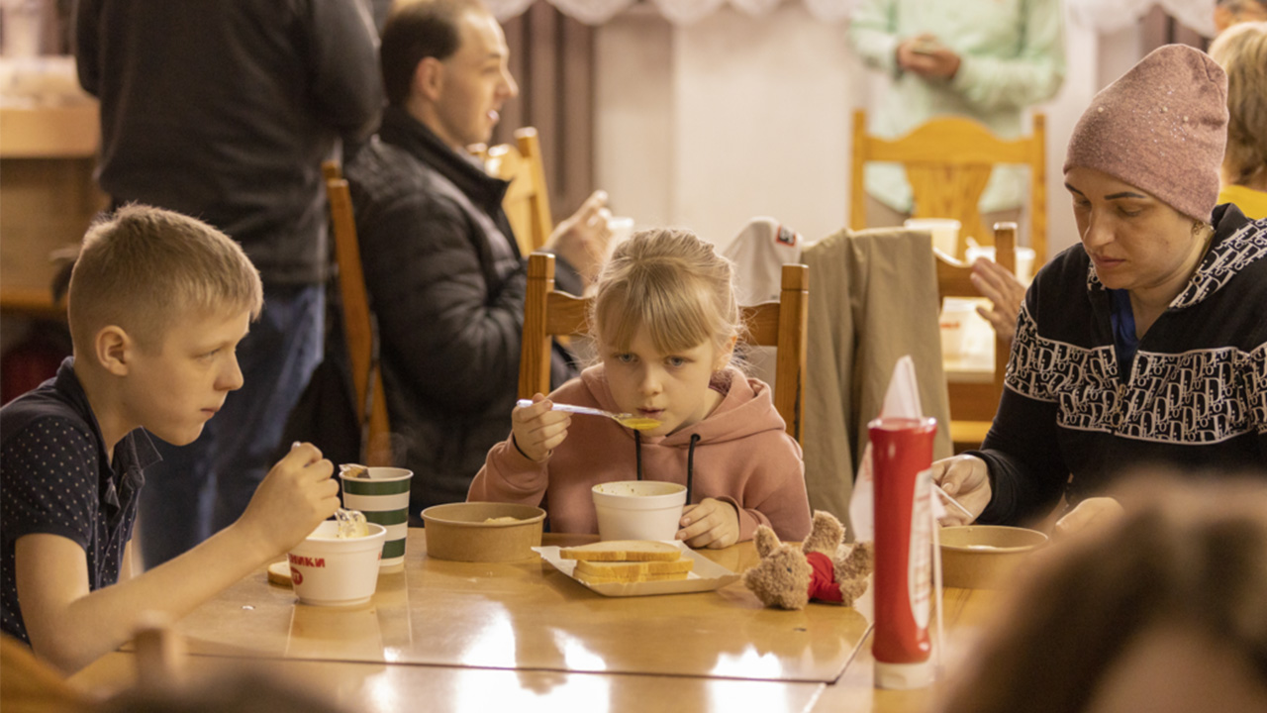
Credit: © Chris Hoskins for BMS World Mission
Pray that forcibly displaced people will receive physical, spiritual, emotional and social care to sustain them on their journey. Pray that we too may receive and give this care (Matthew 6: 11).
Photo: Poland
Notes:
Do you want words over a large image? Use this gradient slide and replace the background image.

Slide 11
Notes:
Use this Gender Justice logo or delete as needed.

Slide 12
Credit: © Clive Thomas for BMS World Mission
Astha Shrestha works with Human Development and Community Services, BMS’ partner in Nepal. Pray for Astha as she promotes maternal and child health, encourages educational attainment for girls, and implements empowerment projects for women and girls.
Photo: Nepal
Notes:
Use this slide to showcase beautiful Gender Justice images. Remember to check sensitivities of images as you do so.

Slide 13
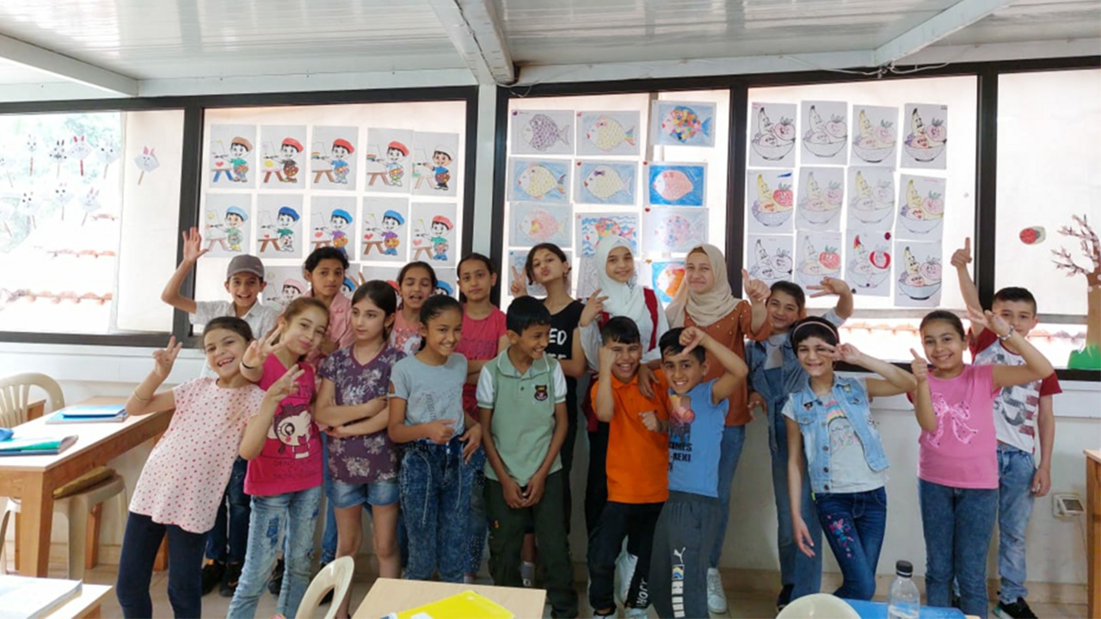
Celebrate individuals with special needs who add value to our communities, remembering their intrinsic worth. Pray for the centre for children with learning differences run by the Lebanese Society for Education and Social Development, now known as Thimar.
Photo: Lebanon
Notes:
Do you want words over a large image? Use this gradient slide and replace the background image.

Slide 15
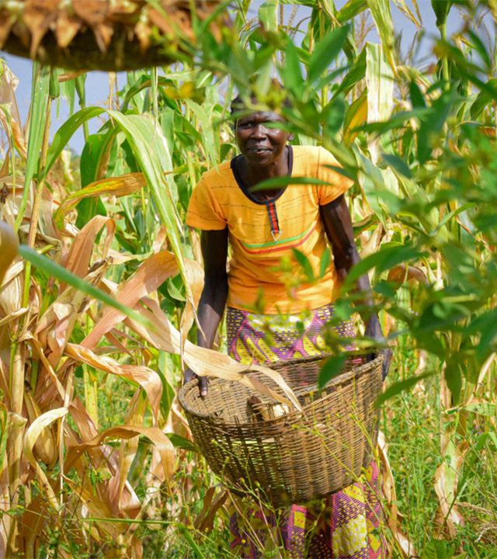
Pray for additional funding to scale up the agroforestry activities in Uganda with over 100 households. We wish to expand the tree growing with more households so that restoration takes place after damage done through tree cutting for charcoal.
Photo: Uganda

Slide 16
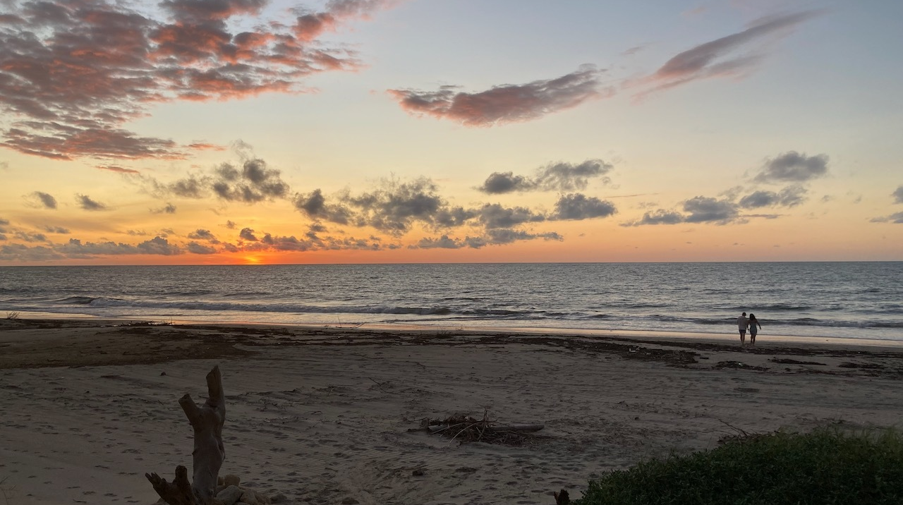
Thank God for creating us and giving us authority over creation. We’re convinced that environmental issues represent one of the greatest opportunities to demonstrate the love of Christ to the world. Pray that God would help us to be good administrators of the resources of your creation, like the water that gives us life.
Photo: Peru

Slide 17
Photo: Chad

