Slide 1
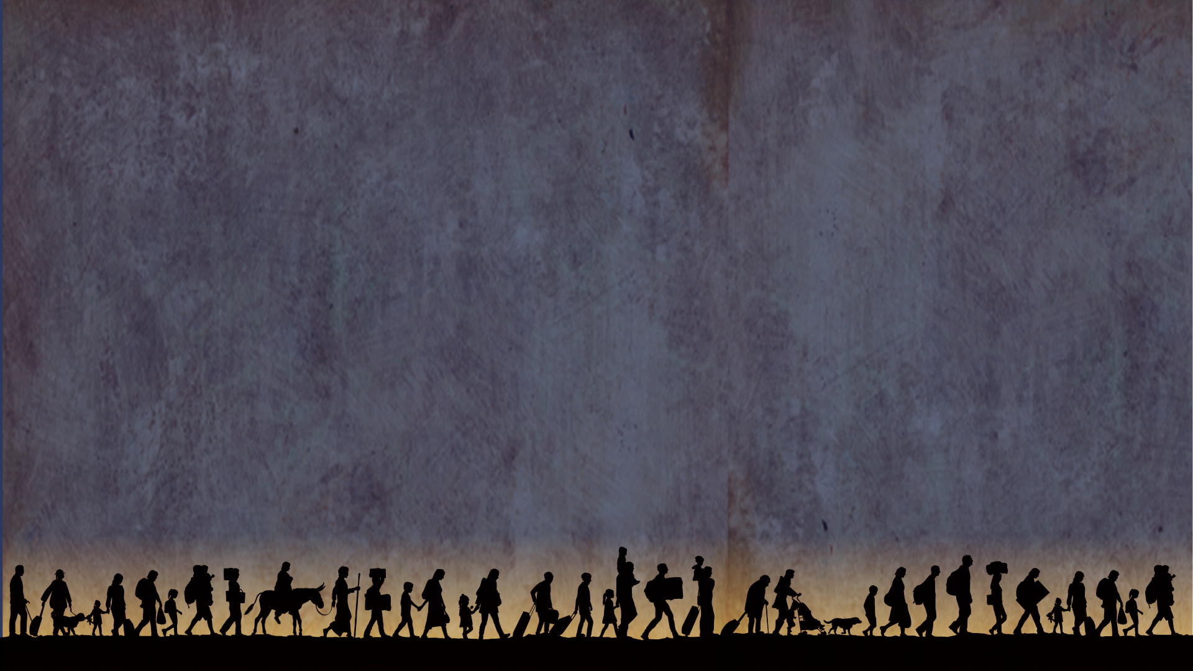
BMS World Mission Safe Haven appeal Pray for refugees on the Greek island of Lesbos
Notes:
BMS World Mission Safe Haven appeal Pray for refugees on the Greek island of Lesbos

Slide 2
Imagine fleeing the country that you love… crossing treacherous seas, only to end up in a desolate transit camp.
Imagine contracting scabies or an infection because you can’t clean your clothes or wash properly.
This is the reality for women like Bibi* this Christmas.
*Name changed to protect Bibi’s identity
Notes:
Imagine fleeing the country that you love… crossing treacherous seas, only to end up in a desolate transit camp.
Imagine contracting scabies or an infection because you can’t clean your clothes or wash properly.
This is the reality for women like Bibi this Christmas.

Slide 3
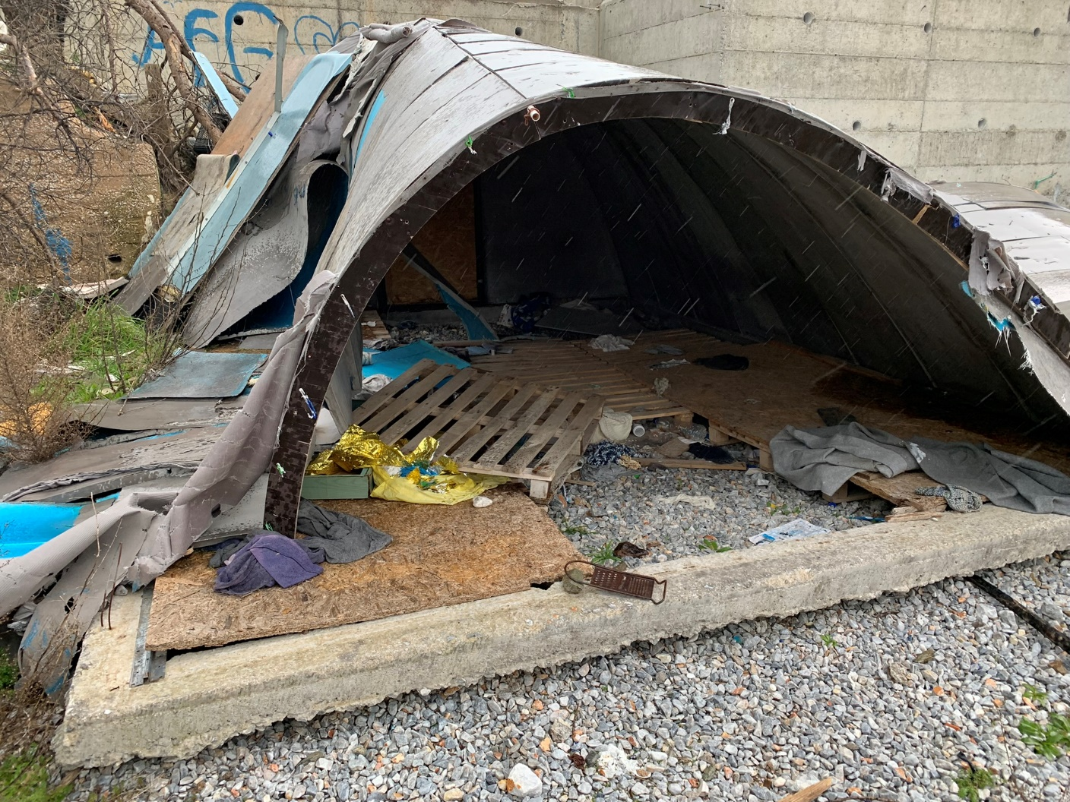
Thankfully, a BMS-supported welcome centre is ready and waiting.
With your help, it can provide a safe space for vulnerable women from Afghanistan, Sudan, Somalia and Palestine to wash, rest and find nourishing food.
A typical shelter on the island of Lesbos
Notes:
Thankfully, a BMS-supported welcome centre is ready and waiting.
With your help, it can provide a safe space for vulnerable women from Afghanistan, Sudan, Somalia and Palestine to wash, rest and find nourishing food.

Slide 4
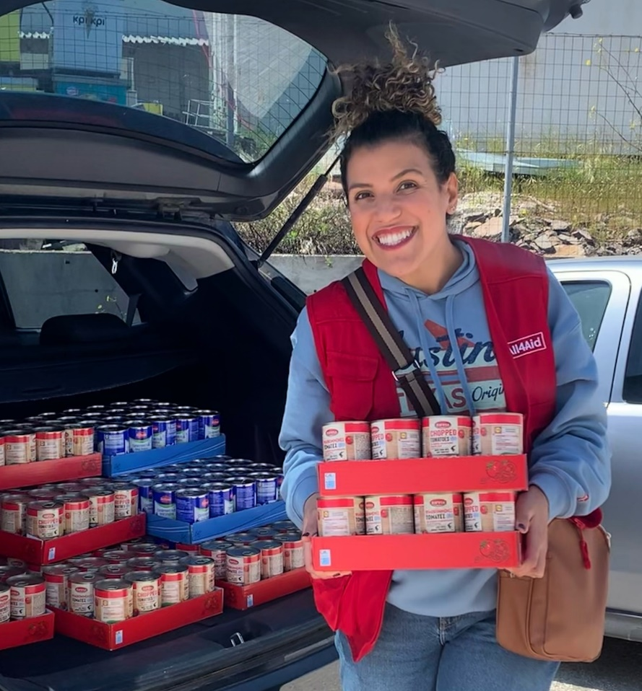
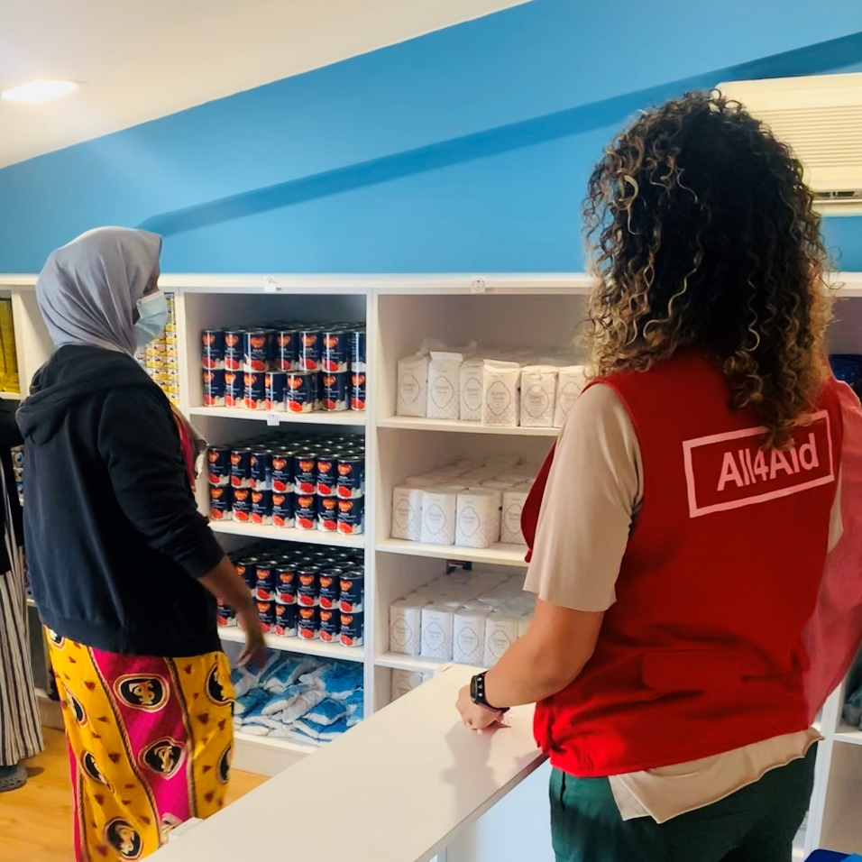
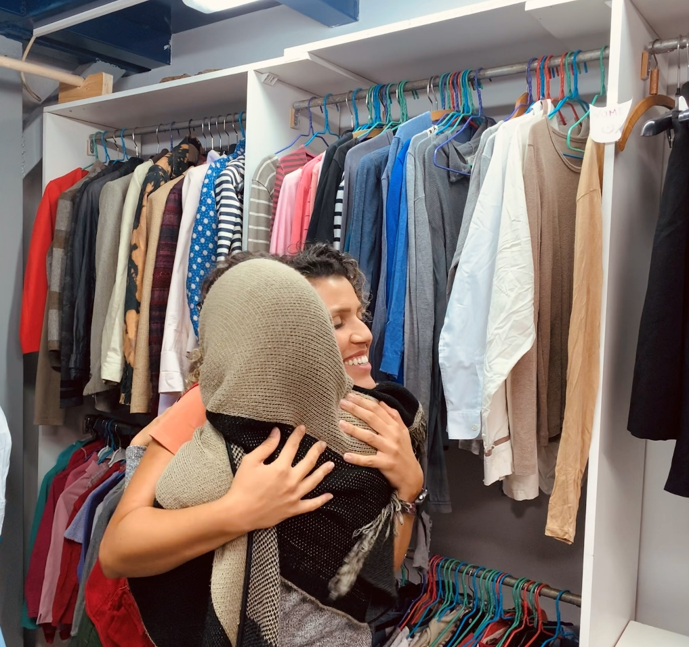
BMS partner worker Haniele asks for your prayers to make this Christ-centred welcome possible for the women they’ll receive this Christmas.
Notes:
BMS partner worker Haniele asks for your prayers to make this Christ-centred welcome possible for the women they’ll receive this Christmas.

Slide 5
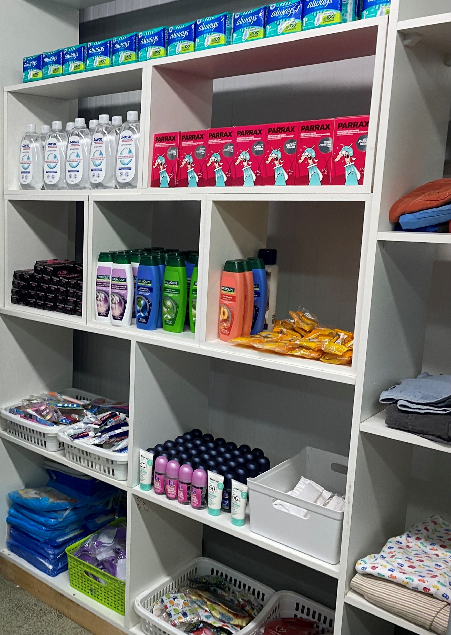
PLEASE PRAY:
Please lift up women like Bibi who have been forced to flee their homes. Pray that they will find comfort, safety and shelter at the BMS-supported centre.
Pray that many generous people would be motivated to help families left with nothing this Christmas. Pray that those in desperate need will have the food, hygiene items and caring support they need to survive the winter.
Notes:
PLEASE PRAY:
Please lift up women like Bibi who have been forced to flee their homes. Pray that they will find comfort, safety and shelter at the BMS-supported centre.
Pray that many generous people would be motivated to help families left with nothing this Christmas. Pray that those in desperate need will have the food, hygiene items and caring support they need to survive the winter.

Slide 6
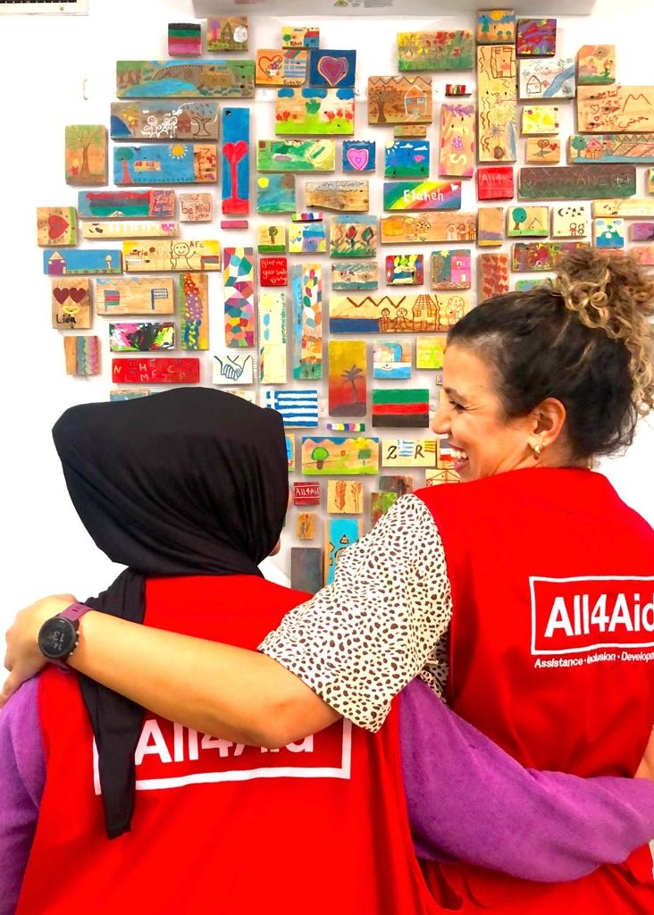
PLEASE PRAY:
The centre provides a wonderful opportunity to share the good news of Jesus with those from countries where the gospel cannot be openly shared.
Ask the Lord that he would use staff at the centre to point those they meet to the gospel. Pray that this Christmas, women like Bibi would put their trust in Jesus for the first time.
Notes:
PLEASE PRAY:
The centre provides a wonderful opportunity to share the good news of Jesus with those from countries where the gospel cannot be openly shared.
Ask the Lord that he would use staff at the centre to point those they meet to the gospel. Pray that this Christmas, women like Bibi would put their trust in Jesus for the first time.

Slide 7
PLEASE PRAY:
An estimated 200 women and children will use the centre every day over the Christmas period. Pray that each would sense the love of Christ as they enter the centre.
Notes:
PLEASE PRAY:
An estimated 200 women and children will use the centre every day over the Christmas period. Pray that each would sense the love of Christ as they enter the centre.

Slide 8
Thank you for your prayers!
Learn more about how you can support the appeal and give today at
www.bmsworldmission.org/safehaven
Notes:
Thank you for your prayers!
Learn more about how you can support the appeal and give today at www.bmsworldmission.org/safehaven

