Slide 2
JOIN BMS WORLD MISSION AND CHRISTIANS ACROSS THE GLOBE AS WE PRAY FOR OUR SUFFERING WORLD

Slide 3
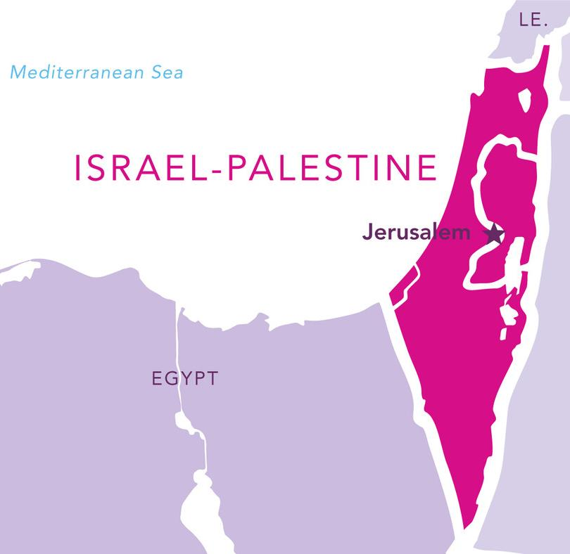
The conflict between Israel and Hamas has raged on since the Hamas attacks on 7 October. Please pray with our partners on the ground for God’s peace to be known across the whole region.
Notes:
The conflict between Israel and Hamas has raged on since the Hamas attacks on 7 October. Please pray with our partners on the ground for God’s peace to be known across the whole region.

Slide 4
Israel-Palestine
Members of the Baptist World Alliance living across Israel-Palestine ask for you to pray with them for just peace:
Please pray for a quick end to the fighting and for the prevention of escalation into a larger war in the region.
Pray for those who have been wounded during the conflict and for those providing medical assistance to them.
Pray for the safety and liberation of hostages, and pray for mediators to facilitate their release.
Notes:
17 Baptist churches from the Association of Baptist Churches in Israel count themselves as members of the Baptist World Alliance, along with 13 Baptist churches from the Council of Local Evangelical Churches in the Holy Land (which represents churches in the Palestinian Territories, including a Baptist church in Gaza). They’ve asked for you to pray with them for just peace:
Please pray for a quick end to the fighting and for the prevention of escalation into a larger war in the region.
Pray for those who have been wounded during the conflict and for those providing medical assistance to them.
Pray for the safety and liberation of hostages, and pray for mediators to facilitate their release.

Slide 5
Israel-Palestine
Pray for the God of all comfort to be with those who are grieving the loss of their loved ones.
Pray that Christians from around the world will unite in prayer for peace, demonstrating the love of Christ to all peoples.
Pray for peace, hope, and security for the entire region, and that the sun of righteousness will rise with healing in its wings so that Israelis and Palestinians will experience life lived in peace and freedom with one another.
Notes:
Pray for the God of all comfort to be with those who are grieving the loss of their loved ones.
Pray that Christians from around the world will unite in prayer for peace, demonstrating the love of Christ to all peoples.
Pray for peace, hope, and security for the entire region, and that the sun of righteousness will rise with healing in its wings so that Israelis and Palestinians will experience life lived in peace and freedom with one another.

Slide 6
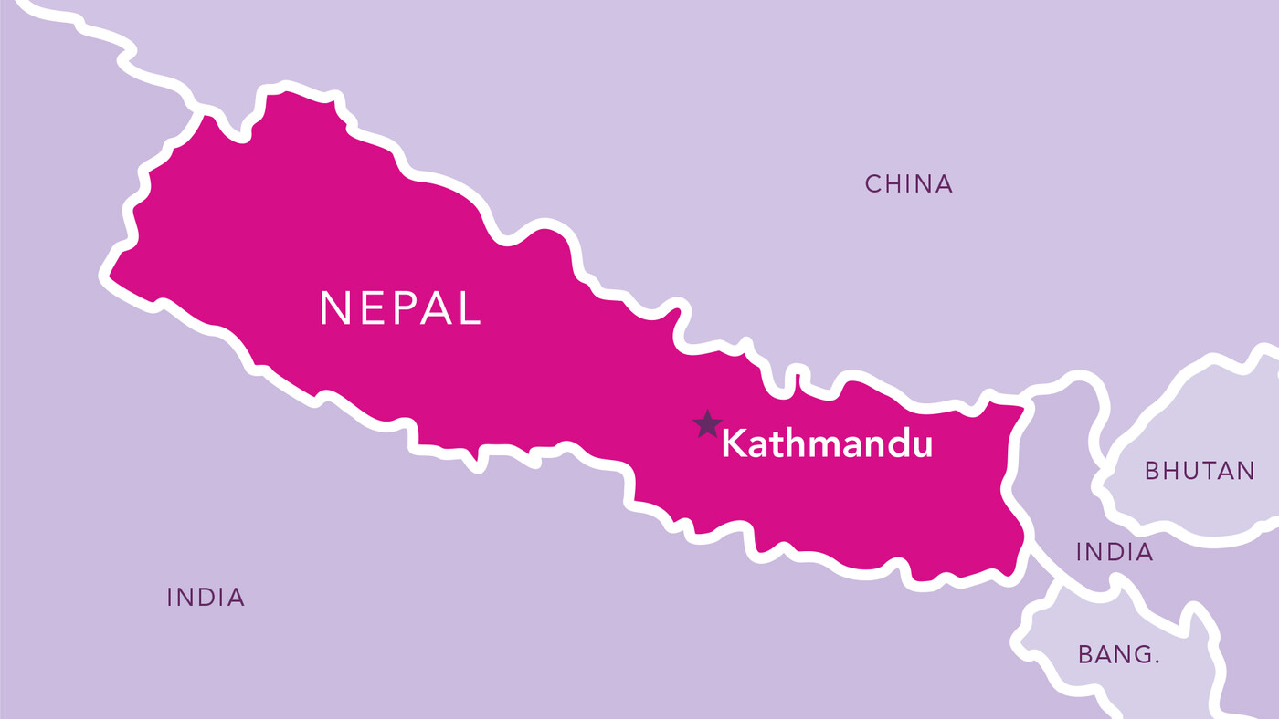
Nepal
Pray for Nepal after a 6.4 magnitude earthquake struck in the regions of West Rukum and Jajarkot in the west of the country on 3 November.
Notes:
Pray for Nepal after a 6.4 magnitude earthquake struck in the regions of West Rukum and Jajarkot in the west of the country on 3 November.

Slide 7
Nepal
Pray for all those who’ve lost loved ones, that they will find space to grieve and that they will know the Lord’s peace.
Pray that God will heal those who are injured, and that people still trapped in the rubble will be found.
Pray for BMS partners in the region as they look to respond.
Pray for staff at a BMS-supported hospital, working relentlessly to save the lives of those hurt and injured.
Pray for people packaging and distributing emergency items such as food and blankets, that the Lord will give them strength and that vital aid will reach those in desperate need.
Notes:
Pray for all those who’ve lost loved ones, that they will find space to grieve and that they will know the Lord’s peace.
Pray that God will heal those who are injured, and that people still trapped in the rubble will be found.
Pray for BMS partners in the region as they look to respond.
Pray for staff at a BMS-supported hospital, working relentlessly to save the lives of those hurt and injured.
Pray for people packaging and distributing emergency items such as food and blankets, that the Lord will give them strength and that vital aid will reach those in desperate need.

Slide 8
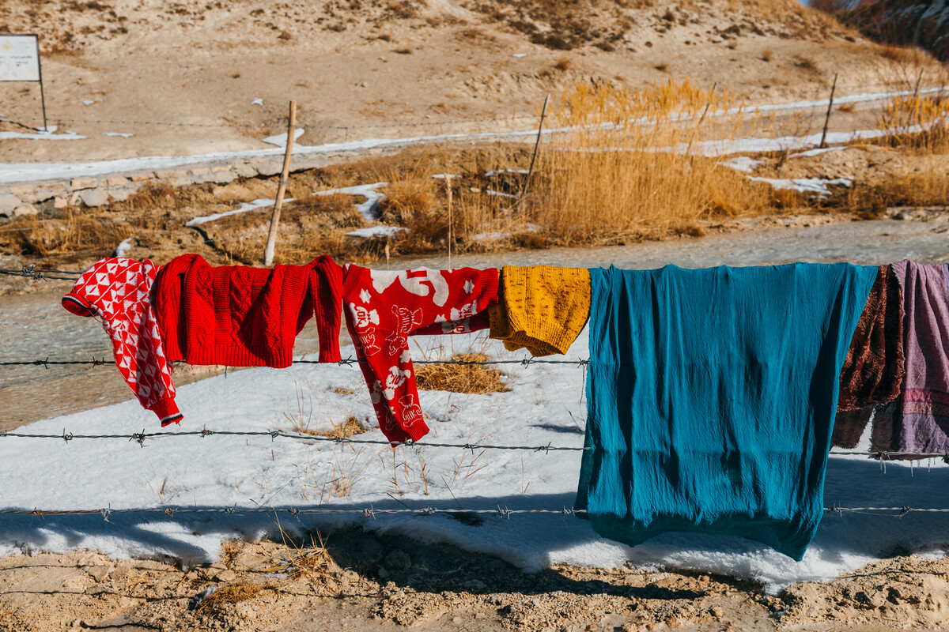
Afghanistan
Lift up the nation of Afghanistan after four 6.3 magnitude earthquakes struck nearby the city of Herat between the 7-15 October.
Photo taken in 2018
Notes:
Lift up the nation of Afghanistan after four 6.3 magnitude earthquakes struck nearby the city of Herat between the 7-15 October.

Slide 9
Afghanistan
BMS’ partner in Afghanistan has been involved in the immediate relief response, providing emergency food and blankets to the most vulnerable, as well as offering crucial mental health support. Please pray for them, that they will stay safe in the wake of any aftershocks, and that they’ll reach as many people as possible.
Pray for the nation of Afghanistan, that humanitarian aid will reach those in need. Pray for the de facto leadership of Afghanistan, that they will have the needs of their citizens in mind as they respond to these catastrophes.
Notes:
BMS’ partner in Afghanistan has been involved in the immediate relief response, providing emergency food and blankets to the most vulnerable, as well as offering crucial mental health support. Please pray for them, that they will stay safe in the wake of any aftershocks, and that they’ll reach as many people as possible.
Pray for the nation of Afghanistan, that humanitarian aid will reach those in need. Pray for the de facto leadership of Afghanistan, that they will have the needs of their citizens in mind as they respond to these catastrophes.

Slide 10
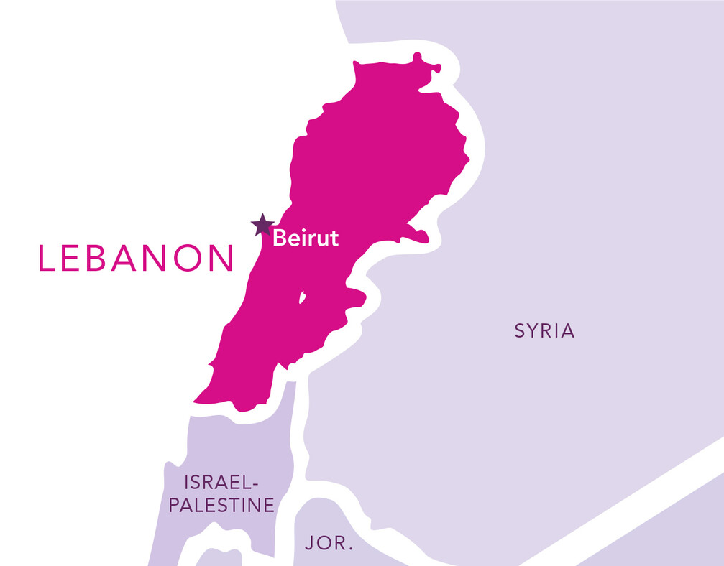
Lebanon
The nation of Lebanon has suffered numerous crises over the last few years – from an economic crisis to the Beirut blast to the ongoing Syrian refugee crisis. An escalation of the conflict between Israel and Hamas could become a major threat to a country already on its knees.
Notes:
The nation of Lebanon has suffered numerous crises over the last few years – from an economic crisis to the Beirut blast to the ongoing Syrian refugee crisis. An escalation of the conflict between Israel and Hamas could become a major threat to a country already on its knees.

Slide 11
Lebanon
Please pray for people in Lebanon amid soaring food prices, political instability in the wake of the Beirut blast and the economic and social strain of the Syrian refugee crisis. Pray that the Lord’s peace will flow across Lebanon and that people will know safety and stability.
Pray that Lebanon will not be drawn into the conflict in neighbouring Israel-Palestine, and that threats of escalation from Hezbollah will be contained.
Notes:
Please pray for people in Lebanon amid soaring food prices, political instability in the wake of the Beirut blast and the economic and social strain of the Syrian refugee crisis. Pray that the Lord’s peace will flow across Lebanon and that people will know safety and stability.
Pray that Lebanon will not be drawn into the conflict in neighbouring Israel-Palestine, and that threats of escalation from Hezbollah will be contained.

Slide 12
Nagorno-Karabakh
After a brief conflict at the end of September, over 100,000 refugees have fled from the Nagorno-Karabakh region of Azerbaijan into Armenia.
Notes:
After a brief conflict at the end of September, over 100,000 refugees have fled from the Nagorno-Karabakh region of Azerbaijan into Armenia.

Slide 13
Nagorno-Karabakh
Pray that God will comfort all those who've fled their homes, leaving everything behind. Pray that they will find a safe welcome as they contend with all the tragedy and trauma they’ve been through.
Pray for churches in Armenia offering shelter to refugees. Pray that they will be well-equipped with beds, food and toiletries as refugees to arrive. Pray they will be able to offer spiritual comfort too for those in need of it.
Notes:
Pray that God will comfort all those who've fled their homes, leaving everything behind. Pray that they will find a safe welcome as they contend with all the tragedy and trauma they’ve been through.
Pray for churches in Armenia offering shelter to refugees. Pray that they will be well-equipped with beds, food and toiletries as refugees to arrive. Pray they will be able to offer spiritual comfort too for those in need of it.

Slide 14
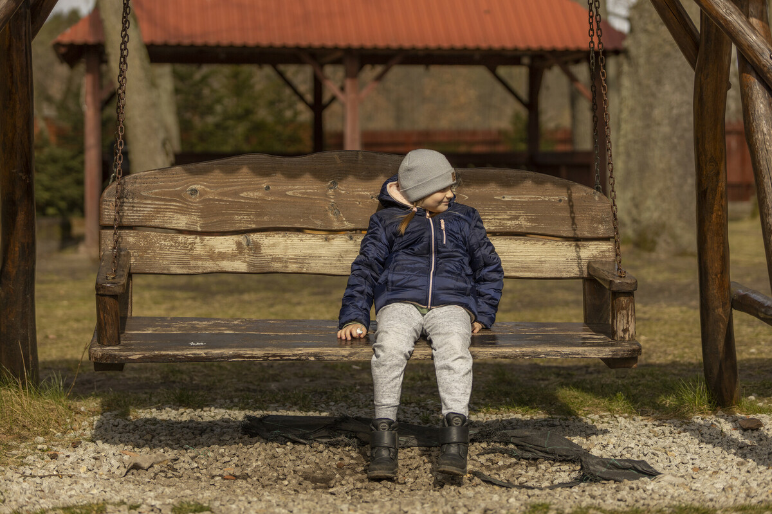
Ukraine
Almost two years on from Russia’s invasion of Ukraine, the conflict there rages on. Please pray for God’s peace to be known in Ukraine.
Photo: ©Chris Hoskins/BMS World Mission
Notes:
Almost two years on from Russia’s invasion of Ukraine, the conflict there rages on. Please pray for God’s peace to be known in Ukraine.

Slide 15
Ukraine
Pray for churches in Ukraine who are working with people who’ve now returned to the country. Pray that they will be able to create supportive and full communities despite the ongoing threat of war.
Pray for BMS partner the European Baptist Federation as they work with churches across Europe continuing to support with displaced Ukrainian people. Pray that God’s strength will be known by all, and that those who’ve fled will find safe and secure communities to live in.
Notes:
Pray for churches in Ukraine who are working with people who’ve now returned to the country. Pray that they will be able to create supportive and full communities despite the ongoing threat of war.
Pray for BMS partner the European Baptist Federation as they work with churches across Europe continuing to support with displaced Ukrainian people. Pray that God’s strength will be known by all, and that those who’ve fled will find safe and secure communities to live in.

Slide 16
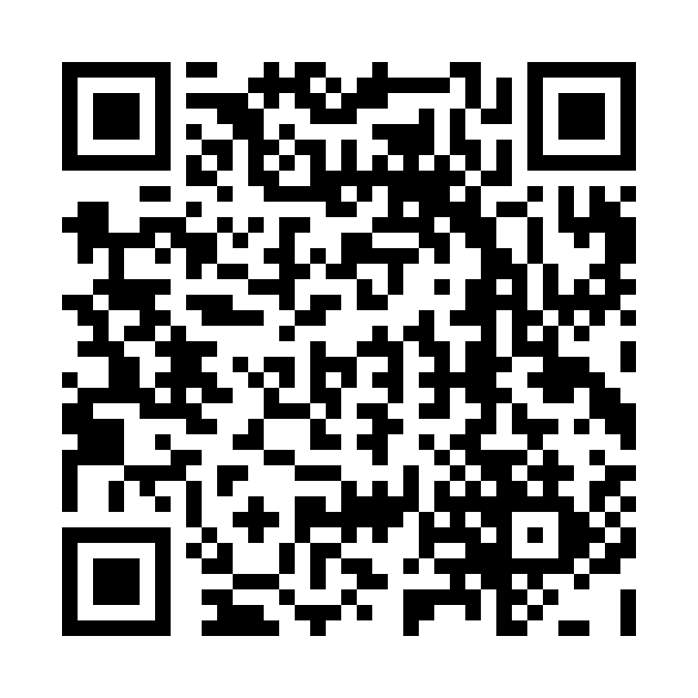
Thank you for your prayers You can help BMS prepare for disasters before they happen. Please consider giving to our disaster recovery fund today. Visit bmswm.org/disaster-recovery or scan the QR code.

