Slide 2
SHARING THE GOSPEL IN THAILAND
Pray for evangelism work this Easter

Slide 3
CAN YOU IMAGINE A LIFE LIVED WITHOUT HOPE?
One where difficult things happened… - relationships breaking down - dreams going unfulfilled - disappointment after disappointment …and you had no framework to understand why?
And no reason to believe that things could ever get better...
Notes:
All text should be in Arial and no smaller than 24pt. Aim for no more than 33 words per slide.
ALL THE TEXT AND IMAGES IN THIS TEMPLATE ARE PLACEHOLDER ONLY, PLEASE DELETE AS APPROPRIATE.

Slide 4
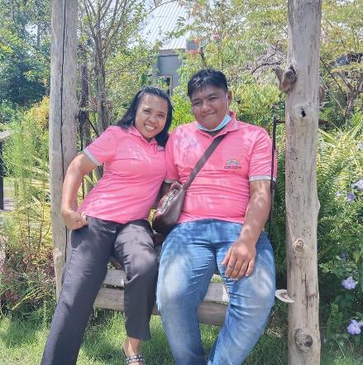
THAT WAS THEW’S EXPERIENCE GROWING UP IN THAILAND
Thew and his wife, Som
Thew’s parents split up when he was little, and he grew up with a lot of anger and sadness.
Making merits in the Buddhist temple brought temporary satisfaction but didn’t fill the hole in Thew’s heart.
Notes:
Bullet points
Try four by five rule
Max four bullet points
Five words in each
Fly in from left

Slide 5
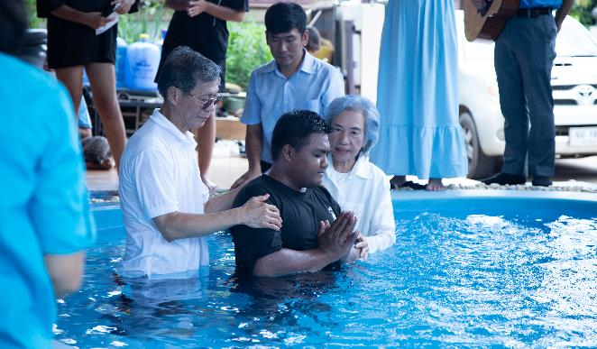
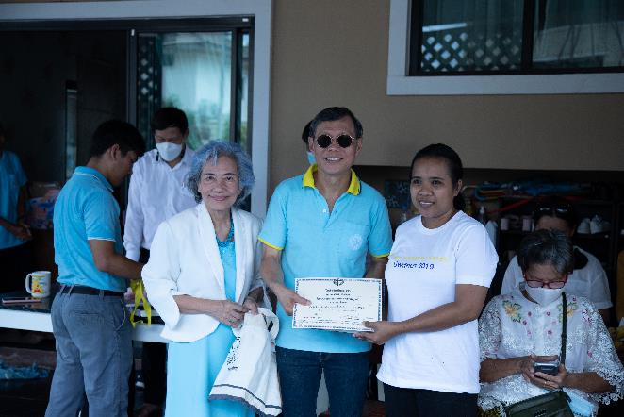
That’s why Thew and Som are so excited to have heard about the good news of Jesus, and the hope and lasting satisfaction it brings in a world that often feels messy
They became Christians on Easter Sunday 2022 and chose to dispose of their idols the same day
Notes:
Text and image? No problem! Add text in the text box and your image next to it
Make sure to include the banner at the bottom by right clicking it and bringing it to the front
Be sure that the image goes right to the top and bottom of the slide, this makes it look slick and professional

Slide 6
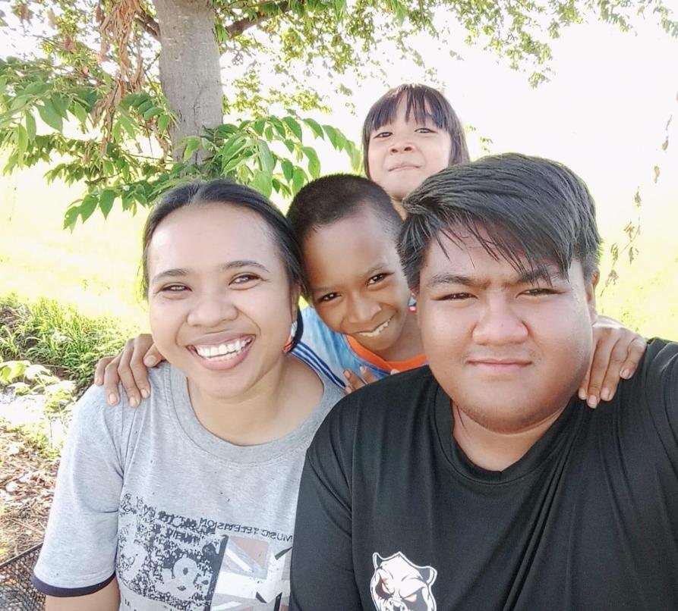
This Easter, Thew and Som would love for others to also have the chance to hear the gospel message that transformed their lives…
Notes:
Text and image? No problem! Add text in the text box and your image next to it
Make sure to include the banner at the bottom by right clicking it and bringing it to the front
Be sure that the image goes right to the top and bottom of the slide, this makes it look slick and professional

Slide 7
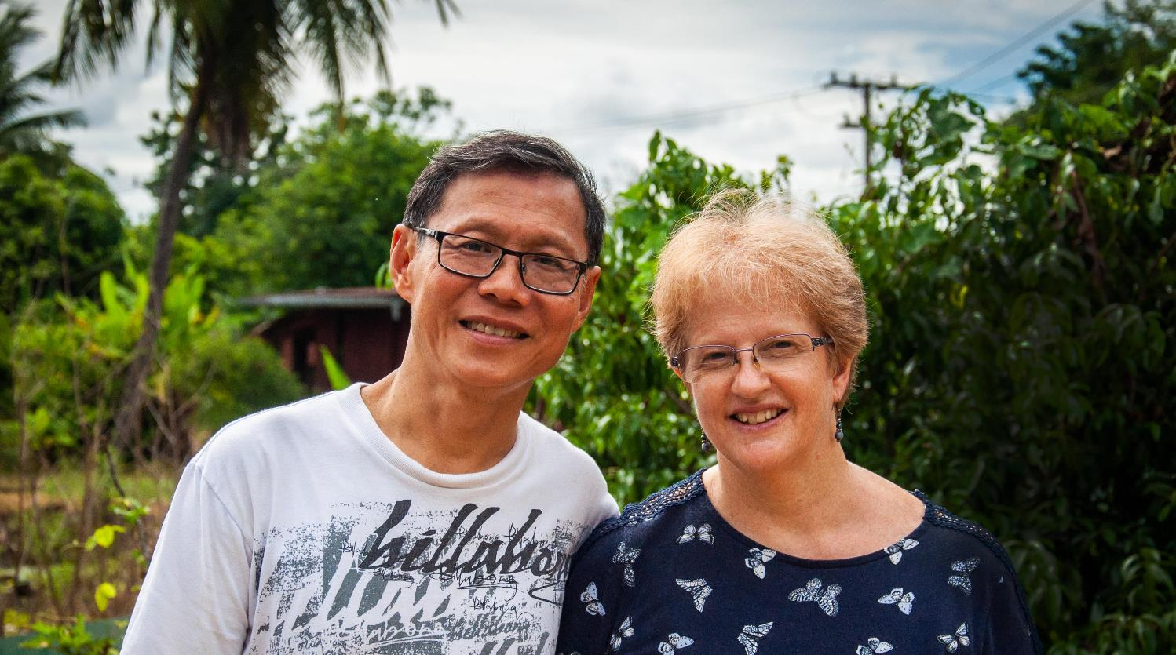
Could you help?
BMS World Mission workers Helen and Wit Boondeekhun are committed to bringing God’s love and light to communities in rural Thailand.
Notes:
Use full screen images! Use the banner at the bottom of the slide and make sure you bring it to the front by right clicking it.

Slide 8
PLEASE PRAY…
For Thew, Som and their young family, as they continue to delight in the hope they have and depend on God as their Father
For God to bless the witness of Helen and Wit and to enable them to share the story of salvation with many others in their community
For God to work powerfully through Moses and Mary, a young Thai couple who have taken over leadership of Thew and Som’s church and who are being supported by BMS World Mission
Notes:
All text should be in Arial and no smaller than 24pt. Aim for no more than 33 words per slide.
ALL THE TEXT AND IMAGES IN THIS TEMPLATE ARE PLACEHOLDER ONLY, PLEASE DELETE AS APPROPRIATE.

Slide 9
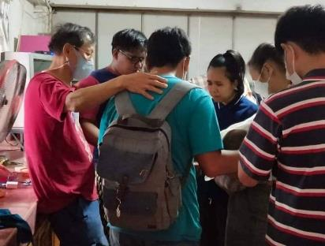
To find out more and to give towards evangelism work in Thailand today, head to www.bmsworldmission.org/thailandappeal
Notes:
Bullet points
Try four by five rule
Max four bullet points
Five words in each
Fly in from left

