Slide 1
Support courageous Christians in hard places living the gospel no matter the cost

Slide 2
Welcome to the I Will Stand service PowerPoint
We hope this slideshow will make planning your I Will Stand service easier. It includes:
An online link to the feature video, and instructions for other video options
The I Will Stand World Church quiz – followed by all the answers
A slide you can use for your own sermon notes
Prayers to use in your service
How to give slide
Feel free to edit the slideshow to suit your church, then delete this slide and the one following it before running your service!

Slide 3
How to include the video in this slideshow
You can either stream the video or use an embedded video file. The method you choose may depend on the internet connection available in your church. When you’re ready to go, delete this slide.
Streaming the video
The next slide includes an online link to the I Will Stand feature video. If this works in your church, you’re sorted. Just press play when in slideshow mode.
If you’d like to add another I Will Stand video to your presentation, create a blank slide then choose Insert/Video/Online Film. Insert any of the following urls:
Reflection video: https://vimeo.com/578054084
Feature video with BSL/subtitles: https://vimeo.com/578067789
J’s story: https://vimeo.com/578124632
Z’s story: https://vimeo.com/578127428
K’s story: https://vimeo.com/578113936
Using a video file
Visit the feature video resource page and click download.
On slide 5, click the little film icon ☞
Find the file you downloaded, either in your downloads folder or another folder you may have specified for downloads. Resize the video to make it fill the screen.
If you need to transfer the slideshow to a church computer, use a memory stick or flash drive as the file will be too large to send by email.
To embed any of the other I Will Stand videos, simply find them at www.bmsworldmission.org/iwillstand and follow the same process.

Slide 6
World Church quiz

Slide 7
Question 1
How many people around the world today follow Jesus?
More than two billion
More than three billion
More than five billion

Slide 8
Question 2
There are places around the world where fewer than one per cent of people know Jesus.
Which is the only country listed below where this isn’t the case?
a) Thailand
b) Afghanistan
c) Tunisia
d) Kosovo

Slide 9
Question 3
Which country has the highest number of different religions practiced?
a) Brazil
b) South Korea
c) The UK
d) The USA

Slide 10
Question 4
…and which place has the smallest number of different religions?
a) Vatican City
b) Afghanistan
c) Fiji
d) Iraq

Slide 11
Question 5
In many countries, numbers of Christians are expected to rise.
But can you guess the region where the numbers of Christians are expected to fall?
a) North America
b) Europe
c) The Middle East and North Africa
d) Sub-Saharan Africa

Slide 12
Question 6
BMS World Mission was founded because of William Carey’s vision to share the gospel with people all over the world. But do you know how many languages Carey translated the Bible into?
a) 2
b) 4
c) 6

Slide 13
Question 7
BMS supporters continue Carey’s legacy by sharing the love of Jesus all over the world. Do you know how many countries BMS works in today?
a) Over 15
b) Over 25
c) Over 30

Slide 14
Answers

Slide 15
Question 1
How many people around the world today follow Jesus?
More than two billion
More than three billion
More than five billion

Slide 16
Question 2
There are places around the world where fewer than one per cent of people know Jesus.
Which is the only country listed below where this isn’t the case?
a) Thailand
b) Afghanistan
c) Tunisia
d) Kosovo

Slide 17
Question 3
Which country has the highest number of different religions practiced?
a) Brazil
b) South Korea
c) The UK
d) The USA

Slide 18
Question 4
…and which place has the smallest number of different religions?
a) Vatican City
b) Afghanistan
c) Fiji
d) Iraq

Slide 19
Question 5
In many countries, numbers of Christians are expected to rise.
But can you guess the region where the numbers of Christians are expected to fall?
a) North America
b) Europe
c) The Middle East and North Africa
d) Sub-Saharan Africa

Slide 20
Question 6
BMS World Mission was founded because of William Carey’s vision to share the gospel with people all over the world. But do you know how many languages Carey translated the Bible into?
a) 2
b) 4
c) 6 (Bengali, Oriya, Marathi, Hindi, Assamese and Sanskri)

Slide 21
Question 7
BMS supporters continue Carey’s legacy by sharing the love of Jesus all over the world. Do you know how many countries BMS works in today?
a) Over 15
b) Over 25
c) Over 30

Slide 22
Sermon

Slide 23
Prayers

Slide 24
Heavenly Father, we pray for people who have been rejected by their families because they have chosen to follow Jesus.
May they experience the unconditional love of God.
May they find strong Christian communities.
And we pray that their families would accept them and reconcile with them.

Slide 25
Lord, we pray for church planters in Asia who are facing persecution because of their faith.
Thank you for the many, many people they are reaching with the gospel, and for the new house churches they have formed.
Please protect church planters and new believers. Please soften the hearts of those who want to harm them.

Slide 26
Father, we pray for isolated Christians.
May they find other believers who can encourage them, whether that is face-to-face or through social media.
Help them to find ways to faithfully follow God, even when they have to live out their faith in secret.

Slide 27
We pray for BMS-supported ministries reaching out to people who are hostile to the gospel.
Help people to have wisdom to know when to speak and when to be silent.
Give them the right words to say. And we pray that they would see many people come to know Jesus.

Slide 28
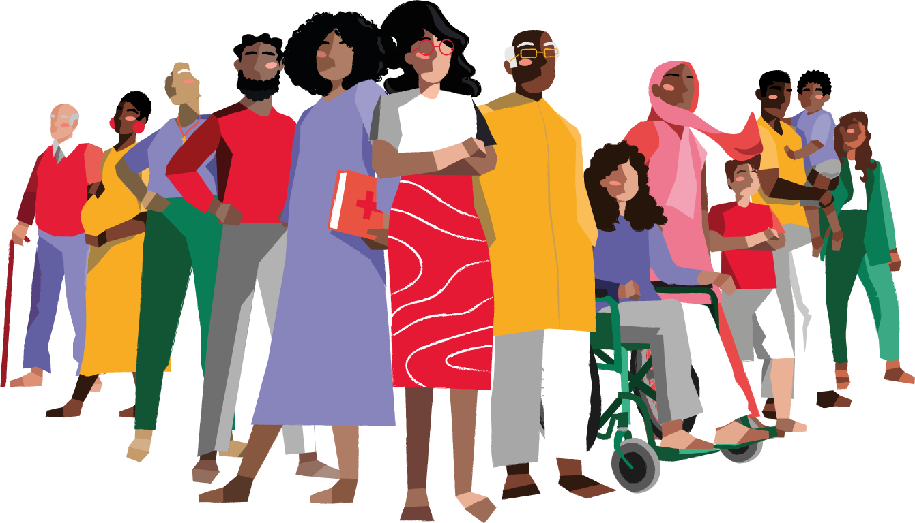
Finally, we pray that through the ministries of BMS-supported believers across the globe, thousands of people will experience whole-life transformation.
As Christians living in hard places seek to share the gospel in word and deed, may people experience the love of Jesus for the first time, and may it transform every area of their lives. Amen.

Slide 29
How can I help?
Stand with the World Church today by supporting I Will Stand. Give now at
www.bmsworldmission.org/stand

