Slide 2
Join Christians across the UK to pray for the global Covid-19 Coronavirus response

Slide 3
We pray that God will stop the spread of the virus.
Pray that those who are ill or displaying symptoms will be healed, and that the Lord will bless the work of all those developing a treatment and a vaccine.
We pray especially for the Lord’s protection over medical workers on the frontline, risking their own health to provide vital care. We pray that they will stay healthy and that their work will bear fruit.

Slide 4
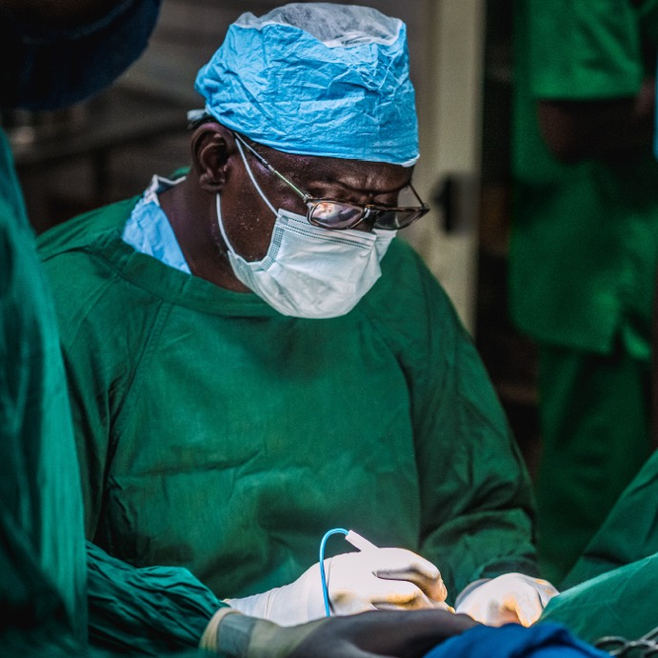
We pray for the response to the virus around the world.
Pray that the Lord will keep NHS workers safe, as well as other healthcare workers across the world also risking their lives in the fight against the Coronavirus. Pray especially for workers in countries that are particularly vulnerable, such as Chad and Afghanistan.

Slide 5
We pray for people living and working under lockdown around the world.
Pray also for people across the world who are unable to work and are struggling to support themselves and their families. Pray for BMS-supported work offering food relief in places like Tunisia, Bangladesh and Albania, that it will help vulnerable people get through this difficult time.

Slide 6
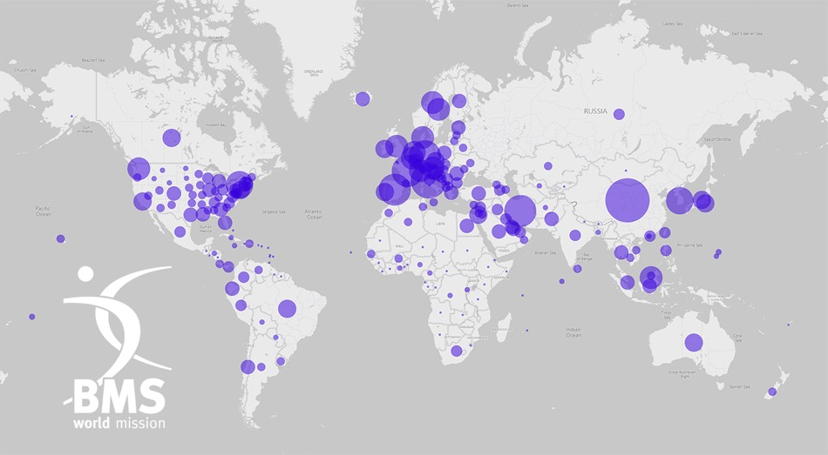
We pray for governments and leaders across the world.
Pray that they will make wise, pro-active decisions that will benefit all their countries and the global community.

Slide 7
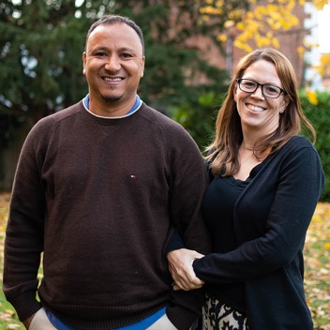
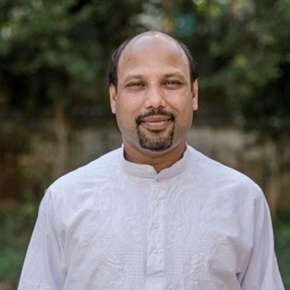
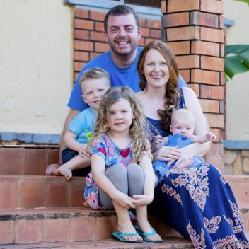
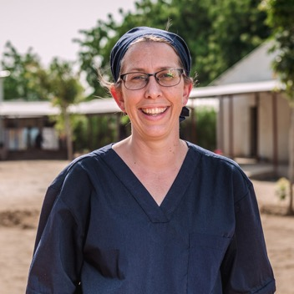
We pray for BMS mission workers and UK staff.
Pray for mission workers who have returned to the UK, that they will be able to continue their work as best they can remotely. Pray for workers still overseas, that the Coronavirus will not prevent them from carrying out their vital work.

Slide 8
What your support is doing now:
You’re providing Personal Protective Equipment (PPE) and other vital equipment for medical workers
You’re giving food support to vulnerable people whose livelihoods have been affected by Covid-19

Slide 9
What your support is doing now:
You’re supporting the mental health needs of medical workers and patients affected by the Coronavirus pandemic
And you’re building capacity among churches, communities and agencies, so they can help people to help themselves in the face of this terrible pandemic

Slide 10
Join the global Christian response.
You can help by supporting the poorest of the poor whose lives will have been decimated by the destructive path of this virus.
BMS is playing a key role in co-ordinating the Baptist World Alliance Forum for Aid and Development (BFAD) – a global body of agencies and churches around the world, able to respond in practical, effective ways where help will be needed most.
Go to www.bmsworldmission.org/coronavirus-appeal

Slide 11
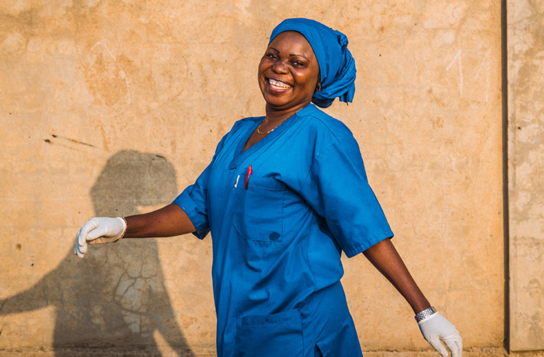
Stay informed!
Sign up to our weekly email update for the latest news about our response to this situation and much more:
Go to www.bmsworldmission.org/stay-informed

