Slide 2
Pray with BMS World Mission for the global Covid-19 Coronavirus response

Slide 3
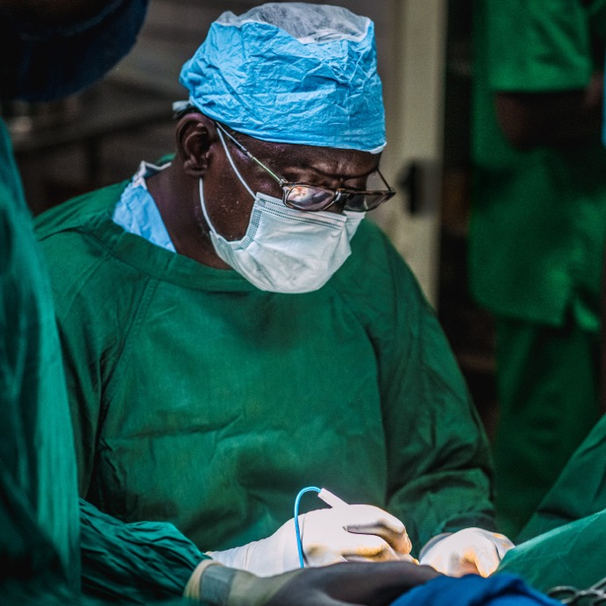
We pray for the response to the virus around the world.
We pray that God will enable the work of our partners to continue where possible, and that our workers who are actively fighting the virus will remain healthy.

Slide 4
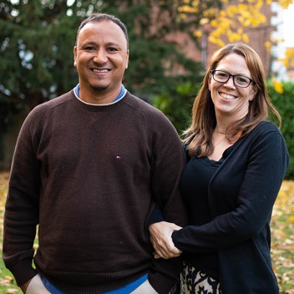
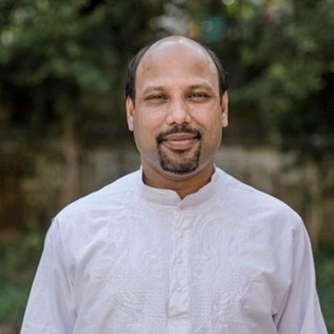
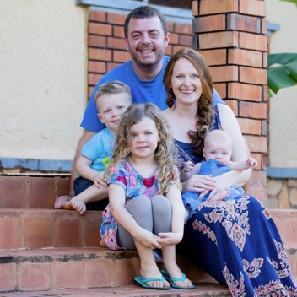
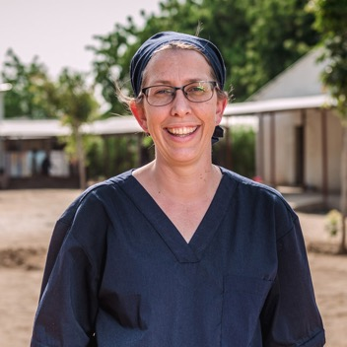
We pray for BMS mission workers and UK staff.
For those who have travelled back to the UK, that they are able to continue their crucial work remotely.

Slide 5
We pray for people spending time in quarantine or self-isolation.
We pray that they might receive the support they need, and that they might stay safe. We praise God for the commitment of those in voluntary isolation, that they will play a real part in slowing the spread of the virus.

Slide 6
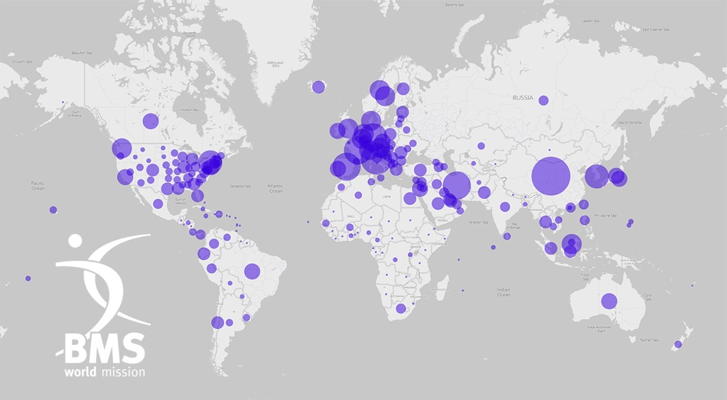
We pray for governments and world leaders globally.
May the Lord bless them with wisdom.
We pray that they will make pro-active decisions that will benefit their countries, and the global community.

Slide 7
We pray that God will slow the spread of the virus.
In the name of Jesus, we pray that those who are ill will be healed and pray that God will bless the work of the people and organisations who are working on a treatment.
We pray especially for the medical workers around the world who are risking their own health to treat the most vulnerable. We ask that they will stay healthy and that their work will be fruitful.
Amen.

Slide 8
What your giving is doing now:
You’re providing Personal Protective Equipment (PPE) and other vital equipment for medical workers
You’re giving food support to vulnerable people whose livelihoods have been affected by Covid-19

Slide 9
What your giving is doing now:
You’re supporting the mental health needs of medical workers and patients affected by the Coronavirus pandemic
And you’re building capacity among churches, communities and agencies, so they can help people to help themselves in the face of this terrible pandemic

Slide 10
Join the global Christian response.
You can help by supporting the poorest of the poor whose lives will have been decimated by the destructive path of this virus.
BMS is playing a key role in co-ordinating the Baptist World Alliance Forum for Aid and Development (BFAD) – a global body of agencies and churches around the world, able to respond in practical, effective ways where help will be needed most.
Go to www.bmsworldmission.org/coronavirus-appeal

Slide 11
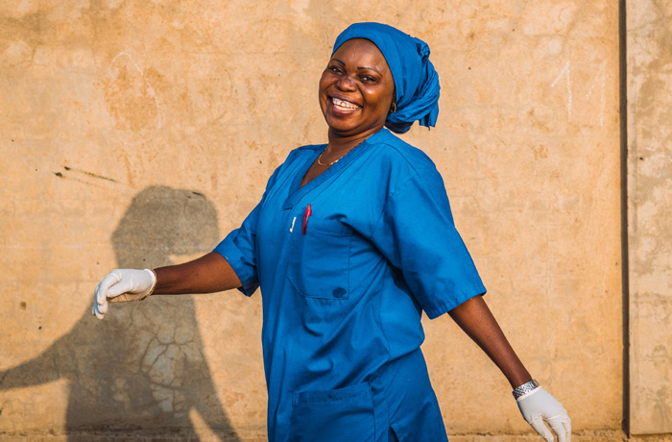
Stay informed!
Sign up to our weekly email update for the latest news about our response to this situation and much more:
Go to www.bmsworldmission.org/stay-informed

