Slide 2
BE A BLESSING ON YOUR BIRTHDAY
More about our church’s Birthday Scheme
Notes:
Use this slide to introduce the topic of the Birthday Scheme. If you are a Co-ordinator, explain your role and that you are going to let people know what the Birthday Scheme is all about, and how they can get involved.

Slide 3
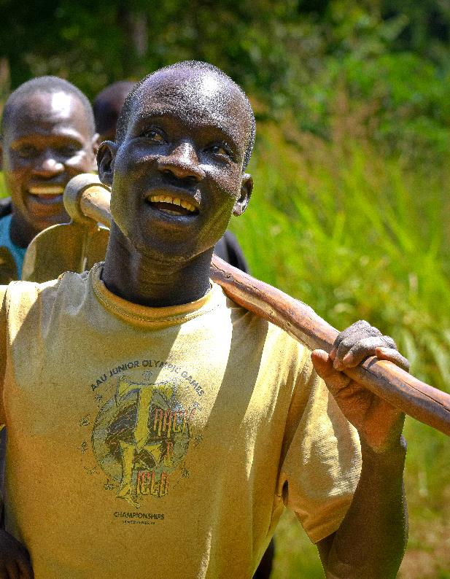
How do you like to celebrate your birthday?
An all-out celebration? A relaxing day with minimal fuss? Cake and balloons, or going out for dinner?
No matter how you like to celebrate your birthday, one thing is for sure. They’re a real marker of God’s blessing!
Notes:
This slide is all about getting people to think about their birthdays and the privilege so many of us have in the UK to enjoy our birthday celebrations each year.
You could even ask for some participation from the congregation as they share some of their preferred birthday celebrations.

Slide 4
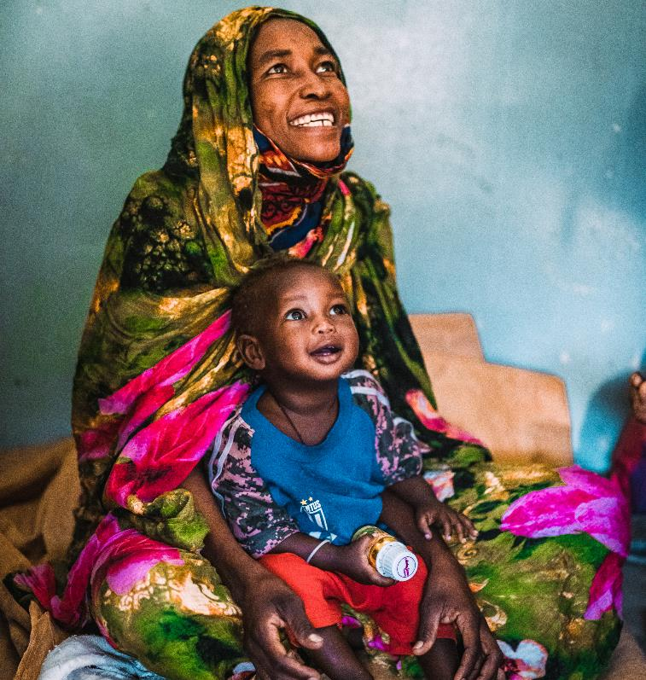
Give someone else a reason to celebrate too!
Birthdays are a reminder of another year of God’s goodness to us.
When you join a BMS Birthday Scheme, you can pass that blessing on to people who really need your support.
Notes:
Use this slide to explain that birthdays signal to us how loved and blessed we are by God.
Explain that joining your church’s Birthday Scheme is a great way to multiply the blessings of a birthday, and help people in real need.

Slide 5
How does it work?
Donations to Birthday Schemes like this one raise hundreds of
thousands of pounds for the work of BMS World Mission every year!
That money helps people in need around the world experience fullness of life in Jesus’ name. ​
Whether it’s feeding hungry families, delivering clean water, enabling ​​ life-saving medical care or sharing the gospel, you can be a part of it!
Notes:
This slide can help people understand where donations to the Birthday Scheme go and the kind of work that their money will support.

Slide 6
How do I join in?
It’s simple!
Fill in a Birthday Scheme Join Now form
Receive a birthday card from your Birthday Scheme Co-ordinator
Read the stories tucked inside of what your birthday donation could do
Decide a gift amount and make your gift
Hear stories throughout the year of the difference you've made!
Notes:
This is an opportunity for you to take people step by step through how the Birthday Scheme works and what they can expect when they join.

Slide 7
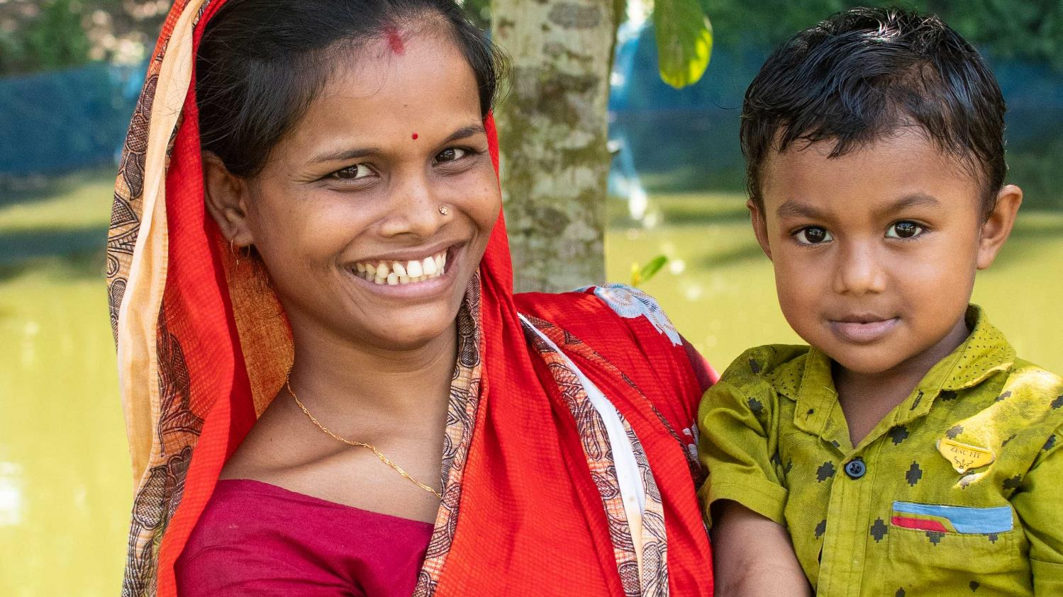
Request a Join Now
leaflet with more information and a form to sign up today!
Notes:
Encourage people to collect a Join Now form from you or from a clearly sign-posted place after the service.
Let them know that you are available to answer any questions they may have too.

