Slide 1
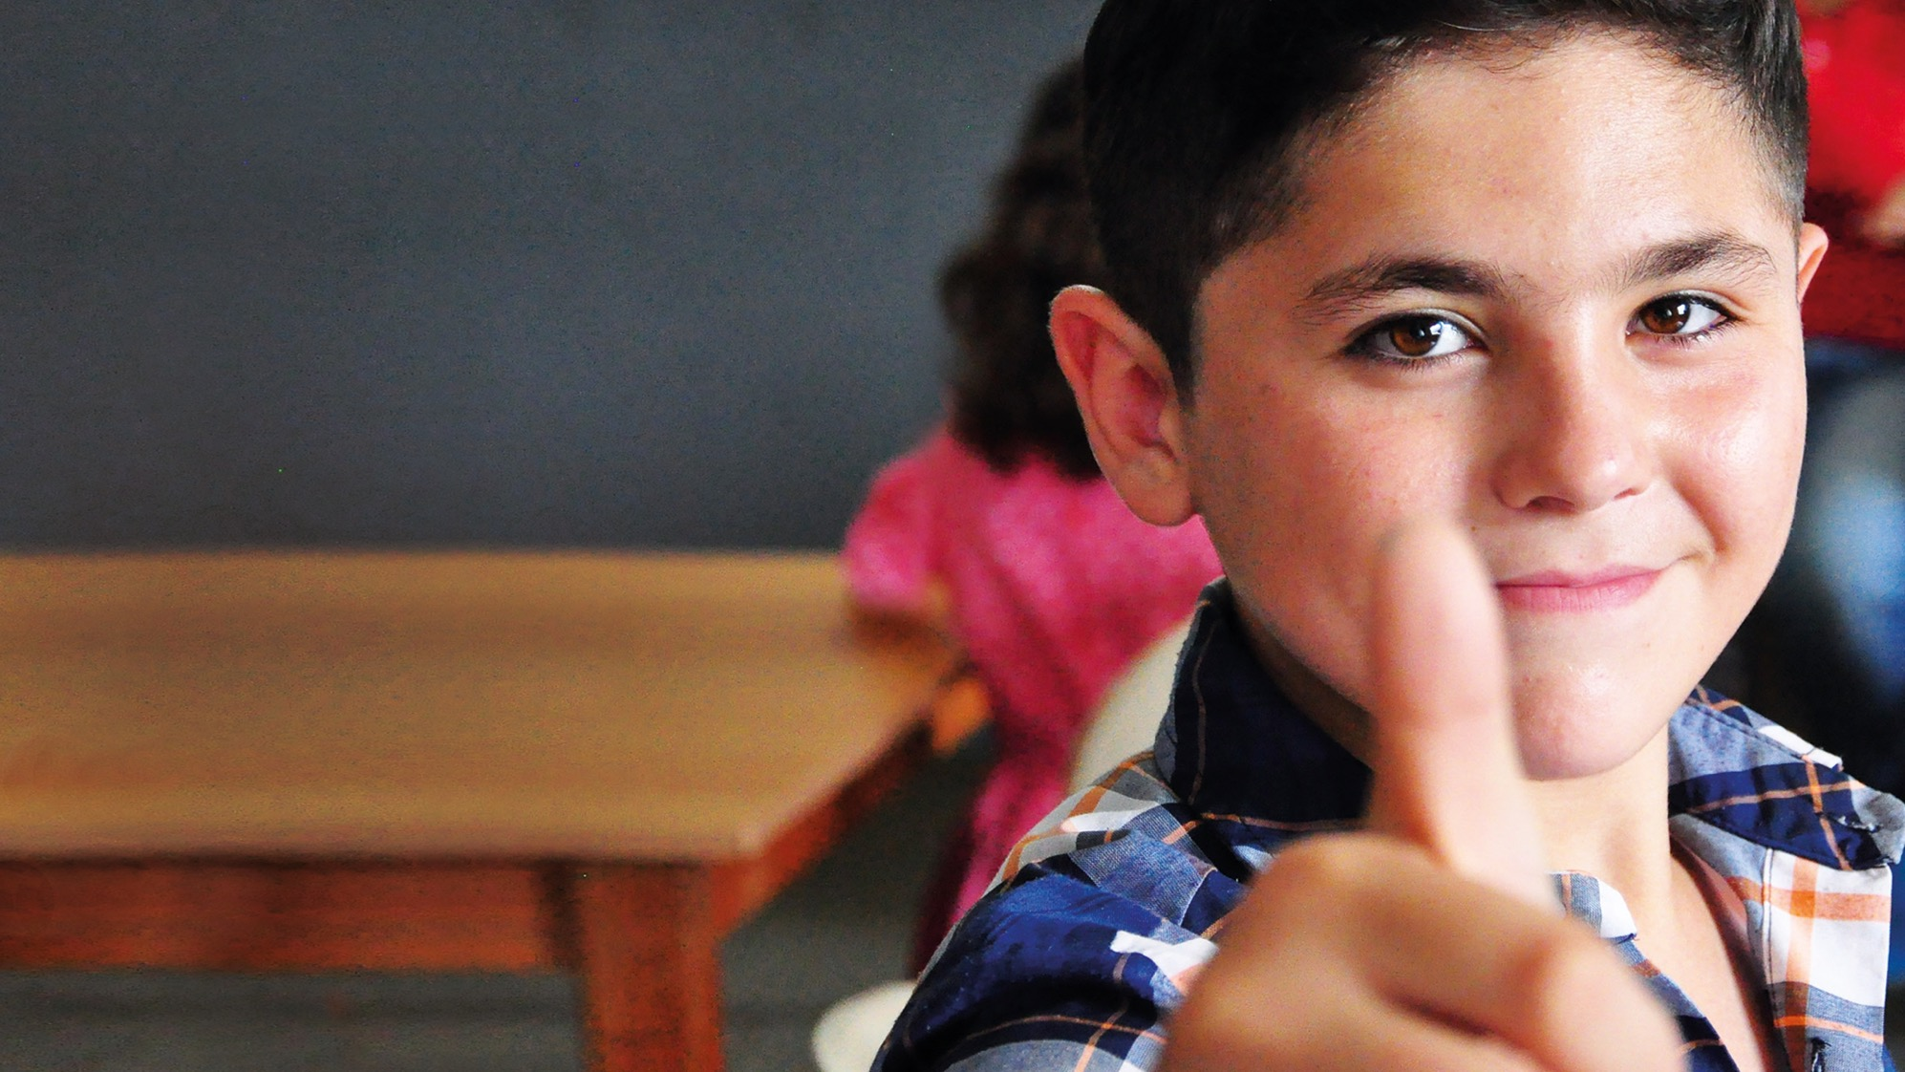
2019-2021

Slide 2
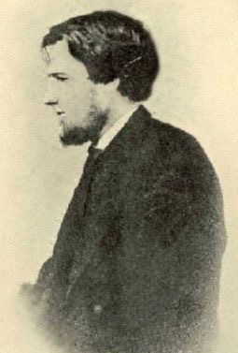
Timothy Richard
1845 –1919
Missionary from Wales to China
Notes:
In 2019, the Baptist Union of Wales commemorated a century since the death of one of our greatest missionaries – Timothy Richard. Hailing from Carmarthenshire, Timothy Richard was sent by the Baptist Missionary Society to China in 1869 and is widely regarded as one of the most pioneering missionaries of his time, and his legacy is still evident in the mission work of BMS World Mission today.
He played an important part in combating the Great Famine of 1876-1879 in China, and set up a Western- Chinese university in China and was passionate about the role education could play in averting and alleviating suffering. He was so respected by the Chinese authorities, for his passion, his compassion and his respect for their culture, that he was awarded the Order of the Double Dragon.

Slide 3
2019-2021

Slide 4
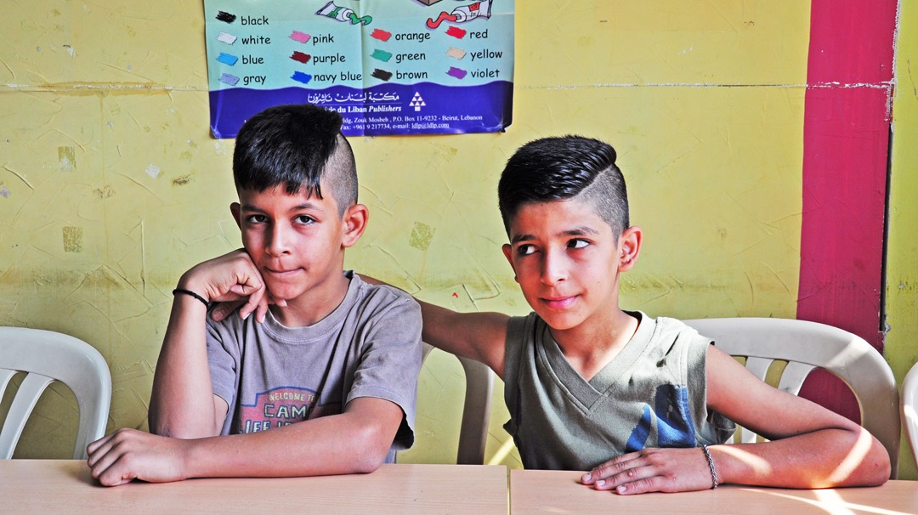
Notes:
Meet Gabi and Maher. Gabi is 10 and Maher is 11 and they are half-brothers. They come from Homs in Syria and today they live outside Beirut in Lebanon.
Gabi loves learning new words, and while he likes playing football, he’s not nearly as good at it as Maher. Maher is cheeky. And confident. And says he gets in trouble a little more than his brother!
Their family lives in a tent and they sleep on mattresses on the floor. That’s not life for all refugees, but it is for their family.

Slide 5
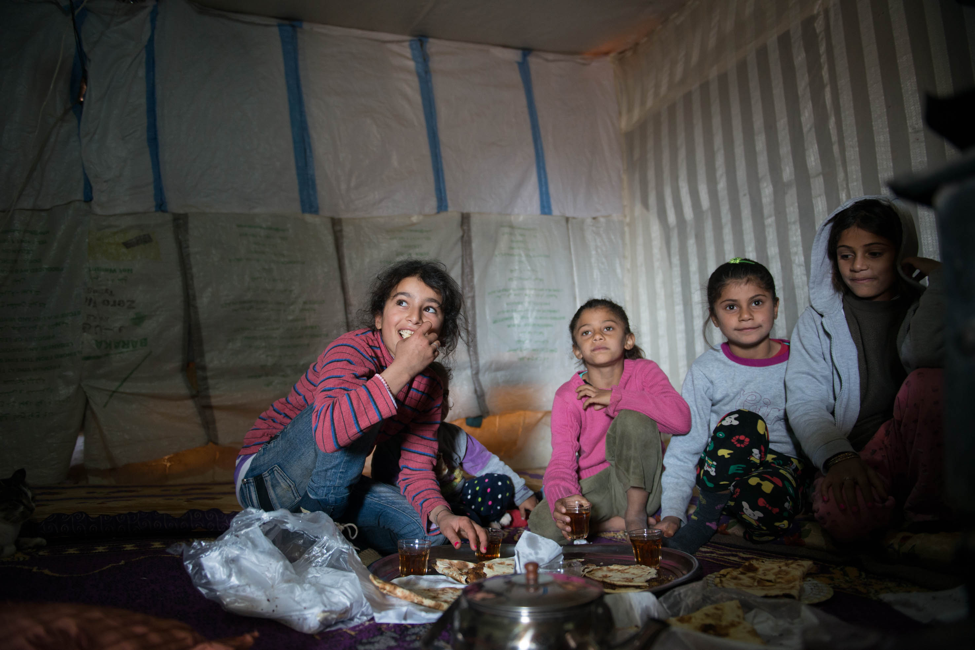
Notes:
Children like Gabi and Maher have had their entire lives disrupted and uprooted by war. They’re living in a country that was once invaded by Syria. They’re in danger of missing years of school, of losing all hope for a future of employment and fulfilled potential. We want to help more refugee children like Maher get back into the classroom, where they can learn, be inspired, and get their childhood back.

Slide 6
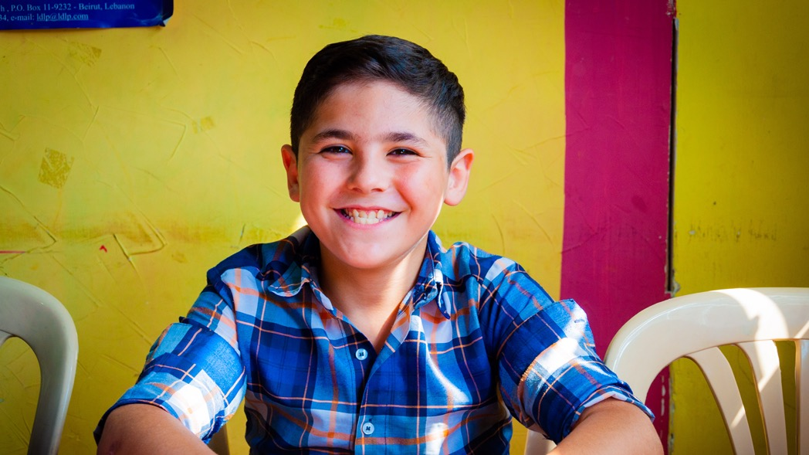
Notes:
Malick is 11 years old. He has a cheeky grin and is always ready to strike a pose.
Malick and his sister Sara are Kurds. They are two of over 1.5 million Syrians estimated to be living in Lebanon today. They are from a Muslim background but most importantly they are children who need access to education.
Malick loves Arabic and English, Sara loves arts and crafts. They both miss their grandparents.
They left Syria when their neighbour’s house was hit by a bomb. They ran. And when they came back, they didn’t have a home anymore. Just rubble. They arrived in Lebanon with just the clothes on their backs and nothing else.

Slide 7
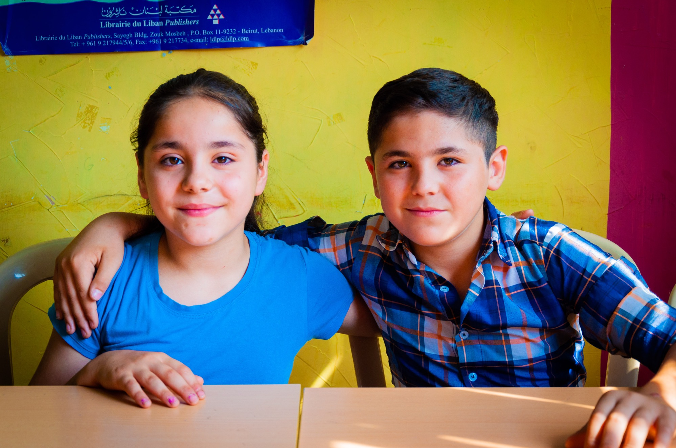
Notes:
In these pictures Malick and Sara are on the third floor of a building without window panes in the hot and noisy urban sprawl just outside Beirut. The concrete walls and ceilings are decorated with alphabets and Bible pictures, they have an assembly hall furnished with light garden furniture and heavy curtains.
This is their school. Malick and Sara spent two years out of the classroom before their mother found this place. They are far from home and, without the handful of teachers here, they’d have no chance of an education.
Life can be hard for refugees. People can be uncaring and ignorant of their situation. But in the school they are treated as equals. “The teachers take care of us,” says Sara. Malick says: “They don’t shout at us, and also when we are sad the teachers come and make us happy.” Roshina, their mother, has found work as a cleaner at the learning centre. She has accepted Jesus into her life and is keen to tell other members of her family about the Lord.
This has all been made possible because of the support for BMS. And we want to see the centre grow and help more children like Malick and Sara.

Slide 8
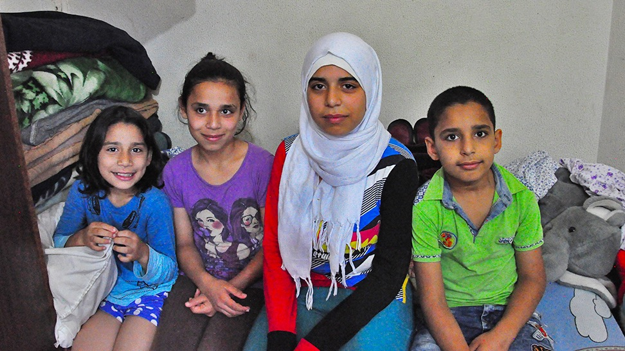
Notes:
This is Shakala and her brother and sisters. They live in a single room in Lebanon.
Shakala didn’t know if she would survive until nightfall most days when she and her family lived in Aleppo, Syria. Bombings, fighting and kidnappings were part of daily life. In all the chaos, Shakala herself was almost kidnapped. Her mother had to lock her children in the house whenever she went out to buy food to stop people getting in and taking them. Eventually, they were forced to flee Syria and try and make a new life in Lebanon.
“Bring me a teacher!” Shakala asked her mother over and over again. Her mother didn’t know what to do. She knew how important it was that her children had an education and that school would bring some stability to their lives. But she was terrified of letting her children go. For two years, Shakala asked for school and her mother had to say no. But then some neighbours told her about a BMS-supported learning centre, held at a nearby church. This was the chance that Shakala had been dreaming about. She started school. And she thrived. She loved it so much that she asked for school during the holidays, and the church was able to set up camps for the children to go to. Her teachers didn’t just teach her about maths and English, but about commitment and working hard.

Slide 9
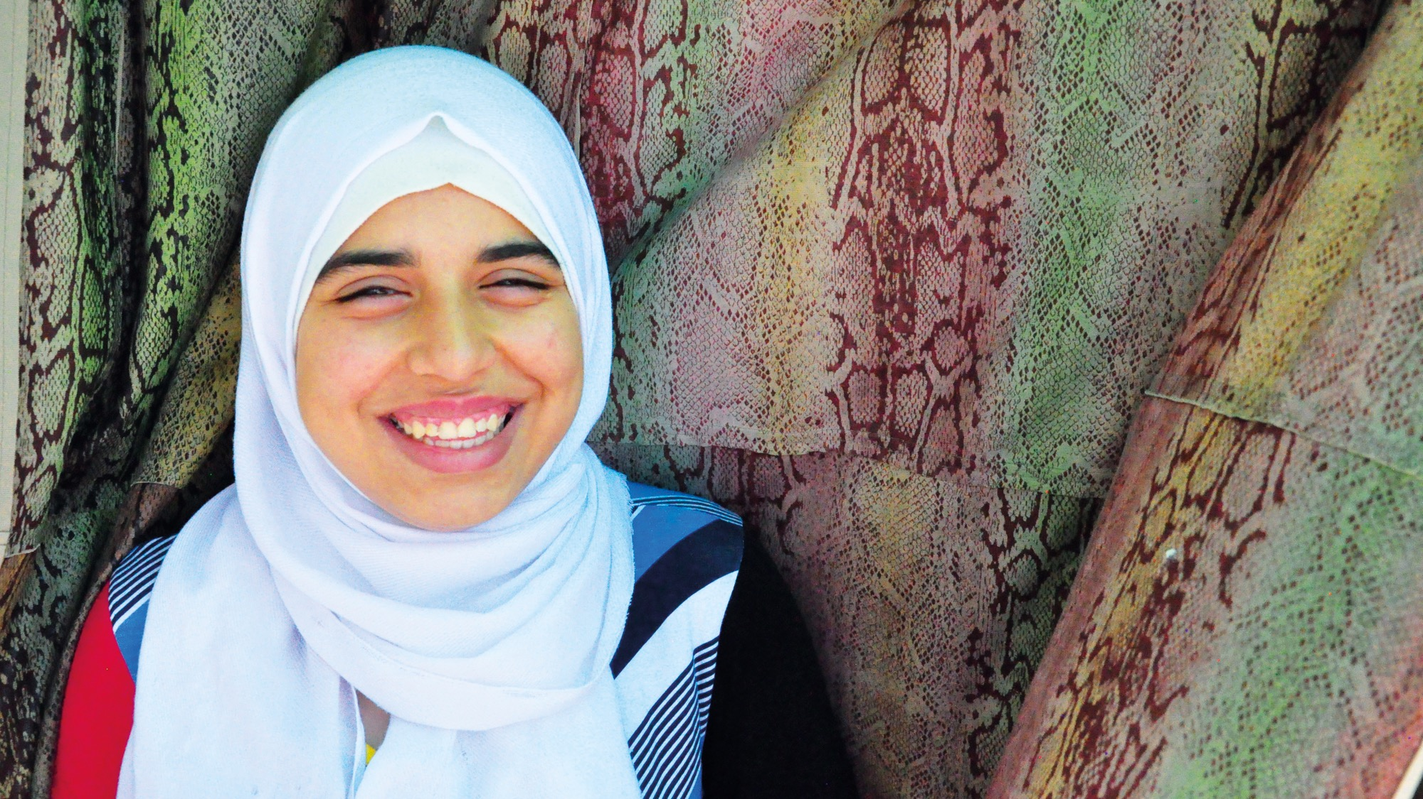
Notes:
Shakala is determined to achieve her dreams. The school means so much to her that she wrote a letter to express her gratitude to the teachers. They’ve taught her to believe in herself. Shakala and many children like her could easily be forgotten, but we as Christians can choose to help them, to give them a chance that the world has taken from them. Your support can allow her to have dreams and has given her the ability to make them a reality. But there are still children that need help.

Slide 10
How can I support the appeal?
Pray for the children and their families. May they find peace and security
Give online at www.bmsworldmission.org/BUWappeal, phone 01235 517641 or give through your church
Thank you for supporting the children and for giving them hope for the future
Notes:
These children and their families are more than refugees. More than Syrians and beneficiaries of your kindness. They are children. Ordinary children, yes, and not important to the world’s powers. But loved by God. Everything we do for them is something that we do for Jesus Christ himself.
Please support this appeal and be pioneers in the world today as Timothy Richard was over a century ago in his own mission in China.
Pray for the children and their families – that they may find peace and security. Pray that all the Syrian children in Lebanon receive education, and for the teachers at the learning centre in Lebanon. Pray that the learning centre will be able to expand and that more teachers will be trained so that they will be able to accept all the children that come to them and give them the education they deserve.
You can give to the appeal online, by phone or through this church (please explain to the congregation how they can do so).
Thank you for supporting the children and for giving them hope for the future.

Slide 11
2019-2021

