Slide 2
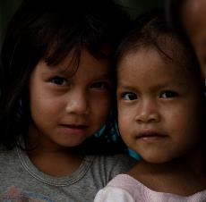
Coffee for a cause –preschool education for underprivileged children
Notes:
Coffee for a cause is helping to raise money to provide preschool education for underprivileged children around the world

Slide 3
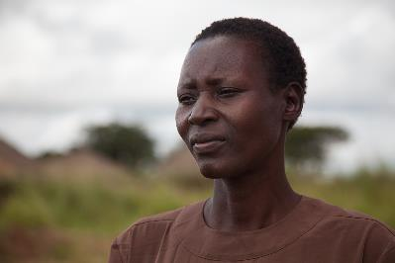
How would you have
got on at primary school if …
Notes:
Invite your church/friends to consider how they would have got on at primary school if they had had to live in circumstances similar to these children

Slide 4
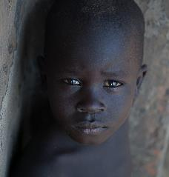
Parents are illiterate
No pencils or books at home
Never sat on a chair at a table
You go to bed hungry
Notes:
These children live in very poor communities. Often their parents are illiterate and so cannot teach even basic reading and writing to their children.
They cannot afford pens, pencils, paper or books and so the children have no opportunity to learn through colouring pictures and copying words.
Their parents often cannot afford furniture and so the children have no experience of sitting on a chair and writing or colouring at a table
Often the family cannot afford sufficient food. The children go to bed hungry or have a very poor diet, lacking in nutrition. This means that they feel lethargic during the day and lack energy.
In some countries children cannot start primary school until they can write their own name. Many underprivileged children are unable to write their own name and so are not accepted at primary schools.

Slide 5
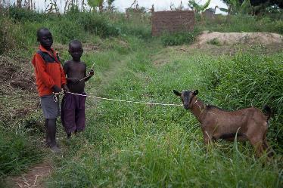
Children are disadvantaged when they start school.
Many give up on education.
Notes:
Without the support and learning through preschool education, many of these people are unable to cope when they start primary school. They soon fall behind their classmates and many give up on education altogether.
This means that they are unable to escape the poverty cycle through education, and face the same suffering through poverty as their parents. They in turn are unable to help their children as they prepare for school.

Slide 6
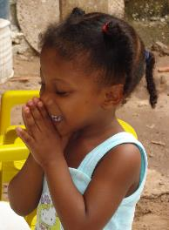
BMS supports preschool projects through the local church that teach:
Writing name/colouring pictures
Sitting at a desk and listening
Basic hygiene
Healthy meal
Good news of Jesus
Notes:
Preschool education helps children prepare for primary school by:
Teaching the children how to hold a pencil, colour in a picture, write their own name
Showing them how to sit at a desk and listen to a teacher
Teaching them basic hygiene such as washing their hands and cleaning their teeth
Giving them a healthy meal and the energy to learn
Telling them the good news of Jesus

Slide 7
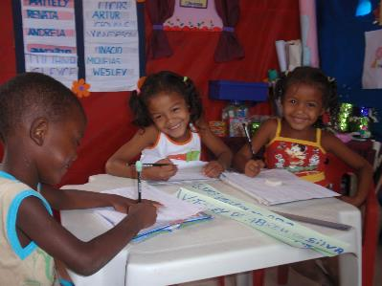
The result?
Notes:
And this is the result

Slide 8
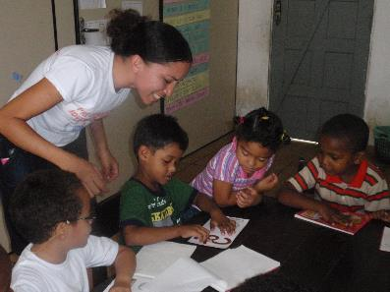
Head start at primary school
Better prospects for the future
First steps to knowing Jesus
Notes:
The children have a head start when they begin primary school
They do not fall behind their classmates
They are more likely to stay on in education
They have better prospects for the future, giving them the tools to help escape the poverty cycle
They take their first steps to knowing Jesus and his love for them

Slide 9
How you can help!
Notes:
And this is how you can help

Slide 10
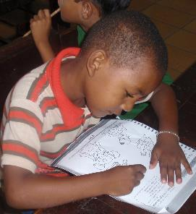
Support the Coffee for a cause event
Just £1 buys 1 day’s schooling
Notes:
Let your church/friends know when the event will take place and the time.
Let them know if a cup of coffee will cost £1 and a slice of cake £1 (or the price you choose) – this will help pay for two day’s schooling!
Explain if you are planning to have other items for sale, eg cards, plants

Slide 11
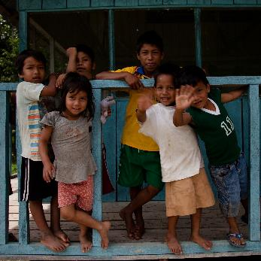
Thank you!
Notes:
Please thank everyone who comes along to the event. This will help vulnerable children and help them on their way to a better future.

