Slide 1
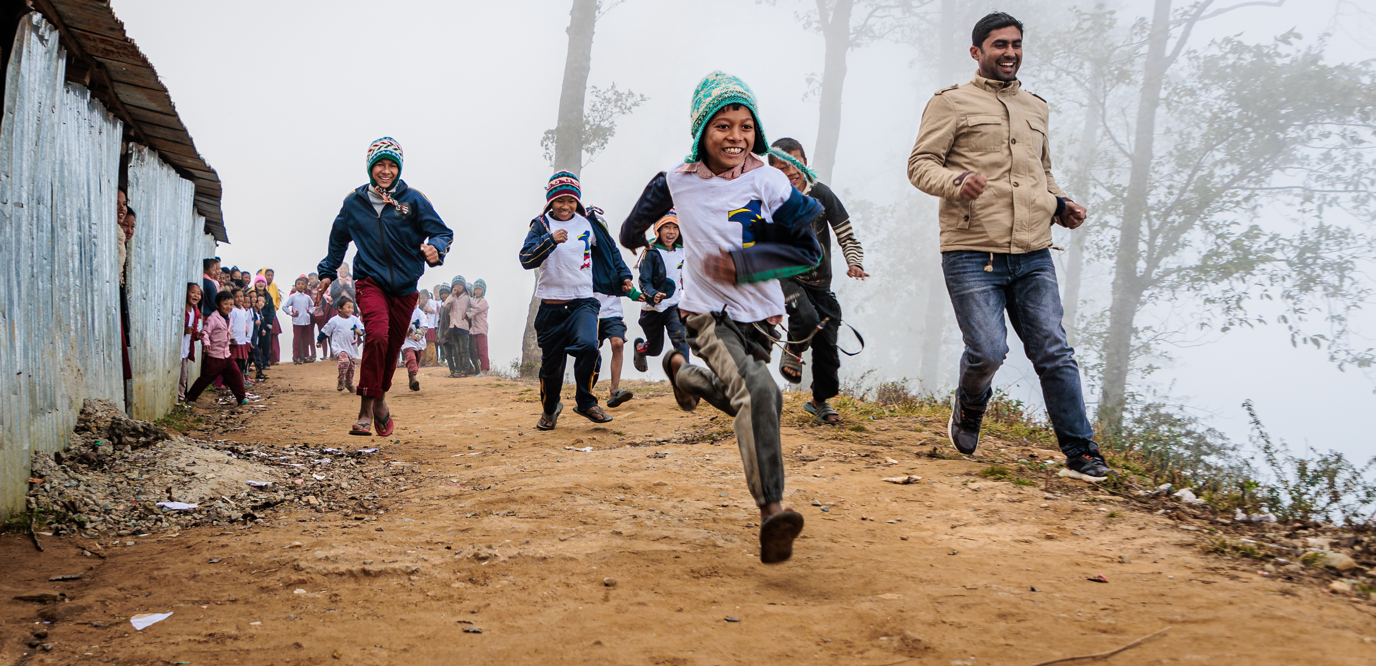

Credit: © Clive Thomas for BMS World Mission
Share abundant life
for generations
tel: 01235 517615
email: legacies@bmsworldmission.org
www.bmsworldmission.org/legacies
Leave a gift in your Will

