Slide 1
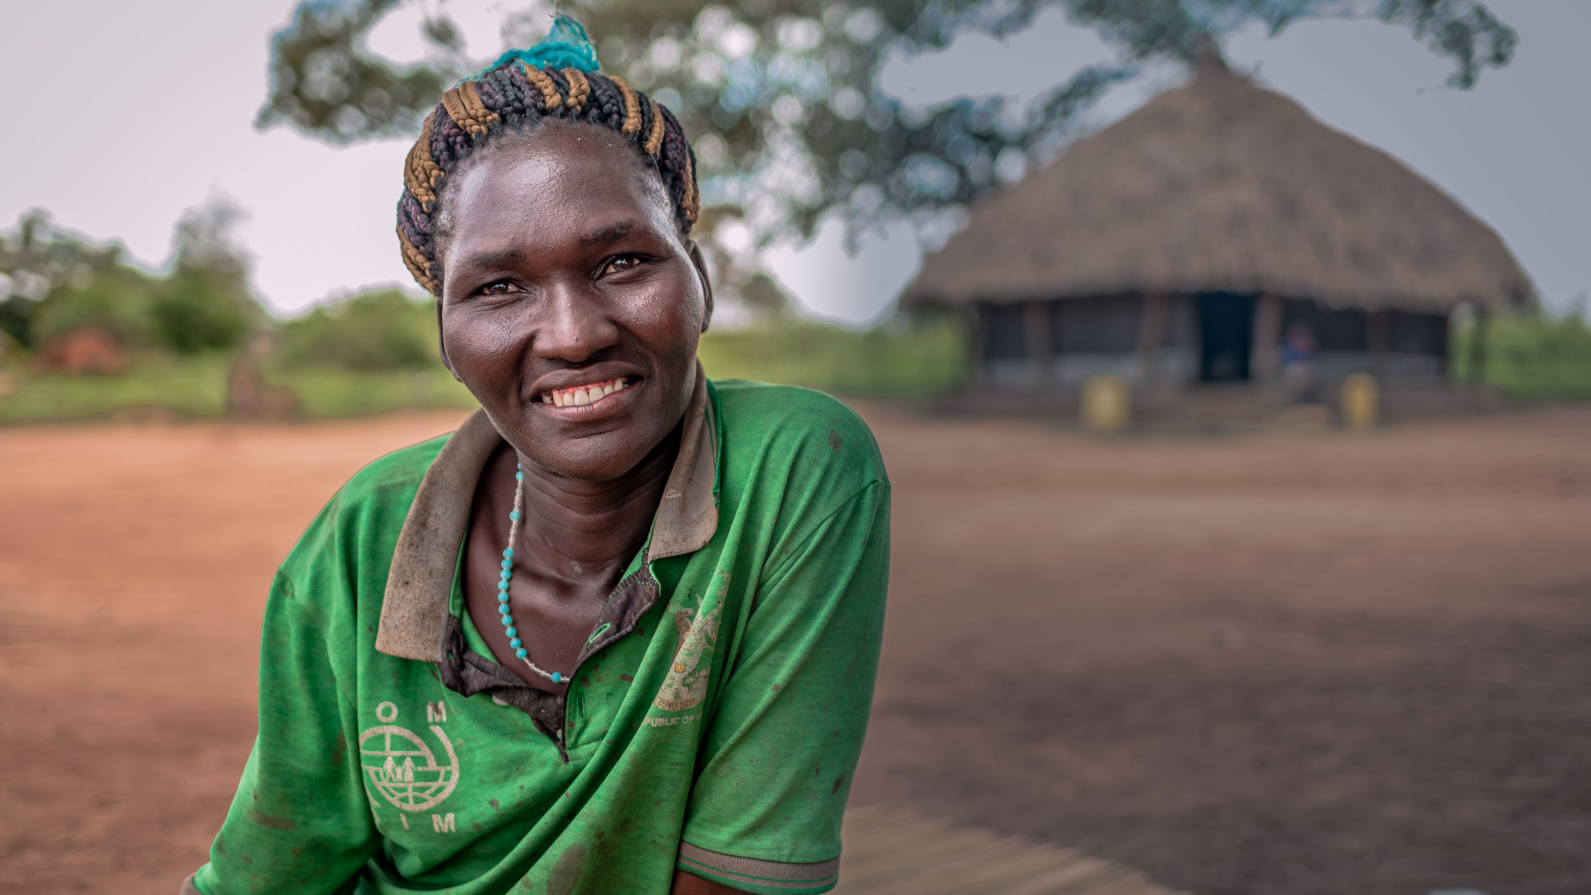
Quiz!

Slide 2
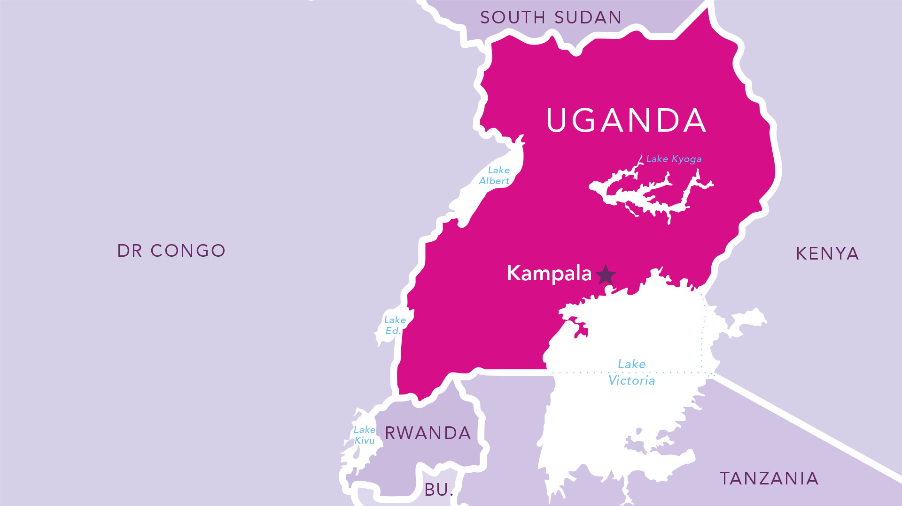
Question 1
Which five countries border Uganda? (5 pts)
Notes:
Question 1 Which five countries border Uganda? (5 pts)

Slide 3
Question 2 How many languages are spoken in Uganda?
57
32
41
Notes:
Question 2 How many languages are spoken in Uganda?
57
32
41

Slide 4
Question 3 Many farmers in Gulu are being helped by BMS’ partner Justice Livelihoods Health (JLH). What percentage of the Ugandan population work in agriculture?
90%
70%
40%
Notes:
Question 3 Many farmers in Gulu are being helped by BMS’ partner Justice Livelihoods Health (JLH). What percentage of the Ugandan population work in agriculture?
90%
70%
40%

Slide 5
Question 4 JLH works through local churches in Gulu to assess the needs of farmers in the area. How many churches does JLH partner with?
15
29
34
Notes:
Question 4 JLH works through local churches in Gulu to assess the needs of local farmers in the area. How many churches does JLH partner with?
15
29
34

Slide 6
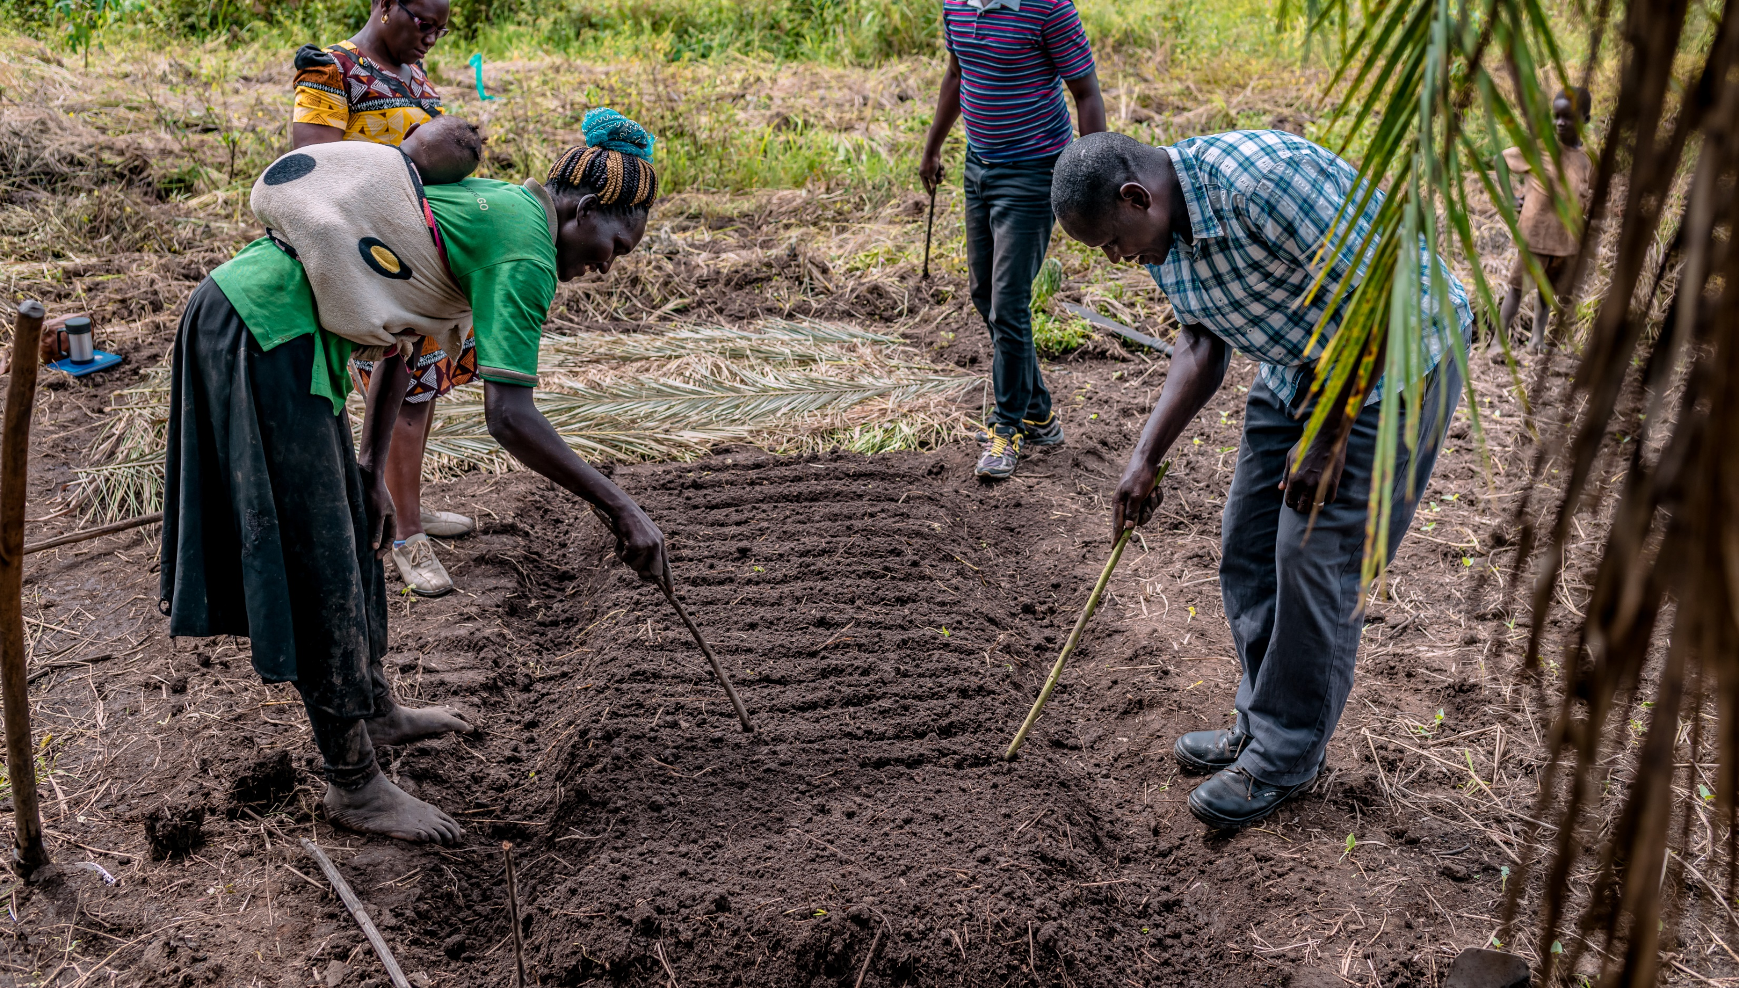
Question 5 Which of these foods would you see growing on a farm in Gulu?
Tomatoes
Sesame seeds
Onions
All of the above
Notes:
Question 5 Which of these foods would you see growing on a farm in Gulu?
Tomatoes
Sesame seeds
Onions
All of the above

Slide 7
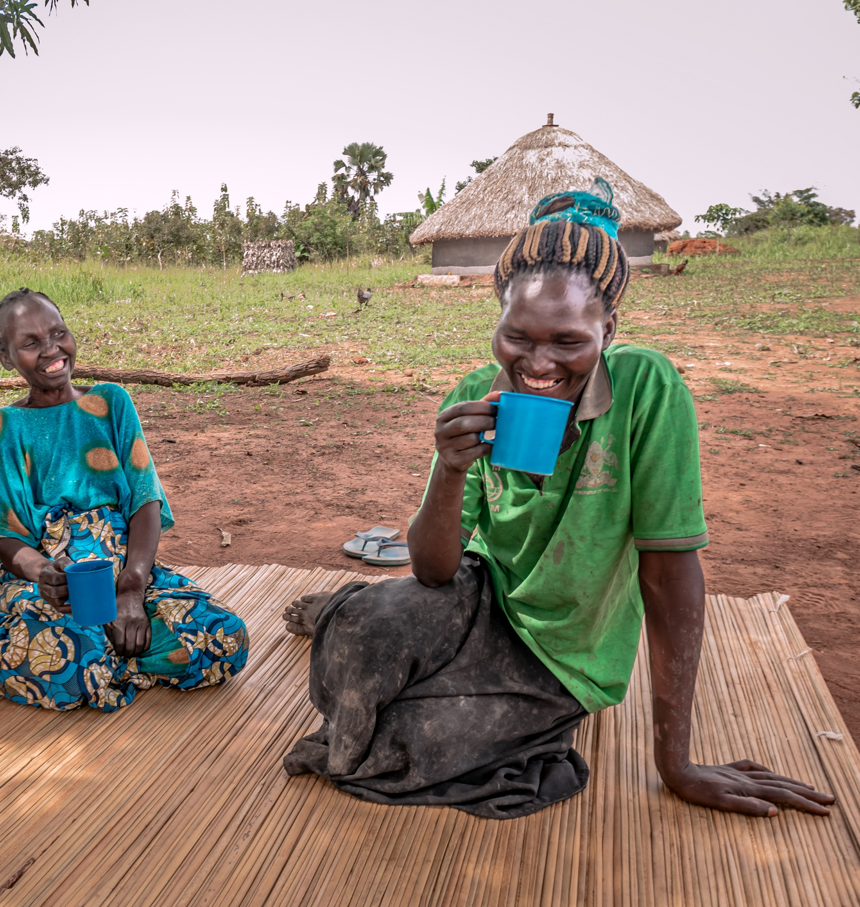
Question 6 Matoke is a famous and delicious Ugandan dish. What does it consist of?
Cooked and mashed bananas
A sauce made of peanuts
Porridge made of maize
Notes:
Question 6 Matoke is a famous and delicious Ugandan dish. What does it consist of?
Cooked and mashed bananas
A sauce made of peanuts
Porridge made of maize

Slide 8
Question 7 When you support Days of Plenty, you help farmers get fair prices for their crops through the Cek Cam project (pronounced ‘chek cham’). But what does Cek Cam mean?
Abundant harvest
Provision
Store house
Notes:
Question 7 When you support Days of Plenty, you help farmers get fair prices for their crops through the Cek Cam project (pronounced ‘chek cham’). But what does Cek Cam mean?
Abundant harvest
Provision
Store house

Slide 9
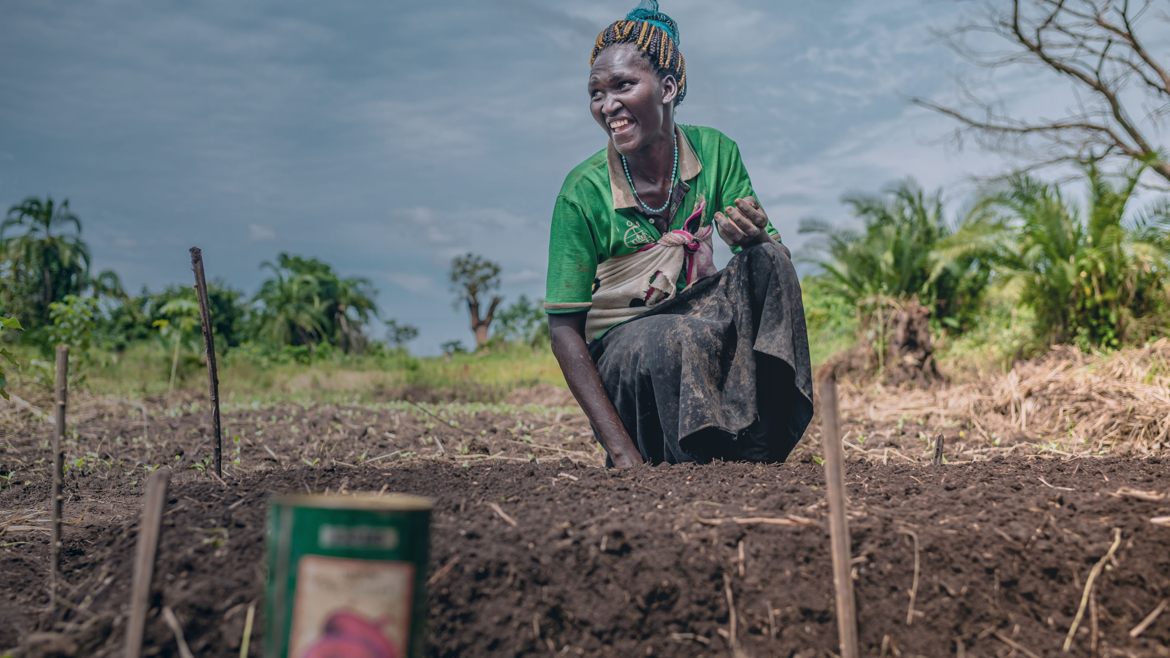
Answers!
Notes:
Days of Plenty Answers!

Slide 10
Question 1
SOUTH SUDAN
Which five countries border Uganda? (5 pts)
KENYA
D R CONGO
RWANDA
TANZANIA
Notes:
Question 1 Which five countries border Uganda? (5 pts) D R Congo Rwanda Tanzania Kenya South Sudan

Slide 11
Question 2 How many languages are spoken in Uganda?
57
32
41
Notes:
Question 2 How many languages are spoken in Uganda?
57
32
41 – CORRECT ANSWER

Slide 12
Question 3 Many farmers in Gulu are being helped by BMS’ partner JLH. What percentage of the Ugandan population work in agriculture?
90%
70%
40%
Notes:
Question 3 Many farmers in Gulu are being helped by BMS’ partner JLH. What percentage of the Ugandan population work in agriculture?
90%
70% - CORRECT ANSWER
40%

Slide 13
Question 4 JLH works through local churches in Gulu to assess the needs of farmers in the area. How many churches does JLH partner with?
15
29
34
Notes:
Question 4 JLH works through local churches in Gulu to assess the needs of local farmers in the area. How many churches does JLH partner with?
15
29 – CORRECT ANSWER
34

Slide 14
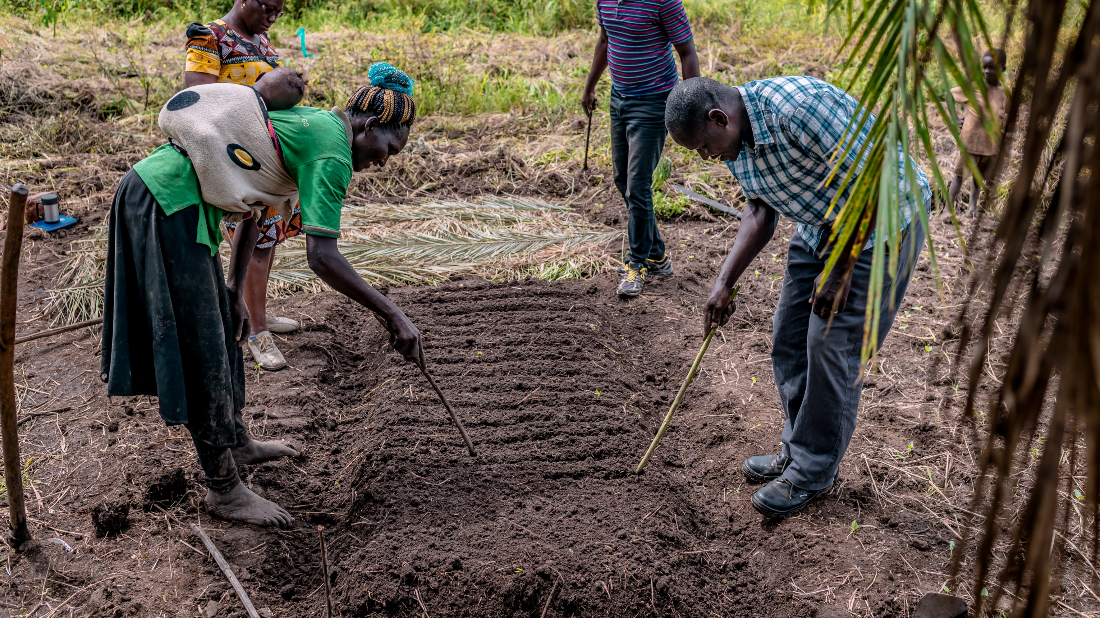
Question 5 Which of these foods would you see growing on a farm in Gulu?
Tomatoes
Sesame seeds
Onions
All of the above
Notes:
Question 5 Which of these foods would you see growing on a farm in Gulu?
Tomatoes
Sesame seeds
Onions
All of the above

Slide 15
Question 6 Matoke is a famous Ugandan dish. What is it made of?
Cooked and mashed bananas
A sauce made of peanuts
Porridge made of maize
Notes:
Question 6 Matoke is a famous Ugandan dish. What is it made of?
Cooked and mashed bananas – CORRECT ANSWER
A sauce made of peanuts
Porridge made of maize

Slide 16
Question 7 When you support Days of Plenty, you help farmers get fair prices for their crops through the Cek Cam project (pronounced ‘chek cham’). But what does Cek Cam mean?
Abundant harvest
Provision
Store house
Notes:
Question 7 When you support Days of Plenty, you help farmers get fair prices for their crops through the Cek Cam project (pronounced ‘chek cham’). But what does Cek Cam mean?
Abundant harvest – CORRECT ANSWER
Provision
Store house

Slide 17
Thank you for supporting Days of Plenty!
Notes:
Thank you for supporting Days of Plenty!

