Slide 1
BARDAï HOSPITAL APPEAL Prayer PowerPoint

Slide 2
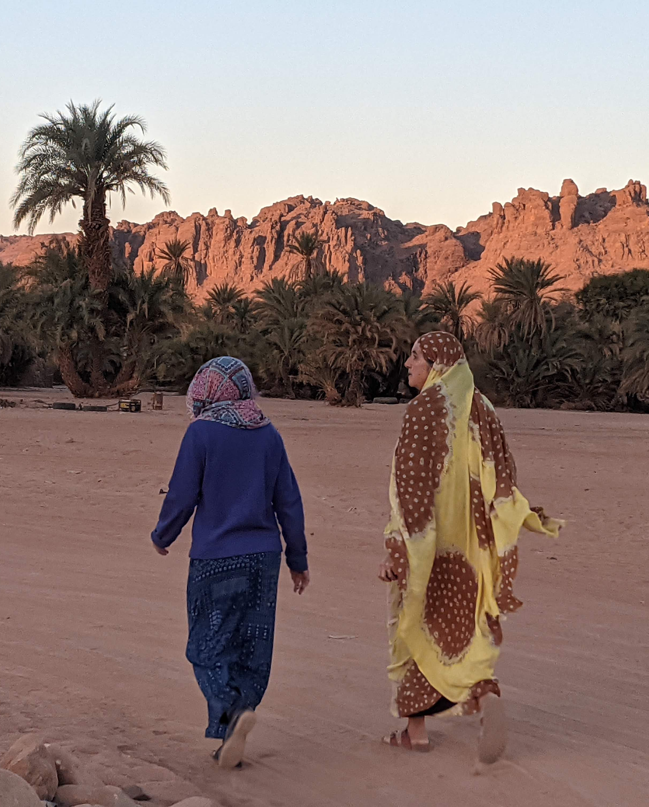
Let us pray
Heavenly Father, we lift the nation of Chad to you. We are saddened to hear that it has gone up in the rankings of most difficult and fragile places to live, owing to recent political instability and the challenges presented by climate change, the economy and more.
Notes:
Let us pray
Heavenly Father, we lift the nation of Chad to you. We are saddened to hear that it has gone up in the rankings of most difficult and fragile places to live, owing to recent political instability and the challenges presented by climate change, the economy and more.

Slide 3
Lord, we thank you:
For the work BMS World Mission surgeons Andrea and Mark Hotchkin are doing to restore hope and health at Bardaï hospital
For the dedicated Chadian staff who have recently been trained in taking and analysing x-rays, enabled by the generosity of BMS supporters
For the opportunity you give us to help, making life-saving work possible
Notes:
Lord, we thank you:
For the work BMS World Mission surgeons Andrea and Mark Hotchkin are doing to restore hope and health at Bardaï hospital
For the dedicated Chadian staff who have recently been trained in taking and analysing x-rays, enabled by the generosity of BMS supporters
For the opportunity you give us to help, making life-saving work possible

Slide 4
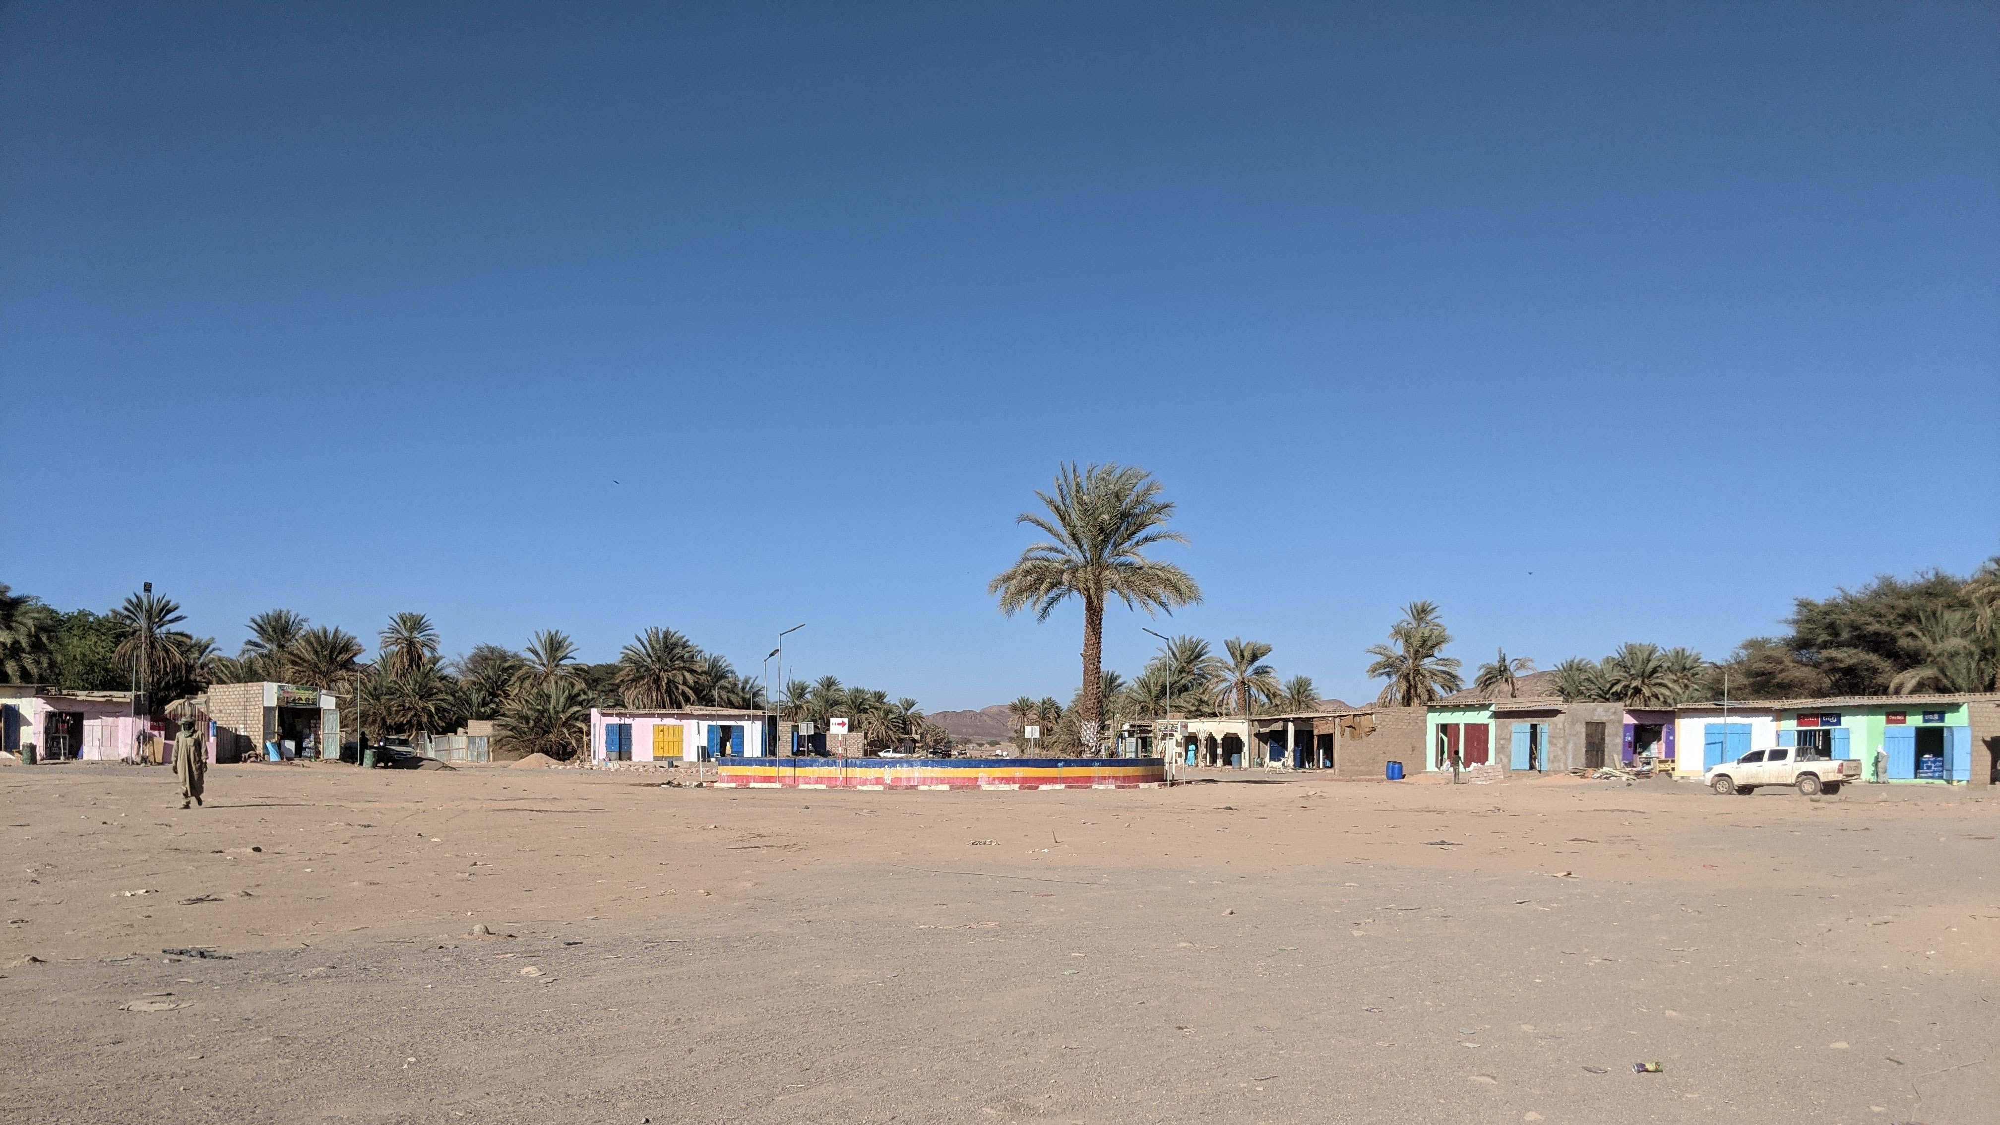
We ask you, Heavenly Father, to intervene in the lives of vulnerable patients. We pray the hospital would have the means to treat them, so they don’t have to risk undertaking dangerous, lengthy and expensive journeys to find medical care.
Notes:
We ask you, Heavenly Father, to intervene in the lives of vulnerable patients. We pray the hospital would have the means to treat them, so they don’t have to risk undertaking dangerous, lengthy and expensive journeys to find medical care.

Slide 5
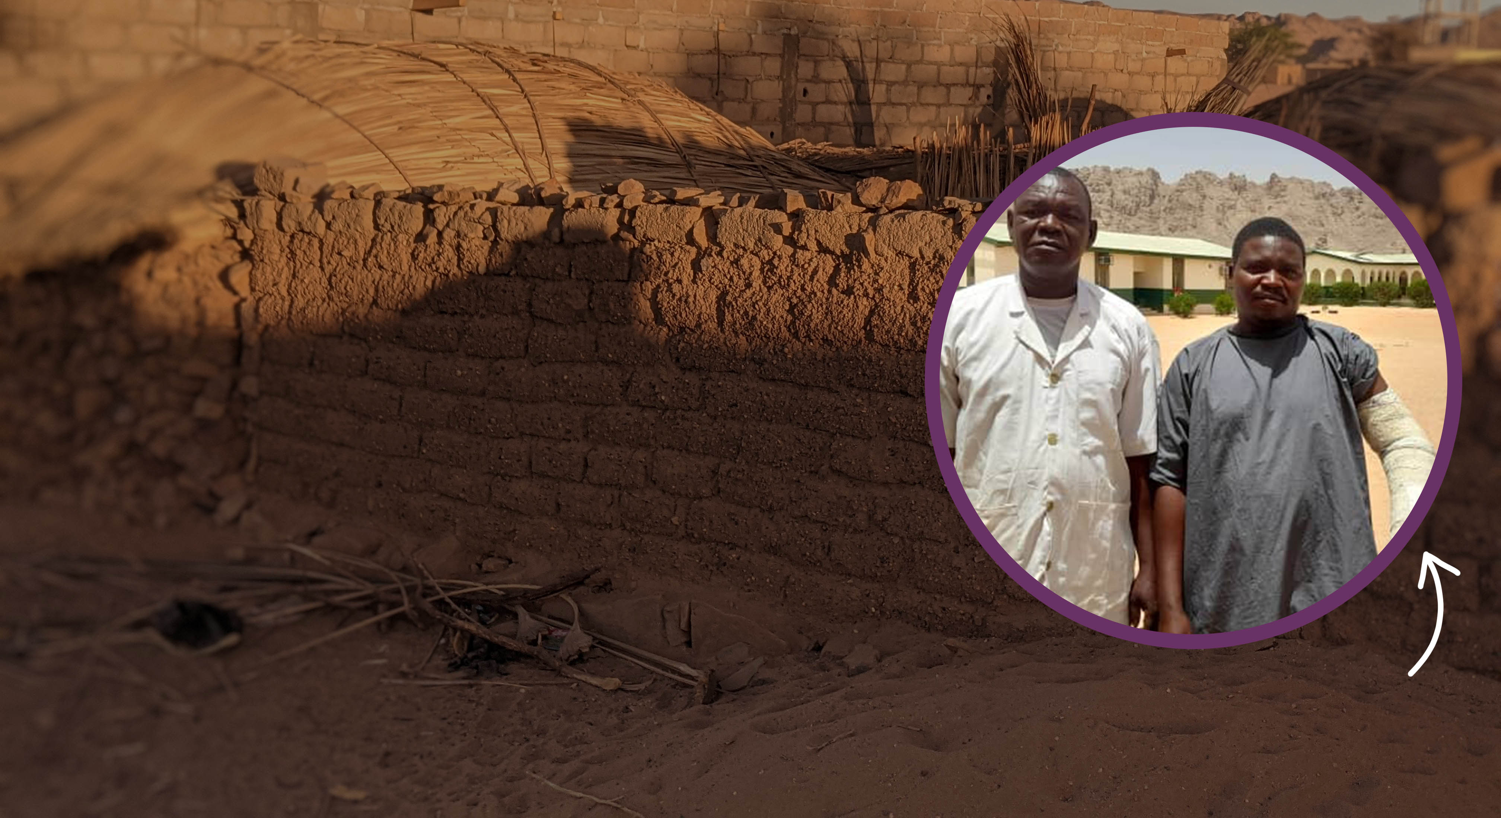
In Chad, the life expectancy is around 50 years old.
Lord God, we pray you would protect patients like Benjamin, who, without the help of the hospital, often have to choose between feeding their families and paying for life-saving treatment.
Benjamin
Notes:
In Chad, the life expectancy is around 50 years old.
Lord God, we pray you would protect patients like Benjamin, who, without the help of the hospital, often have to choose between feeding their families and paying for life-saving treatment.

Slide 6
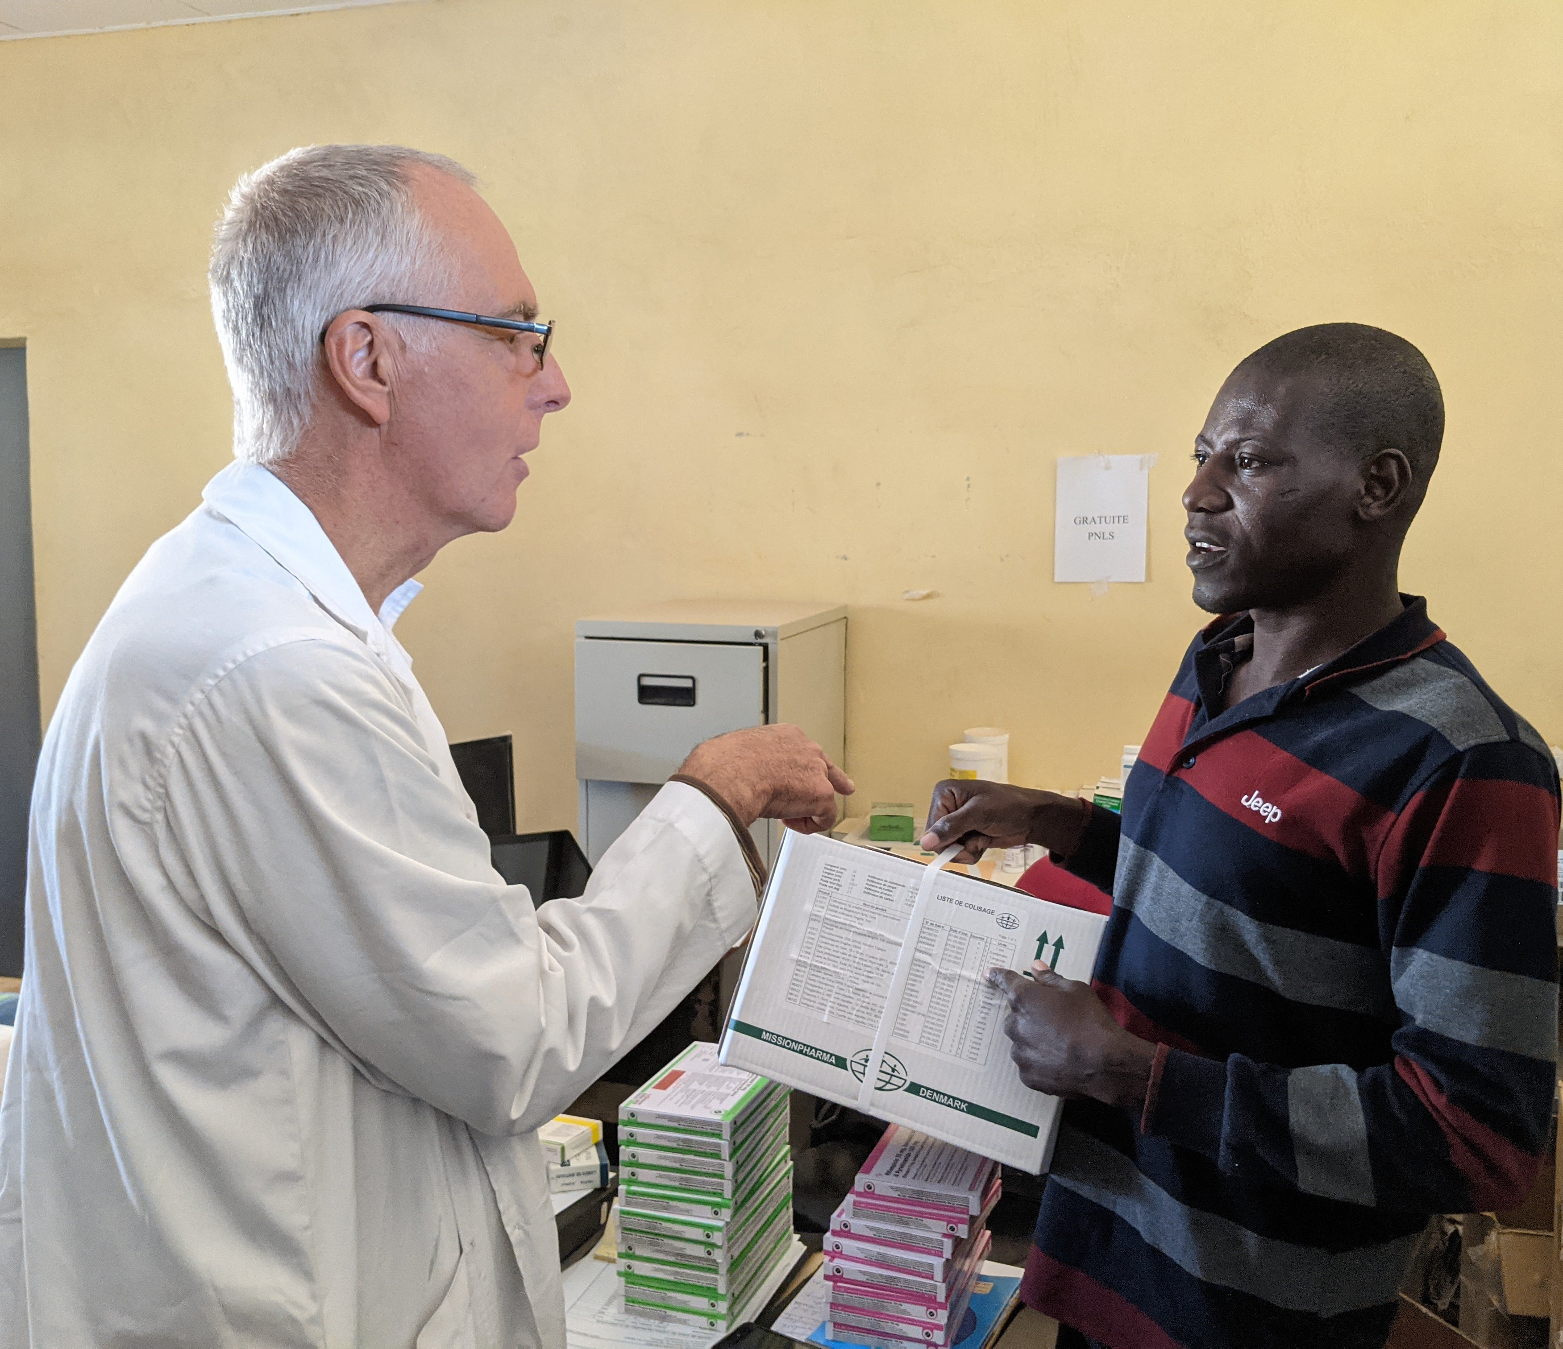
Lord, we pray:
That you would strengthen the team in Bardaï through staffing changes and other challenges that face the hospital
That you would enable vital medication and life-saving treatment to reach those patients who need it most.
Notes:
Lord, we pray:
That you would strengthen the team in Bardaï through staffing changes and other challenges that face the hospital
That you would enable vital medication and life-saving treatment to reach those patients who need it most.

Slide 7
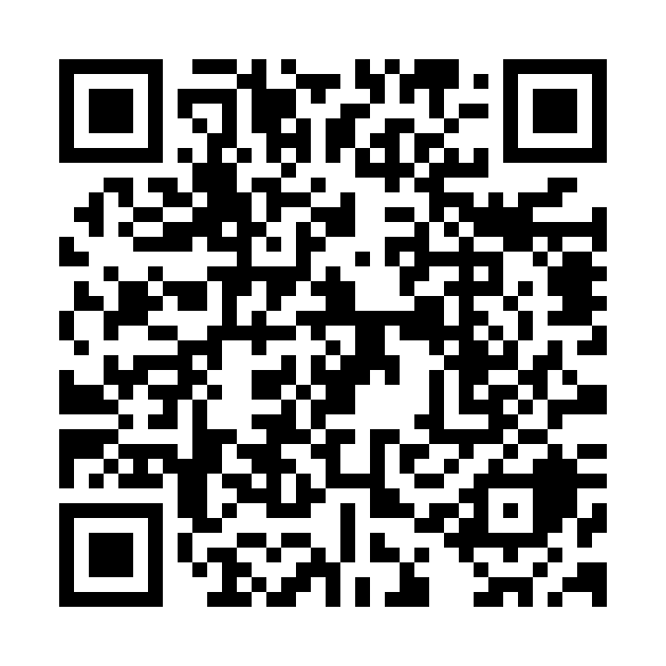
Thank you for your prayers!
To find out more about the Bardaï Hospital appeal and donate today, head to
www.bmsworldmission.org/bardai-hospital
or scan the QR code:
Notes:
Thank you for your prayers!
To find out more about the Bardaï Hospital appeal and donate today, head to www.bmsworldmission.org/bardai-hospital

