Slide 2
Prayers for a troubled nation
Written by Grace, a BMS World Mission Afghanistan-based worker

Slide 3
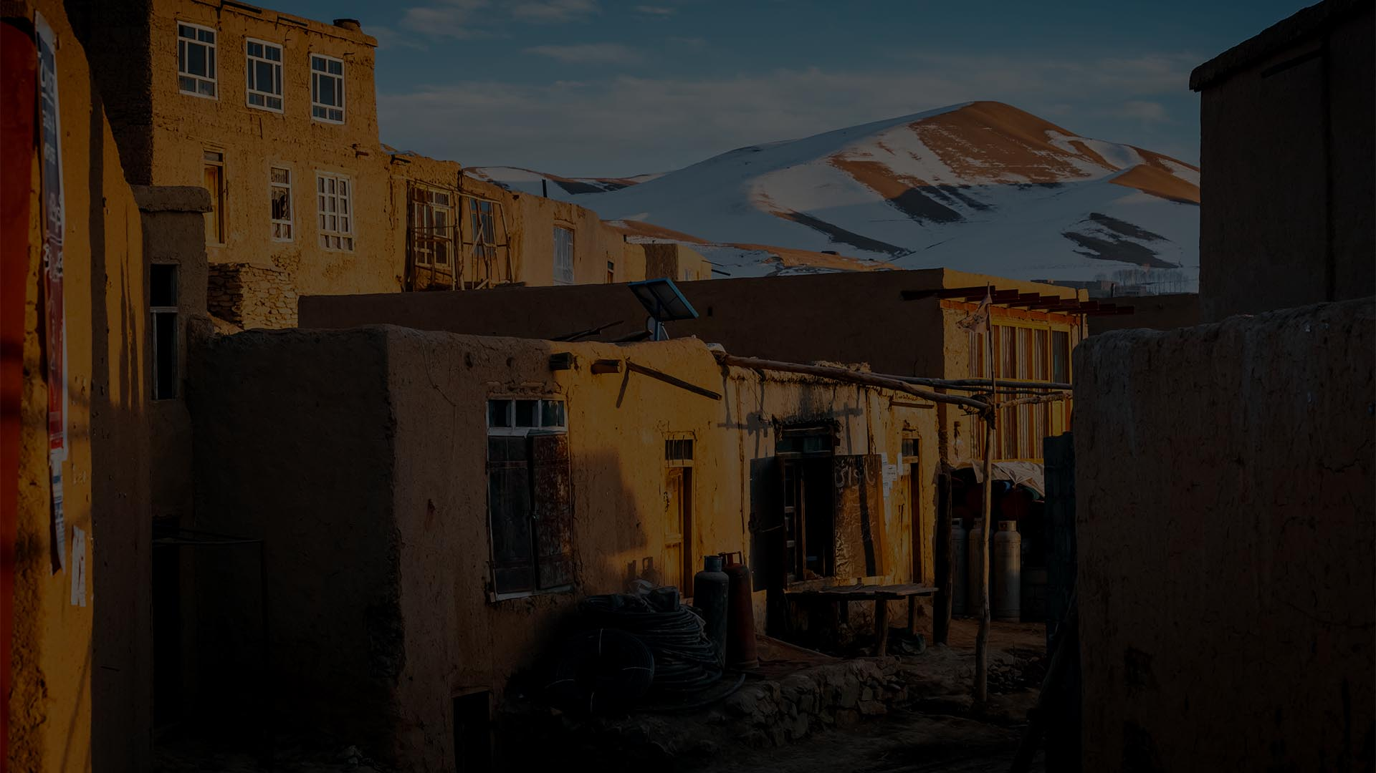
Afghanistan is a country in crisis
In the past year one challenge or disaster has overlaid another

Slide 4
Livelihoods are being lost as the economy crashes
Drought has driven people from their land
Education options for girls have reduced, negatively impacting mental health
High inflation and unemployment mean hundreds of thousands brought to the breadline
Flash flooding has finished off what for many has been a really tough year

Slide 5
Even those who have shown incredible resilience over many years have begun to sound like the psalmists…
“Why, LORD, do you stand far off? Why do you hide yourself in times of trouble?” (Ps 10: 1)
“Why have you forgotten me? Why must I go about mourning, oppressed by the enemy?” (Ps 42: 9)

Slide 6
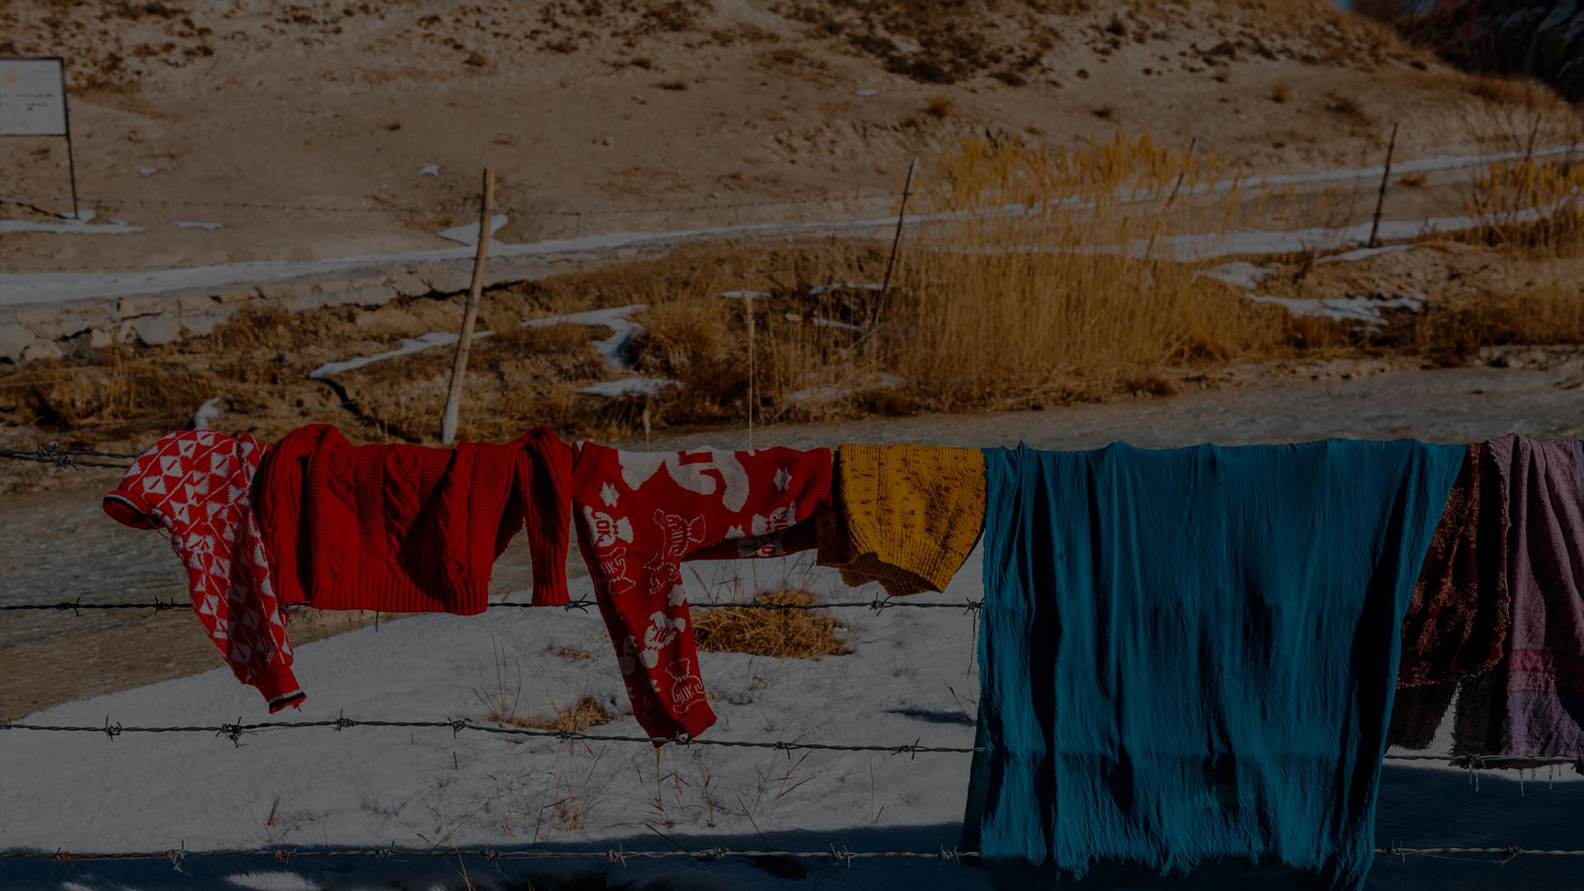
As workers for BMS we have been privileged to be a part of bringing hope in these troubled times.
And yet we know that the only power for real change lies with God - and that the true change needed goes deeper than meeting practical needs.

Slide 7
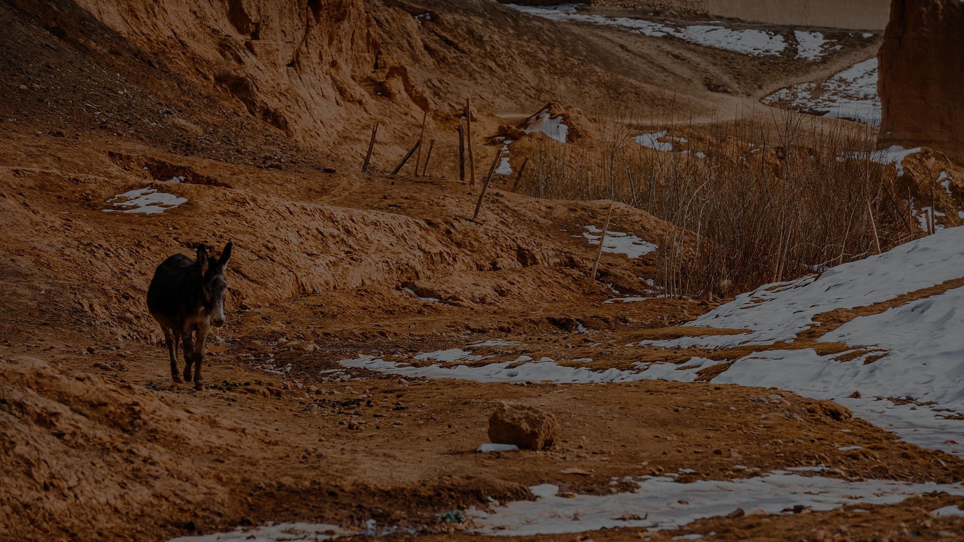
And so we pray…
That as the people of Afghanistan cry out in helplessness, asking questions of God, He will reveal more of himself to them, teaching them new truths, giving them dreams and visions of our Lord and Saviour.

Slide 8
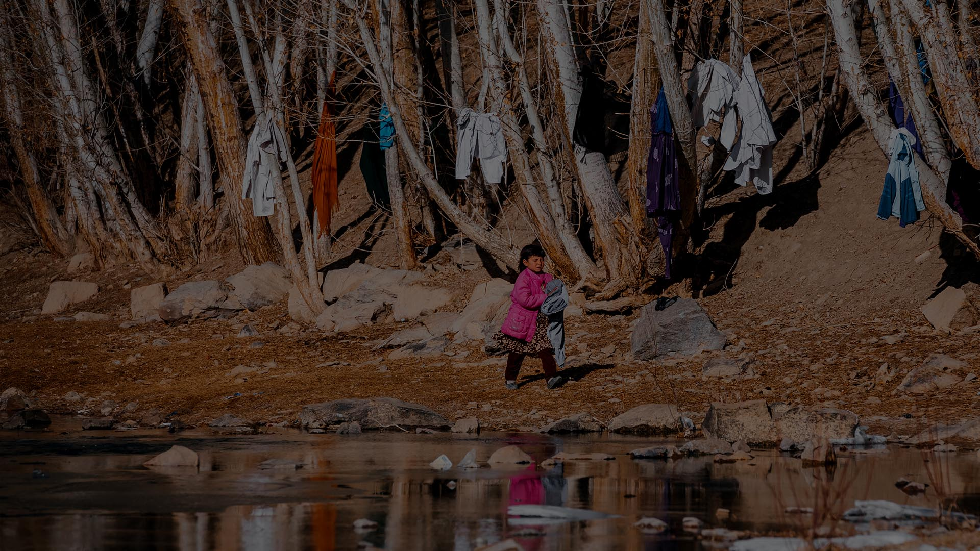
And so we pray…
Not only for the oppressed and marginalised but also for those in positions of power, that they will be wise and compassionate when faced with many problems, making choices that bring hope and life to all peoples.

Slide 9
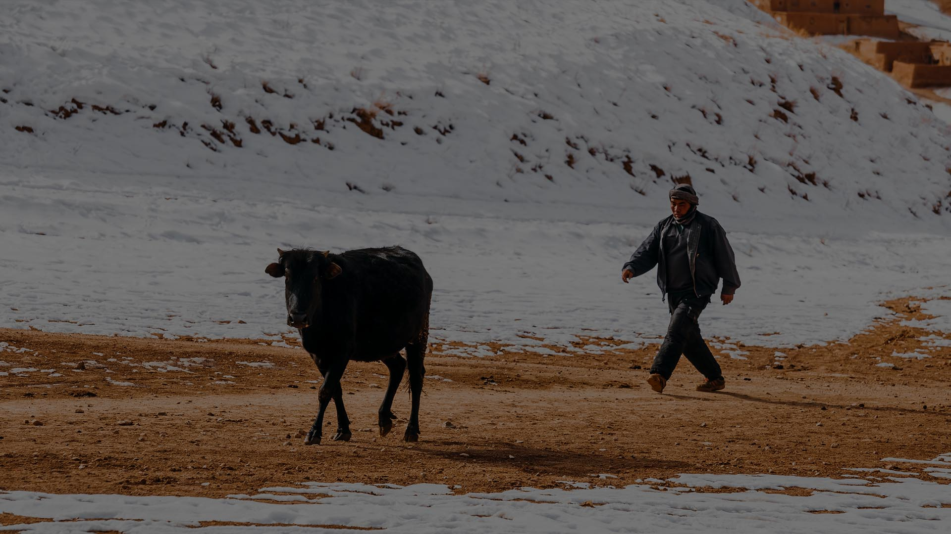
And so we pray…
We ask for help, as the family of God, to faithfully uphold each other in prayer knowing that you gave us to each other, to partner in the work of bringing in kingdom.

Slide 10
Amen

