Slide 1
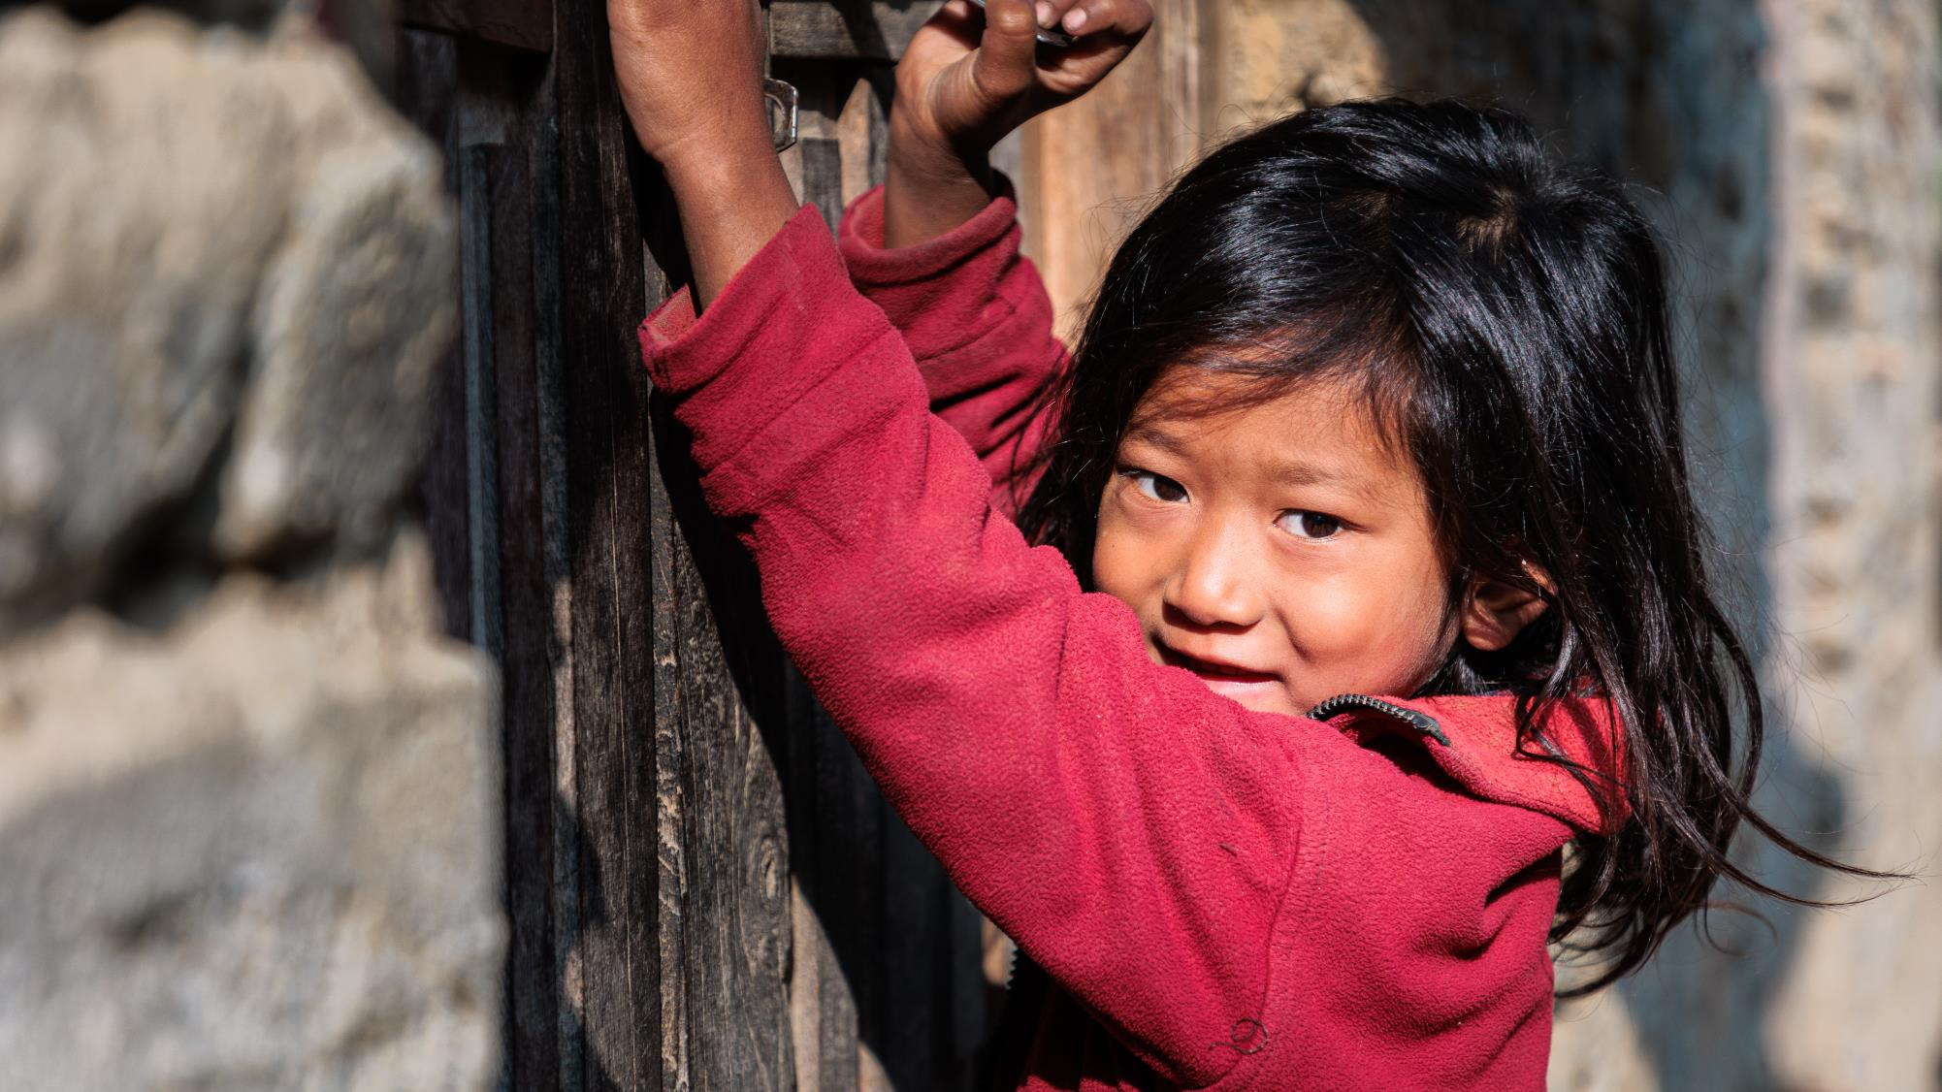
Church quiz

Slide 2
Question 1
Eight of the world’s ten tallest mountains are found in Nepal’s beautiful and rugged mountain ranges.
But can you guess which countries are home to the two tallest mountains not found in Nepal?
a) India and Afghanistan
b) Peru and Tunisia
c) Bhutan and the USA
d) China and Pakistan

Slide 3
Question 2
Ghusel village, featured in the Good Land appeal, is located 2,200 metres above sea level. How many Eiffel Towers, stacked on top of each other, would you need to reach that height?
a) 4
b) 7
c) 15

Slide 4
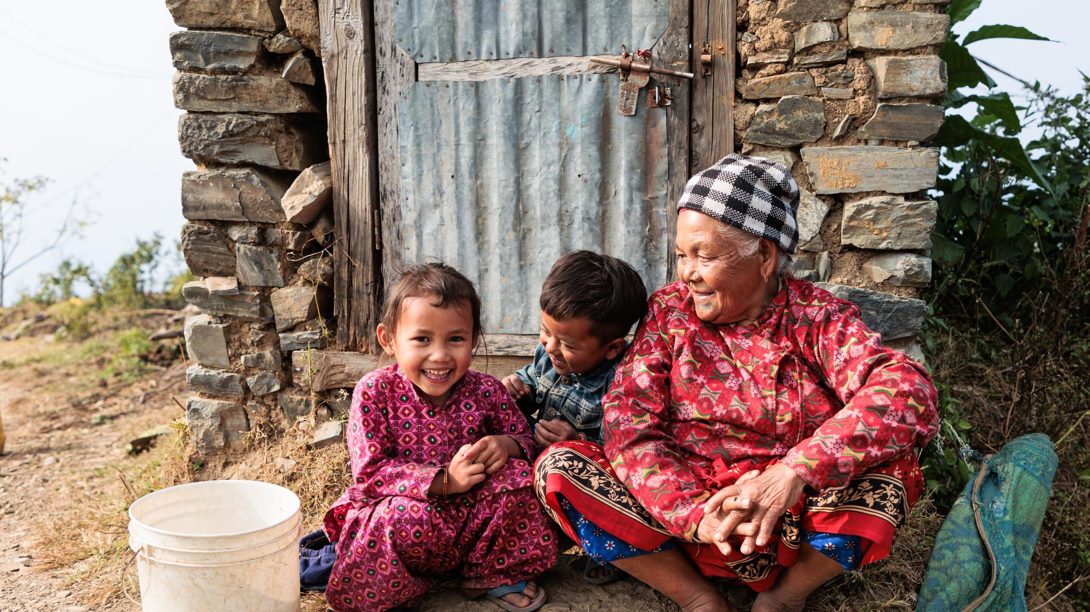
Question 3
The people of Nepal represent many languages, cultures and faiths. Below are just some of the religions followed in Nepal. Can you put them in order from most practiced to least?
a) Islam
b) Hinduism
c) Christianity
d) Buddhism

Slide 5
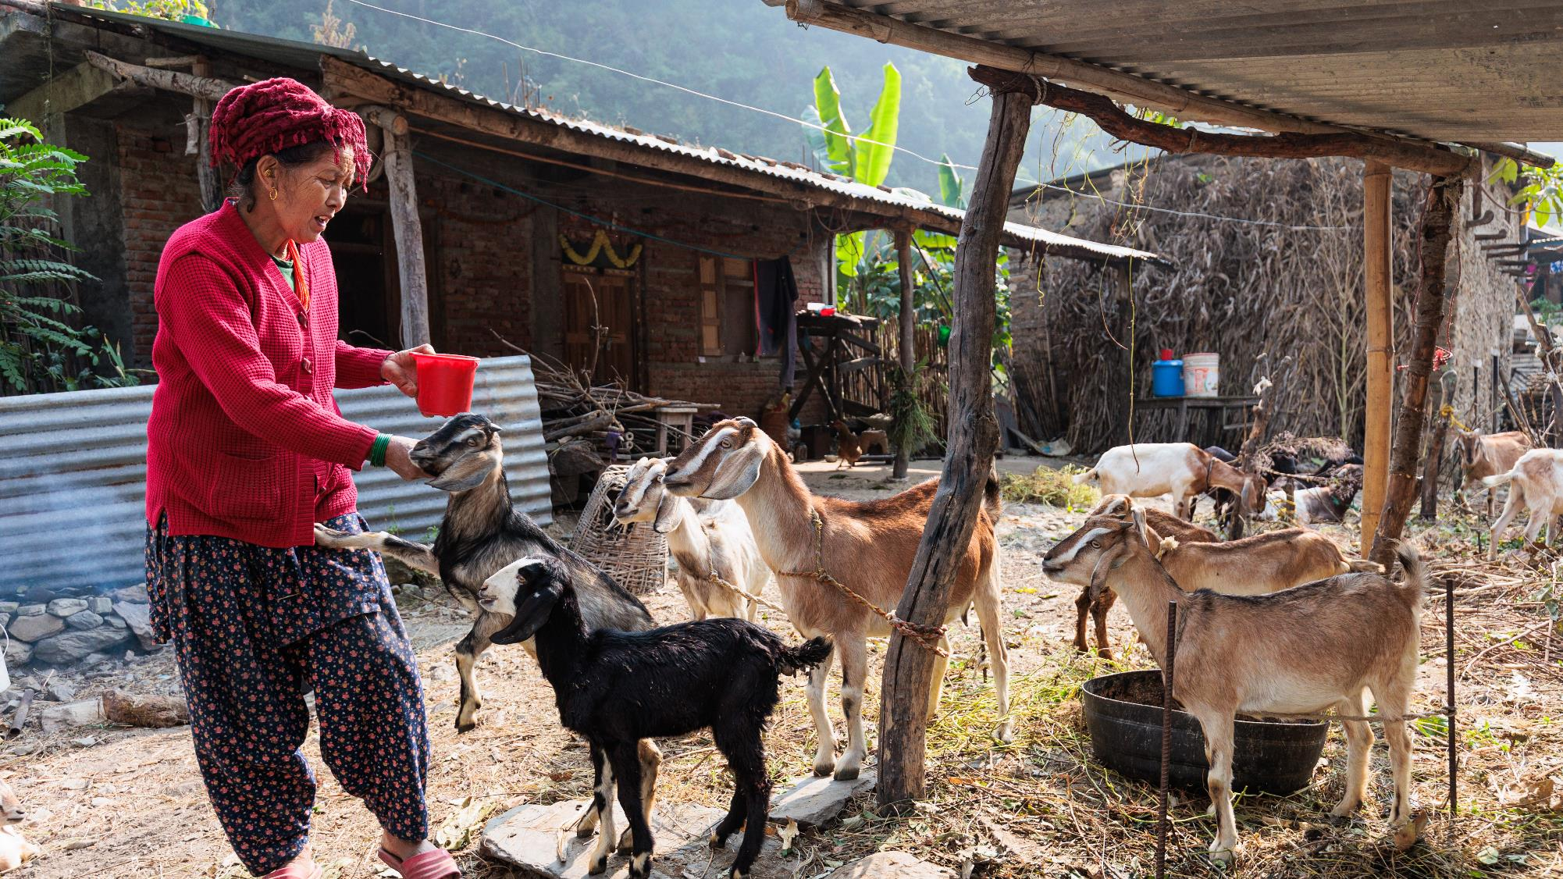
Question 4
Monsoons, earthquakes and landslides can make life much harder for the most vulnerable in Nepal. Can you guess how much rain falls during monsoon season each year?
a) 20 inches
b) 37 inches
c) 58 inches
Notes:
Statistics taken from a 2021 Kathmandu Post article.

Slide 6
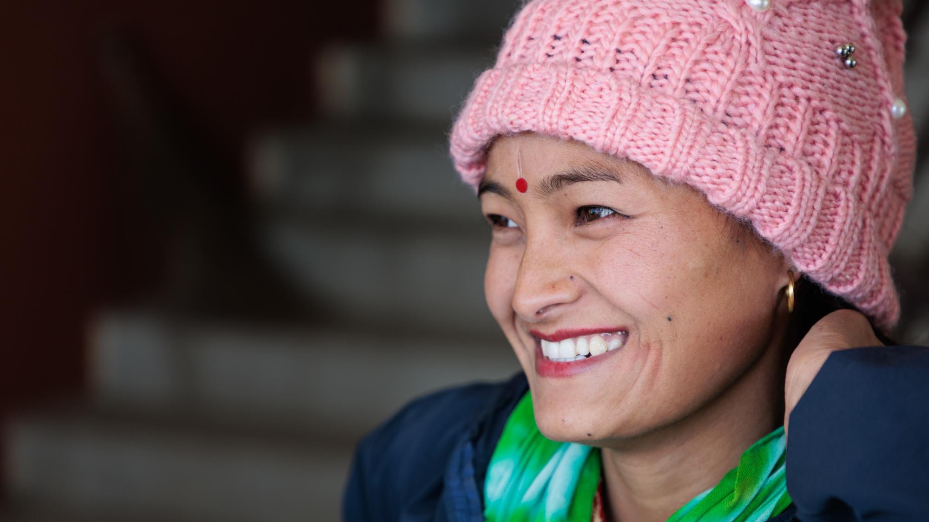
Question 5
Families in Ghusel village rely on animal rearing to make ends meet. Which animals are you most likely to find in Ghusel village?
a) Goats and buffalo
b) Goats and cows
c) Goats and sheep
d) Goats and pigs

Slide 7
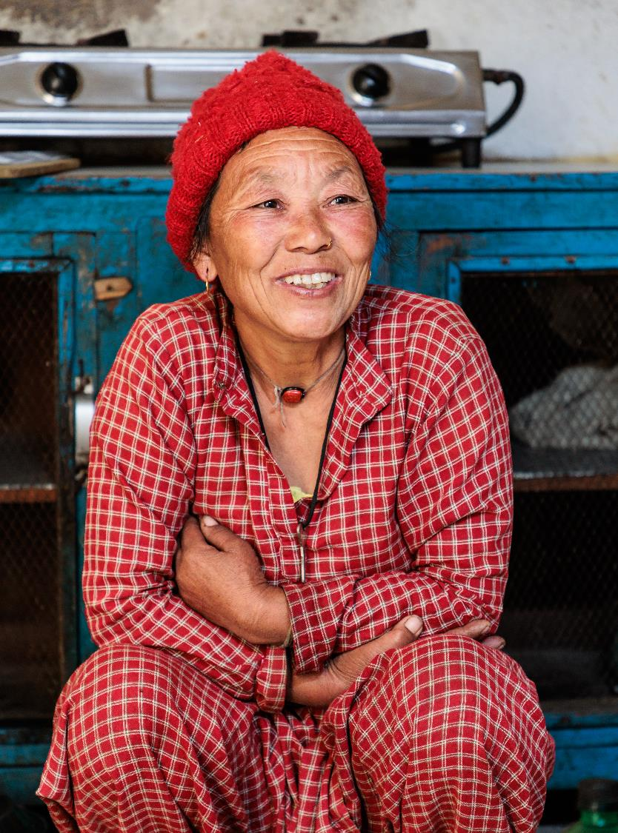
Question 6
Families in Ghusel long for good schooling for their children. How many children from the poorest communities in Nepal currently reach national targets for literacy and maths?
a) 12%
b) 23%
c) 36%
Notes:
Statistics taken from UNICEF's Country Programme Action Plan for Nepal (2018-2022). Here, the poorest communities means the poorest quintile of the population.

Slide 8
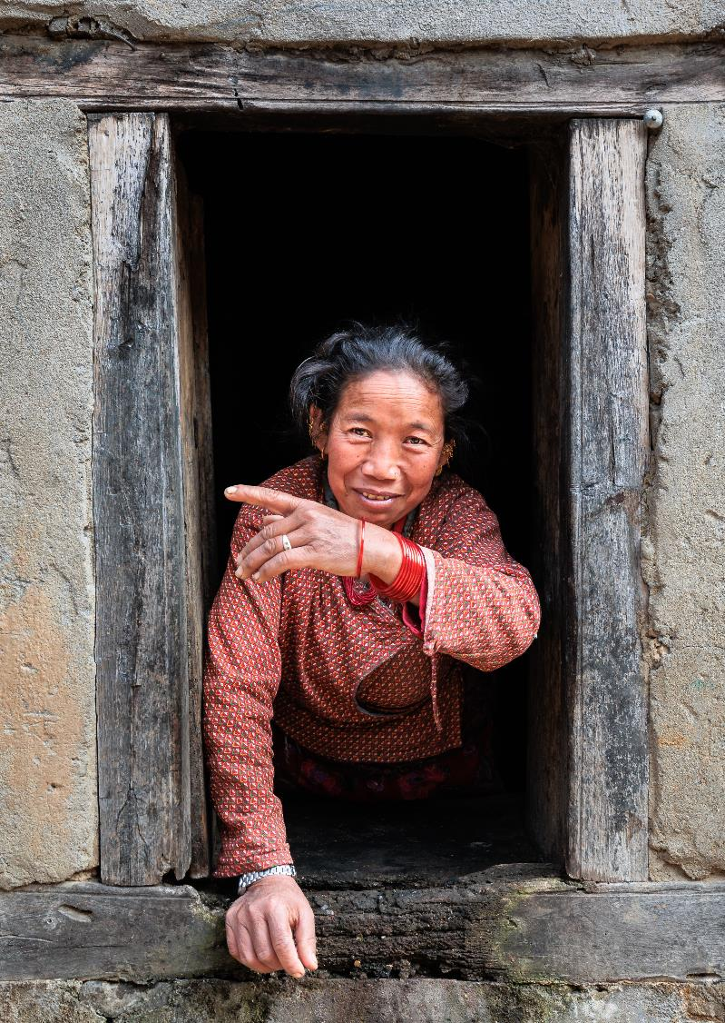
Question 7
The people of Ghusel are amazing. They're created and loved by God. But how many households are there in Ghusel village?
a) Over 100 households
b) Over 400 households
c) Over 800 households

Slide 9
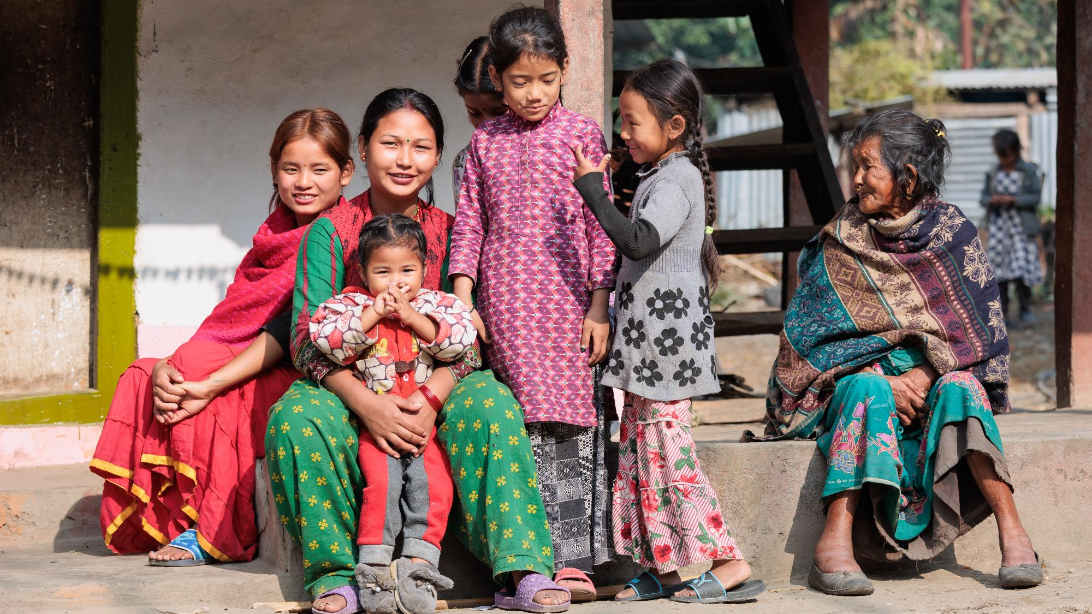
The answers!

Slide 10
Question 1
Eight of the world’s ten tallest mountains are found in Nepal’s beautiful and rugged mountain ranges.
But can you guess which countries are home to the two tallest mountains not found in Nepal?
a) India and Afghanistan
b) Peru and Tunisia
c) Bhutan and the USA
d) China and Pakistan

Slide 11
Question 2
Ghusel village, featured in the Good Land appeal, is located 2,200 metres above sea level. How many Eiffel Towers, stacked on top of each other, would you need to reach that height?
a) 4
b) 7
c) 15

Slide 12
Question 3
The people of Nepal represent many languages, cultures and faiths. Below are just some of the religions followed in Nepal. Can you put them in order from most practiced to least?
a) Islam – 3
b) Hinduism – 1
c) Christianity – 4
d) Buddhism – 2 (One mark for getting them all in the correct order!)

Slide 13
Question 4
Monsoons, earthquakes and landslides can make life much harder for the most vulnerable in Nepal. Can you guess how much rain falls during monsoon season each year?
a) 20 inches
b) 37 inches
c) 58 inches
Notes:
Statistics taken from a 2021 Kathmandu Post article.

Slide 14
Question 5
Families in Ghusel village rely on animal rearing to make ends meet. Which animals are you most likely to find in Ghusel village?
a) Goats and buffalo
b) Goats and cows
c) Goats and sheep
d) Goats and pigs

Slide 15
Question 6
Families in Ghusel long for good schooling for their children. How many children from the poorest communities in Nepal currently reach national targets for literacy and maths?
a) 12%
b) 23%
c) 36%
Notes:
Statistics taken from UNICEF's Country Programme Action Plan for Nepal (2018-2022).

Slide 16
Question 7
The people of Ghusel are amazing. They're created and loved by God. But how many households are there in Ghusel village?
a) Over 100 households
b) Over 400 households
c) Over 800 households

Slide 17
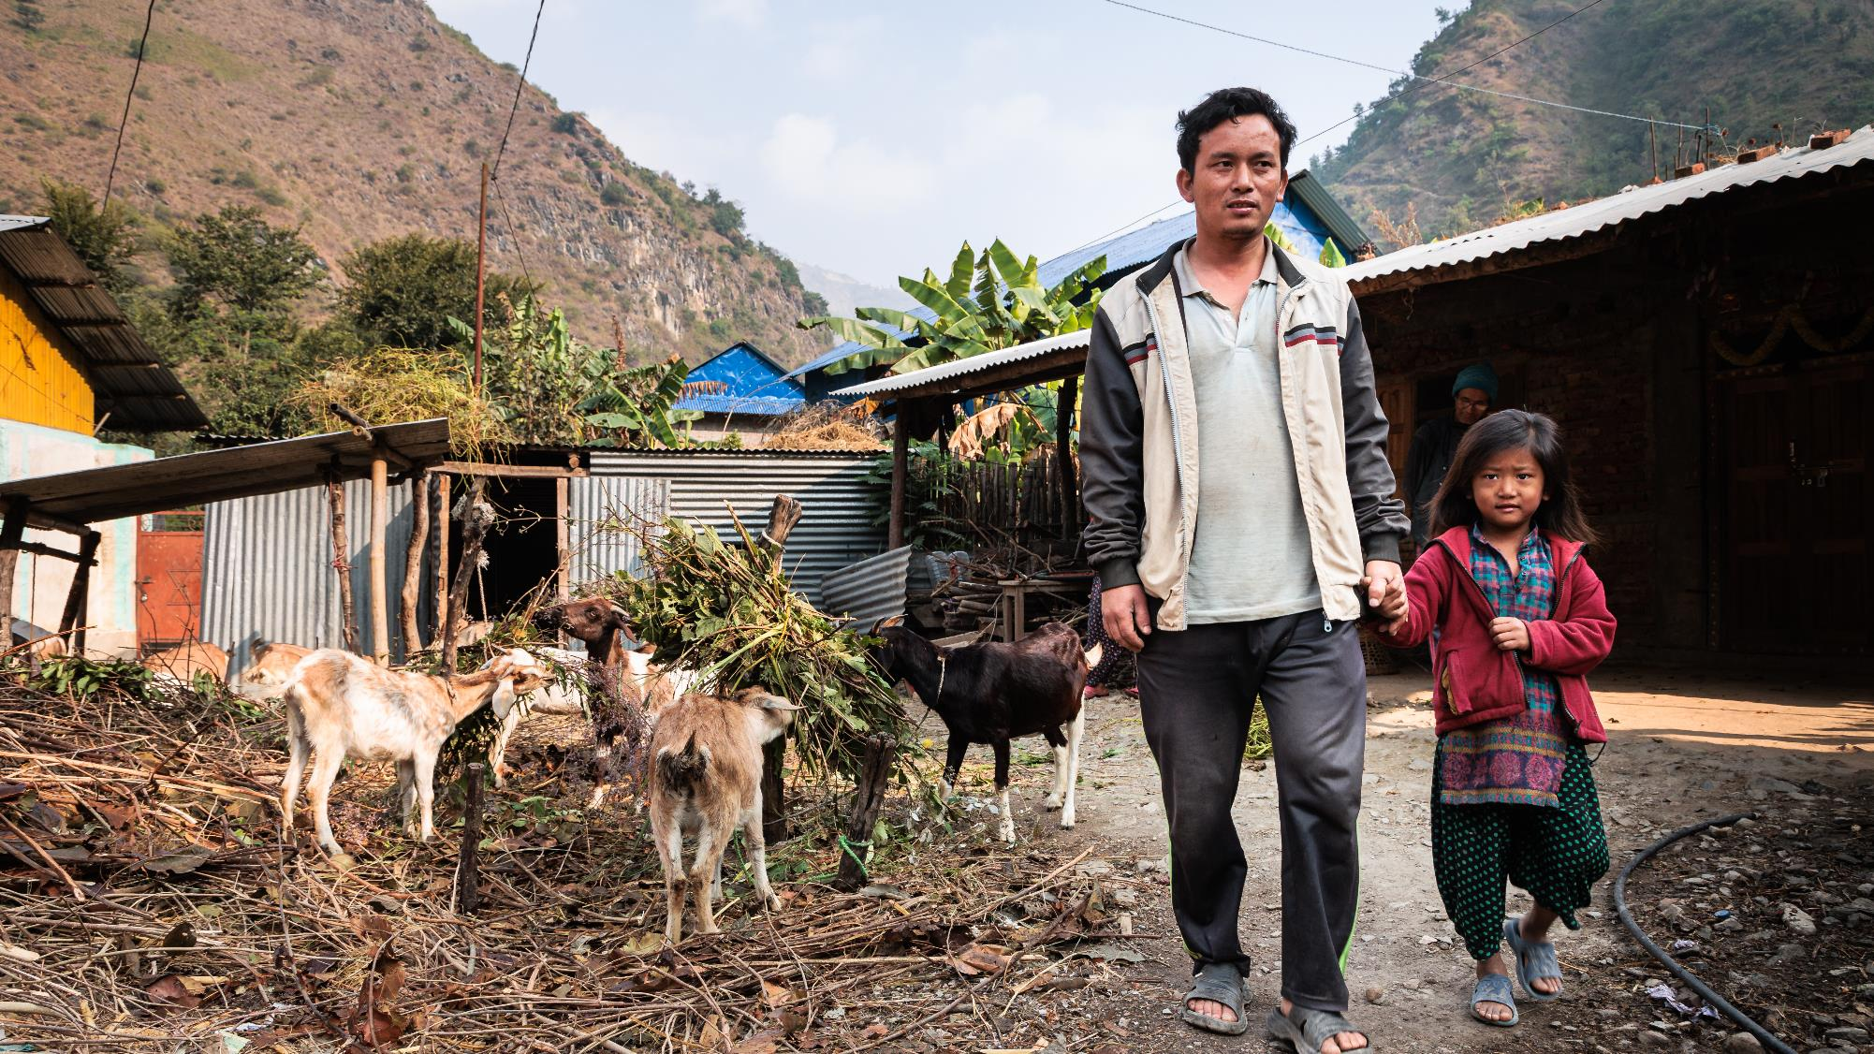
Enjoyed this quiz?
Stand with the people of Ghusel and help them to achieve their dream of transforming their village.
Find out more at www.bmsworldmission.org/goodland
Photo credit: ©Clive Thomas for BMS World Mission

