Slide 2
Prayers for your church
Notes:
Use this PowerPoint to share some prayer points from the countries named in the BMS World Mission Global Cost of Living Crisis appeal.

Slide 3
Notes:
Ukraine is nicknamed ‘The World’s Bread Basket’. It’s estimated that a staggering 50 per cent of the world’s sunflower oil, 20 per cent of the world’s maize and 30 per cent of the world’s barley and wheat come from Ukraine. When instead of growing crops, Ukraine has been forced into growing armies, it’s not surprising that this has had a devastating impact on vulnerable nations across the world.

Slide 4
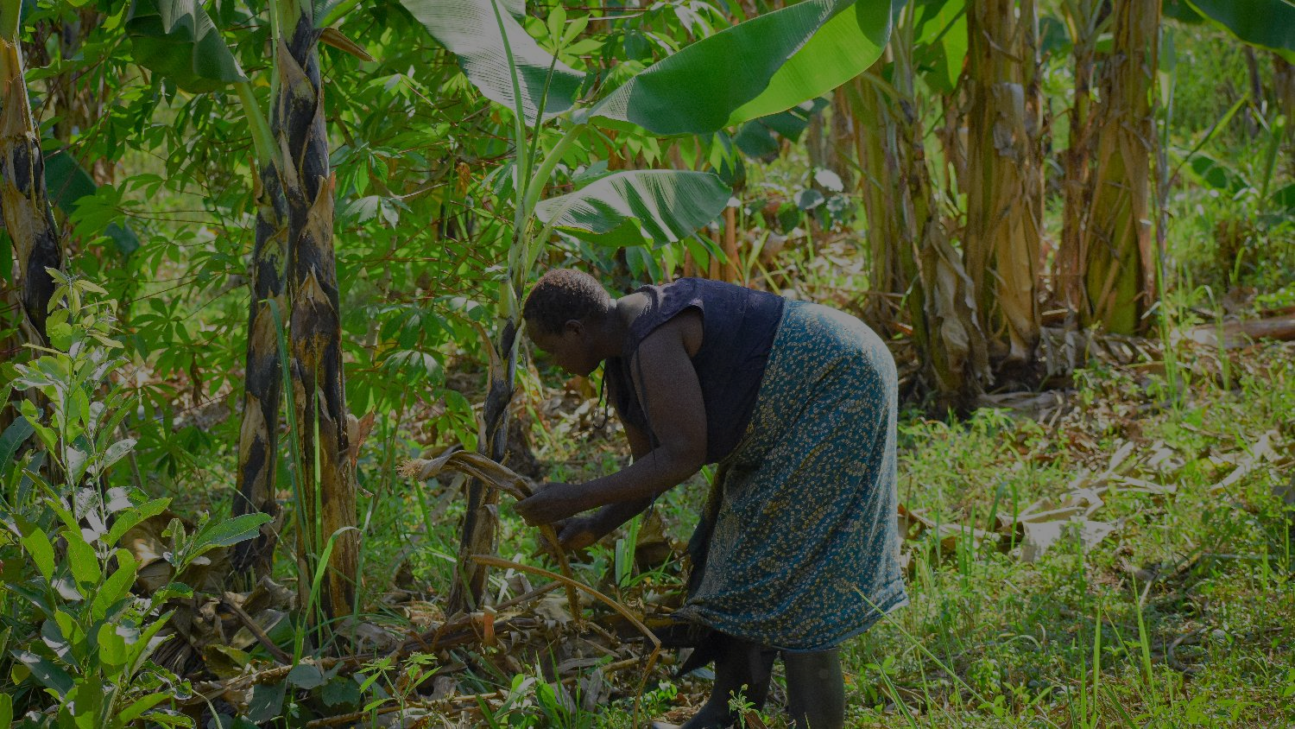
Dear Lord,
We pray for BMS World Mission worker Benon Kayanja, who writes from Uganda with news of fuel prices going up, of the sharp increase in the prices of everyday products and of Ugandans
struggling to make ends meet. We join him in praying for hope for better days and for a return to normal life.
Uganda
Notes:
Dear Lord,
We pray for BMS World Mission worker Benon Kayanja, who writes from Uganda with news of fuel prices going up, of the sharp increase in the prices of everyday products and of Ugandans struggling to make ends meet. We join him in praying for hope for better days and for a return to normal life.

Slide 5
Dear Lord,
We pray for our partners in Lebanon, who tell us that the conflict in Ukraine is already worsening the humanitarian needs in their region and deepening the food crisis they have been going through. The country has started rationing wheat, only allowing it to be used for bread, and people have started stockpiling wheat and yeast, as well as sunflower oil. We pray that the hungry in Lebanon will be fed and that our partners can be your hands and feet in the region.
Lebanon
Photo: Helen Manson for World Renew
Notes:
Dear Lord,
We pray for our partners in Lebanon, who tell us that the conflict in Ukraine is already worsening the humanitarian needs in their region and deepening the food crisis they have been going through. The country has started rationing wheat, only allowing it to be used for bread, and people have started stockpiling wheat and yeast, as well as sunflower oil. We pray that the hungry in Lebanon will be fed and that our partners can be your hands and feet in the region.

Slide 6
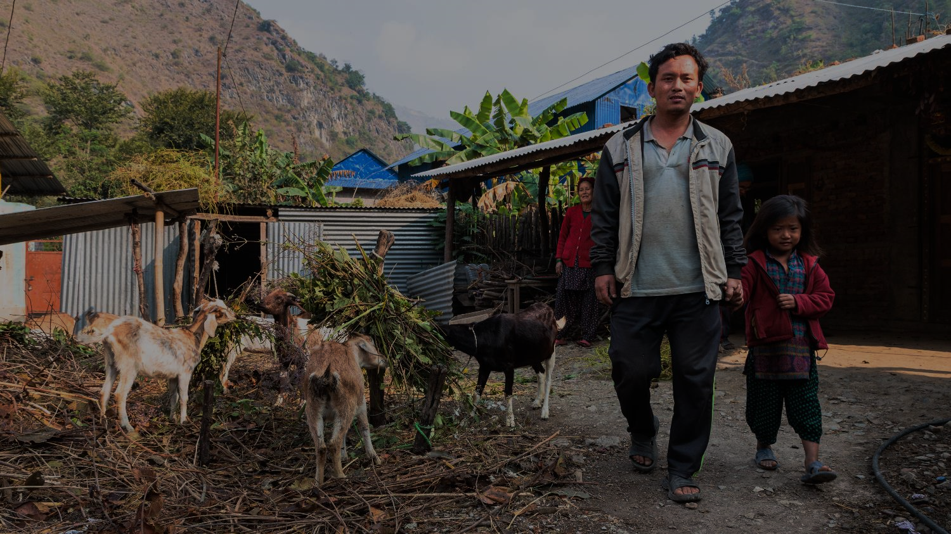
Dear Lord,
We pray for our partners in Nepal, where Dipak Raj Rai tells us that the cost of basic food stuffs is going up every week and that their redevelopment projects are becoming more and more expensive as the price of materials and fuel shows no sign of coming down. We pray that those on the margins in Nepal will be provided for and that a solution can be found.
Photo: ©Clive Thomas for BMS World Mission
Ghusel village, Nepal
Notes:
Dear Lord,
We pray for our partners in Nepal, where Dipak Raj Rai tells us that the cost of basic food stuffs is going up every week and that their redevelopment projects are becoming more and more expensive as the price of materials and fuel shows no sign of coming down. We pray that those on the margins in Nepal will be provided for and that a solution can be found.

Slide 7
AMEN

Slide 8
£29
Could provide veterinary training and breeding goat for one family in Nepal
£88
Could buy seeds to grow vital food and generate income for 11 vulnerable families in Uganda
£160
Could provide a young Syrian refugee in Lebanon with vocational training and schooling

Slide 9
www.bmsworldmission.org/costofliving

