Slide 2
Sleeping on the pavements, studying on the streets: helping children in India to thrive

Slide 3
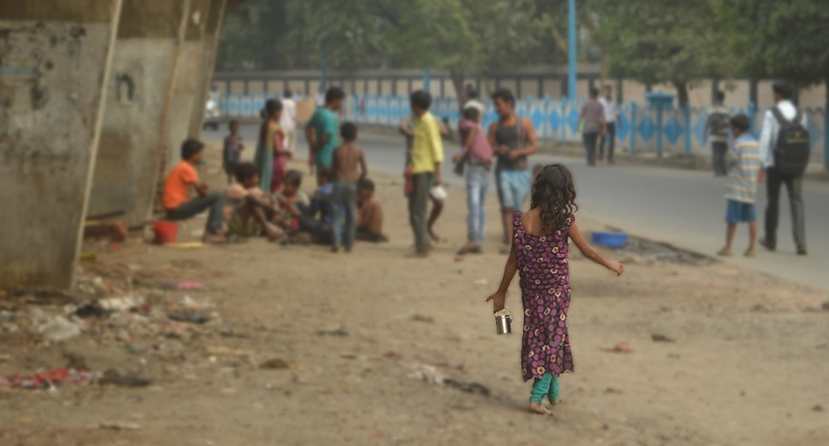
The street school takes place here, underneath this bridge.

Slide 4
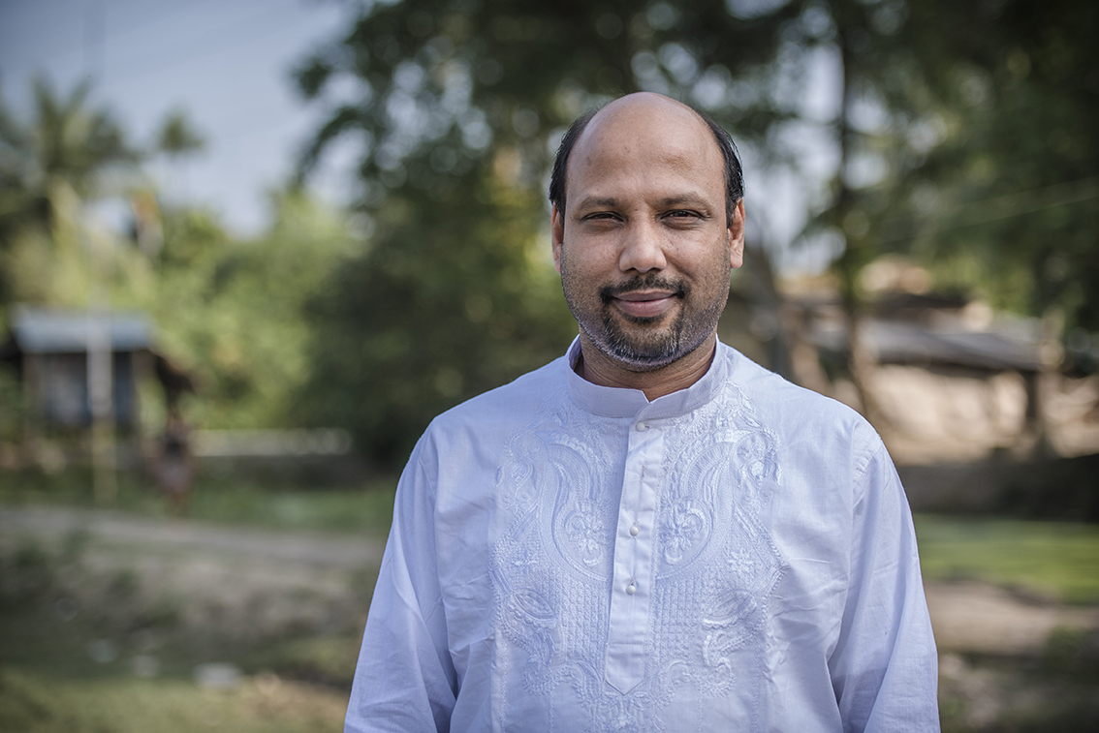
Ben Francis, who helps oversee the Street Servants project in Kolkata.

Slide 5
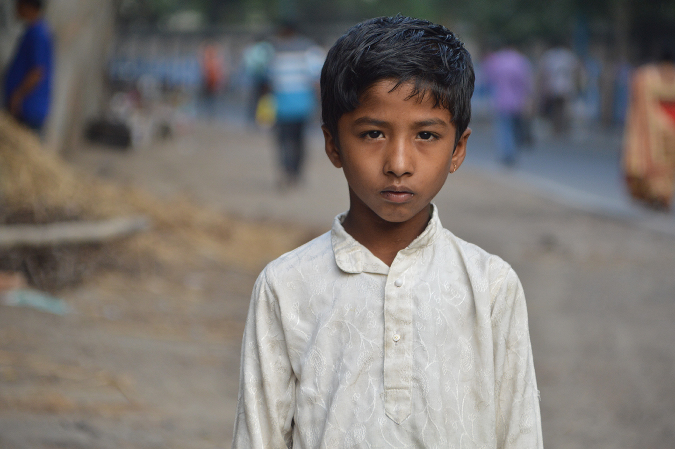
This serious boy is Nawab. Thanks to your support, he's now in a government school along with seven other children from the street school.
Notes:
Nawab was begging outside a horse racing track when the BMS-supported Street Servants met him. After meeting with his parents, the team invited Nawab to come to the street school, along with his two sisters. He excelled. Thanks to the school, Nawab’s life has changed dramatically. Along with seven other children who were taught by BMS-supported teachers in Kolkata, he’s now in a government school. Sat in a busy classroom of children in school uniform, after a life without much structure, the adjustment has not been easy. But now, Nawab has the opportunity of a full education. A way off the streets.

Slide 6
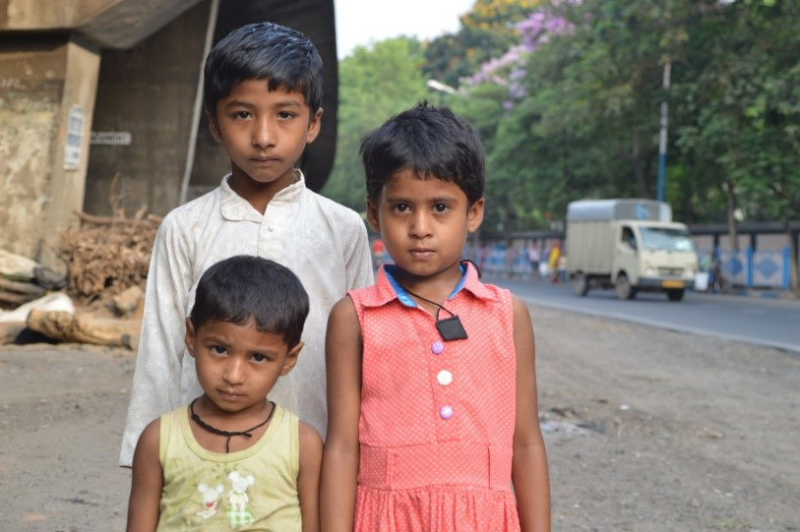
We want to help more children like Nawab. Thank you for being a part of this story! Every gift makes a difference. https://www.bmsworldmission.org/give/

