Slide 2
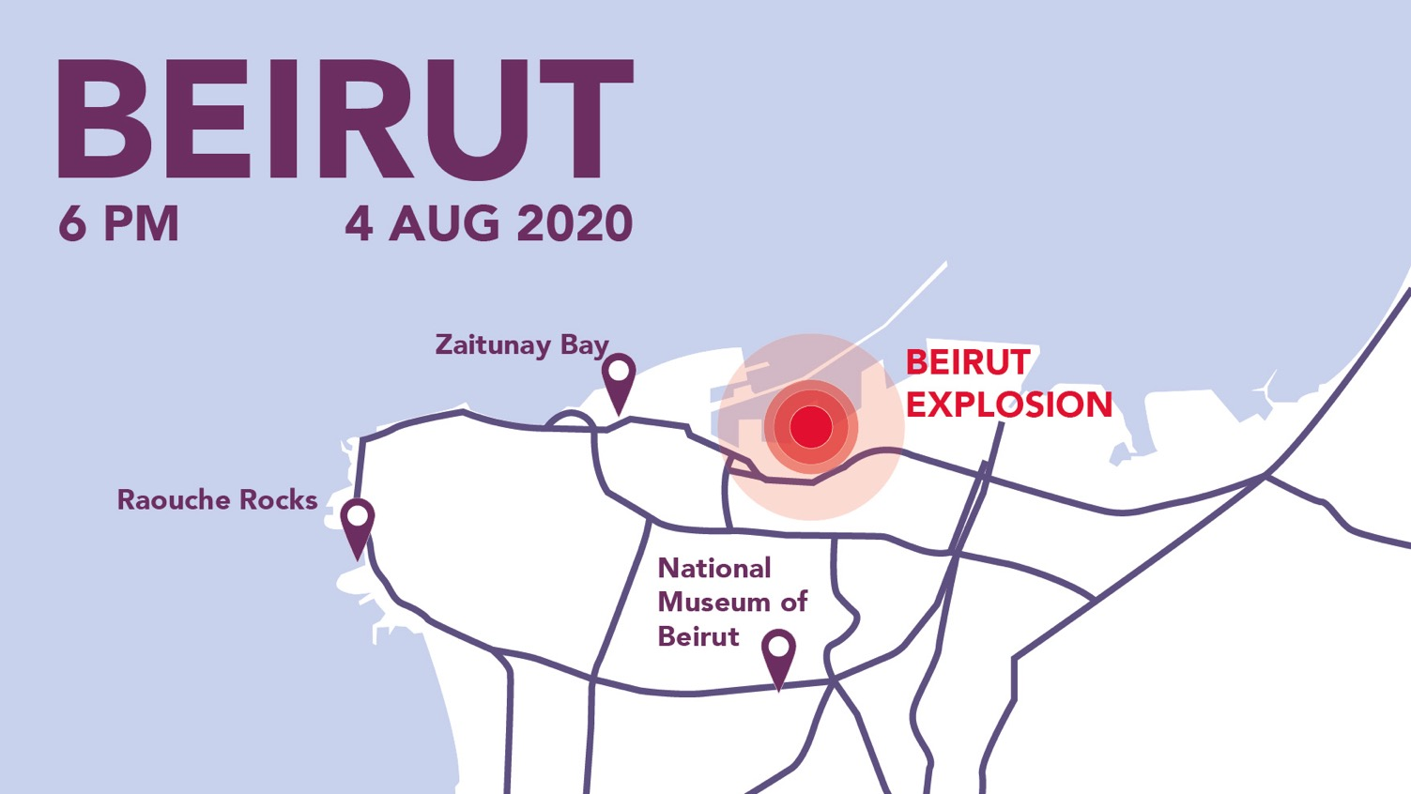

Slide 3
Pray for Beirut:
Please pray for all those who have lost loved ones in the explosion, that they would know God’s comfort.
Pray for those who have been injured, or whose homes and offices have been damaged by the blast.

Slide 4
Pray for Beirut:
Please pray for the doctors, nurses and paramedics who are caring for the injured. Pray that they would have energy and wisdom, and that hospitals would be able to cope with the number of patients they are taking in.

Slide 5
Pray for Beirut:
The people of Lebanon have already faced so much this year – from a collapsing economy to the spread of Covid-19. Please pray for hope for those who are feeling hopeless, and that Christians can be a positive witness in this challenging time.

Slide 6
Pray for Beirut:
Our partners at the Lebanese Society for Educational and Social Development (LSESD) are under a lot of stress (both mentally and physically) as they seek to support the most vulnerable in an increasingly volatile context. Pray for wisdom, energy, protection and strength for this dedicated team.

Slide 7
Pray for Beirut:
Pray for refugees living in Lebanon, who may be reminded of past trauma following the explosion. Pray for BMS work supporting Syrian refugee children in Beirut.

Slide 8
Pray for Beirut:
Pray for staff and students at the Arab Baptist Theological Seminary (a department of LSESD), based in Beirut. Pray that they would experience the peace of Christ and would be used as vessels to bring that peace to others.

Slide 9
Visit www.bmsworldmission.org/beirut to give to our Beirut appeal.

