Slide 1
Remembering the Easter bombings:
prayer for Sri Lanka

Slide 2
One year ago, on Easter Sunday (21 April 2019), more than 250 people were killed in co-ordinated attacks on churches and hotels in Sri Lanka.
On what should have been a great day of celebration, six bombs exploded, leaving the country in mourning.

Slide 3
Today, the people of Sri Lanka are facing yet another crisis – Coronavirus.

Slide 5
You didn’t forget Sri Lanka last year, and you haven’t forgotten them today.
Because of your generous giving, in 2019 BMS World Mission was able to give £20,000 to our partners in Sri Lanka. Your gifts enabled children and families directly affected by the attacks to receive the psychosocial support they desperately needed to begin to work through the trauma they experienced and to feel safe again.

Slide 6
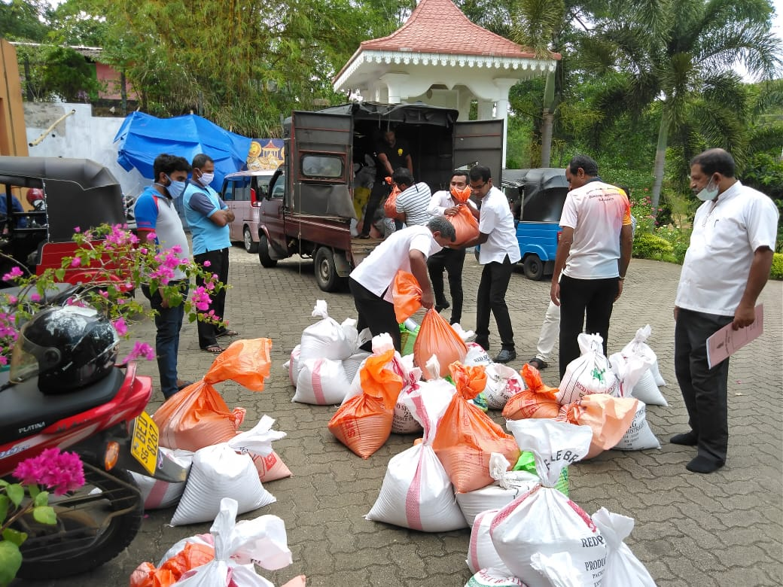
Now, you’re providing vulnerable families with food parcels to help them survive Coronavirus.

Slide 8
Our brothers and sisters in Sri Lanka have lived through so much – and we have so much to learn from them. Please pray for them today, as we remember all the lives lost in last year’s Easter atrocity.

Slide 9
Pray:
For those who lost loved ones in the bombings, as they continue to work through the trauma and grief
For those who were injured in the bombings and who continue to rebuild their lives
For the Church in Sri Lanka to shine brightly, and to be filled with hope
Against hatred and division, and for protection over Christians in Sri Lanka

Slide 11
Please pray too for Sri Lanka as it faces the threat of Coronavirus.
For pastors impacted by the alienation from their congregations
For many households whose income has been impacted and businesses and industry that has been hampered in local production
Against those seeking to stigmatise and bring racist elements into the conversation around people affected by the virus
For the impact of the Coronavirus on Sri Lankan churches both economically and as a community
For the economic impact on the nation with a significant loss of jobs

Slide 12
For the many households that are rent payers at risk of being evicted
For those driven to despair to receive the psychosocial support that they need
For wisdom for the government leadership to work together. At this time due to an impending election, parliament was dissolved and so there is an absence of a voice for people
For required equipment and testing kits

