Slide 2
International Women’s Day
8 March 2020
Notes:
This International Women's Day, be inspired by some amazing women from BMS World Mission's history – as well as some women making history right now.

Slide 3
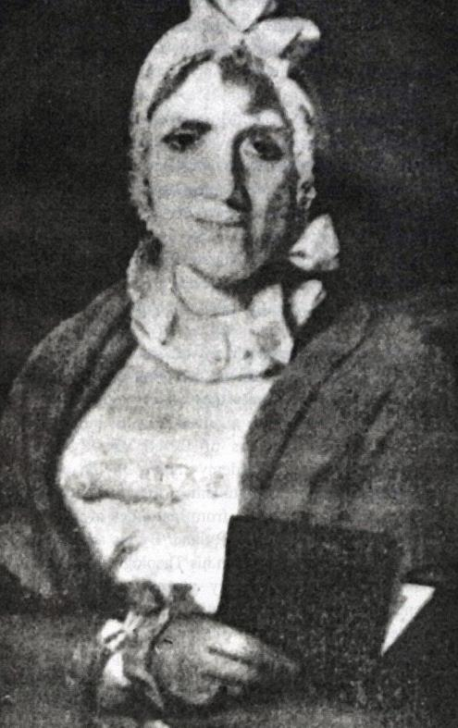
Notes:
Hannah Marshman (1767 – 1847): “Outstanding among the wives”
Noted as being “outstanding among the missionaries’ wives,” Hannah Marshman was more than just the wonderful spouse as remembered in her obituary. Recorded as being the first female missionary in India, this passionate woman single-handedly set up a boarding school and became a pioneer of education for Bengali girls. The school went on to fund Baptist missionary work in the area. All this while becoming fluent in Bengali and having 12 children!

Slide 4
Notes:
Dr Ellen Farrer (1865 – 1959): “First in her field”
Overcoming the prejudice faced by working women of the era, Dr Ellen Farrer began to challenge society’s disapproval when she was accepted by a Baptist mission in India as its first female doctor.
The mission reached out to Hindu women from the wealthier classes, who were secluded in zenanas – private apartments to segregate female family members from the rest of society.
She soon won the trust and love of these women, who preferred to be seen by a female doctor. The so-called “Baptist Zenana Mission” became known as an “achievement impossible to a man.”
Administering aid during a famine, fighting annual outbreaks of the bubonic plague, expanding the dispensary she worked at into a hospital and translating textbooks for nurses and midwives were just some of Ellen’s achievements during her incredible lifetime in India.

Slide 5
Notes:
Dr Ellen Clow (1901 – 1984): “Determined to make a difference”
A kick-ass surgeon and incredibly brave lady to boot, Dr Ellen Clow devoted her life to mission in China. Unperturbed by the Japanese invasion in the north of the country, it was reported that Ellen remained at The Women’s Hospital in Taiyuan where she worked despite being “menaced by soldiers and looters” in raid after raid. Even the news that a shell had destroyed a bedroom she’d vacated earlier that day couldn’t persuade Ellen to leave, and as the hospital building shook and rattled, a patient grabbed Ellen’s hand and said “You are good to stay with us.” Many women in the region were said to have owed their lives to her skill. Ellen’s commitment to God’s mission in China and Hong Kong was unwavering throughout her life, and she returned twice to serve overseas until her death in 1984.

Slide 6
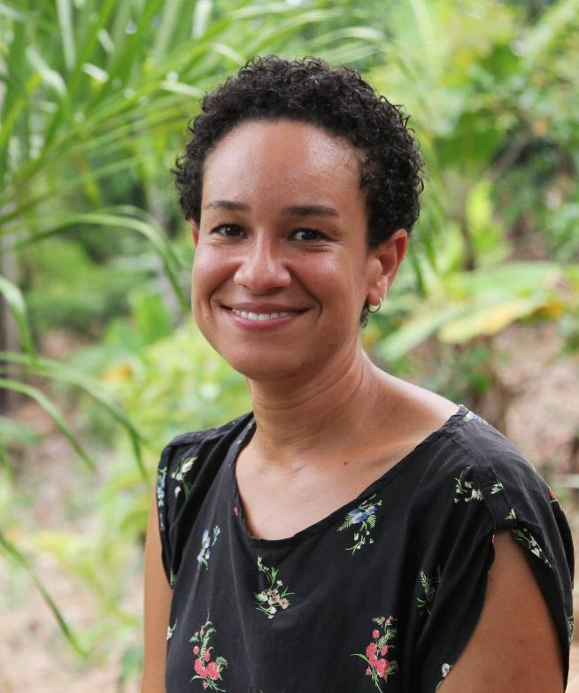
Notes:
Left: Louise Lynch – Bangladesh Louise Lynch and her husband Peter are working alongside the Baptist church leaders in Bangladesh.
Her role involves training, teaching, support and pastoral care, as well as keeping strong partnership links between the Baptist churches in Bangladesh, BMS and their other partners. Right: Laura-Lee Lovering – Peru
Laura is an environmental scientist who has been based in Nauta, Peru, since 2011, which is situated on the Marañon River in the Amazon jungle. She works to help BMS’ local Baptist partner the Nauta Integral Mission Training Centre and also leads on a number of environmental initiatives.

Slide 7
Have these inspiring women encouraged you to explore your calling overseas?
Head to www.bmsworldmission.org/serve to get in touch with the team at BMS World Mission about serving with us!

